Slide 1


Precipitation & Forecast Challenges (Northeast/Mid-Atlantic)
Jay Cordeira, Ph.D.
Atmospheric Science and Applications Manager,
Center for Western Weather & Water Extremes (CW3E)
Scripps Institution of Oceanography at UC San Diego
With contributions by
Nicholas Metz, Ph.D.
Hobart and William Smith Colleges
FE Walter FIRO Exploration Meetings
28–29 March 2023
Grahamsville, NY/White Haven, PA

Slide 2
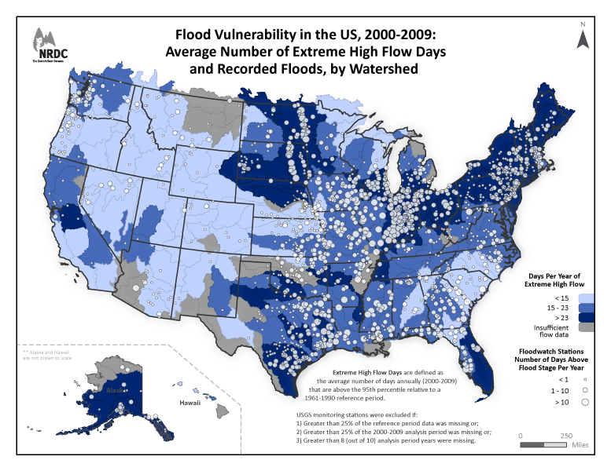
Flood Vulnerability in the U.S.
Flood Vulnerability in the U.S., 2000–2009
Average Number of Extreme High Flow Days
and Recorded Floods
Northeast and Mid-Atlantic regions have high number of extreme high streamflow days and floods by watershed
Darker Blue → High streamflow
Larger dots → More days with flood
Notes:
https://climatechange.lta.org/wp-content/uploads/cct/2015/02/flood_large.gif

Slide 3
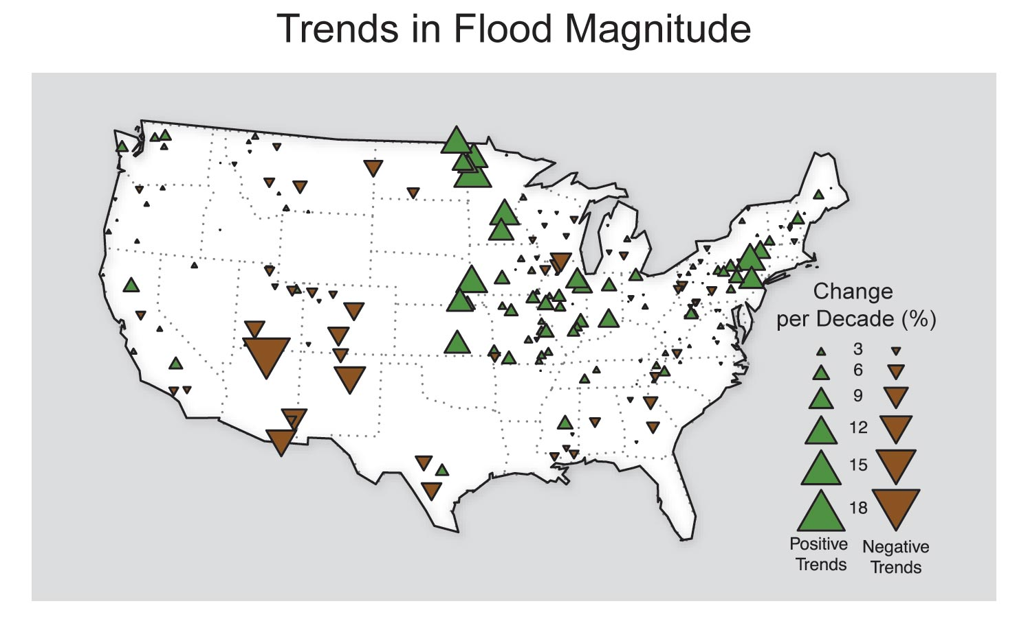
Change in Flood Magnitudes 1920s to present
GlobalChange.gov
Flood magnitudes are increasing over time
Notes:
https://nca2014.globalchange.gov/highlights/report-findings/extreme-weather

Slide 4
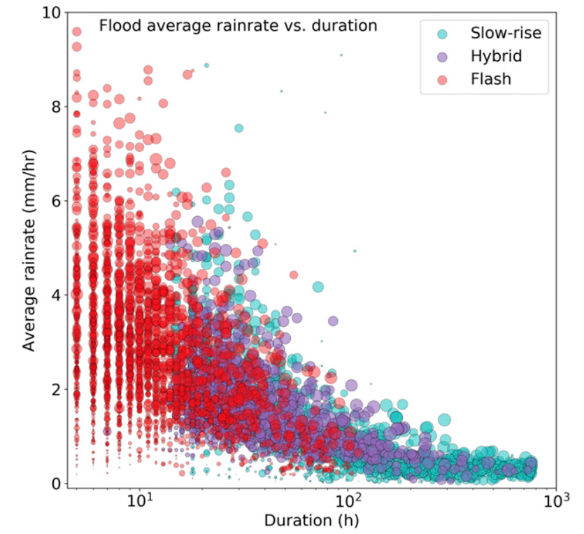
Precipitation and Flooding
Dougherty and Rasmussen (2019; MWR)
Nationwide precipitation event average rainfall rate (mm/h) as a function of the log of duration (hours) for:
flash floods (red)
slow-rise floods (blue)
hybrid floods (purple)
size of the dot represents area of the flood
Short-duration,
high-intensity
Long-duration,
lower-intensity
Days-to-weeks,
low-intensity

Slide 5
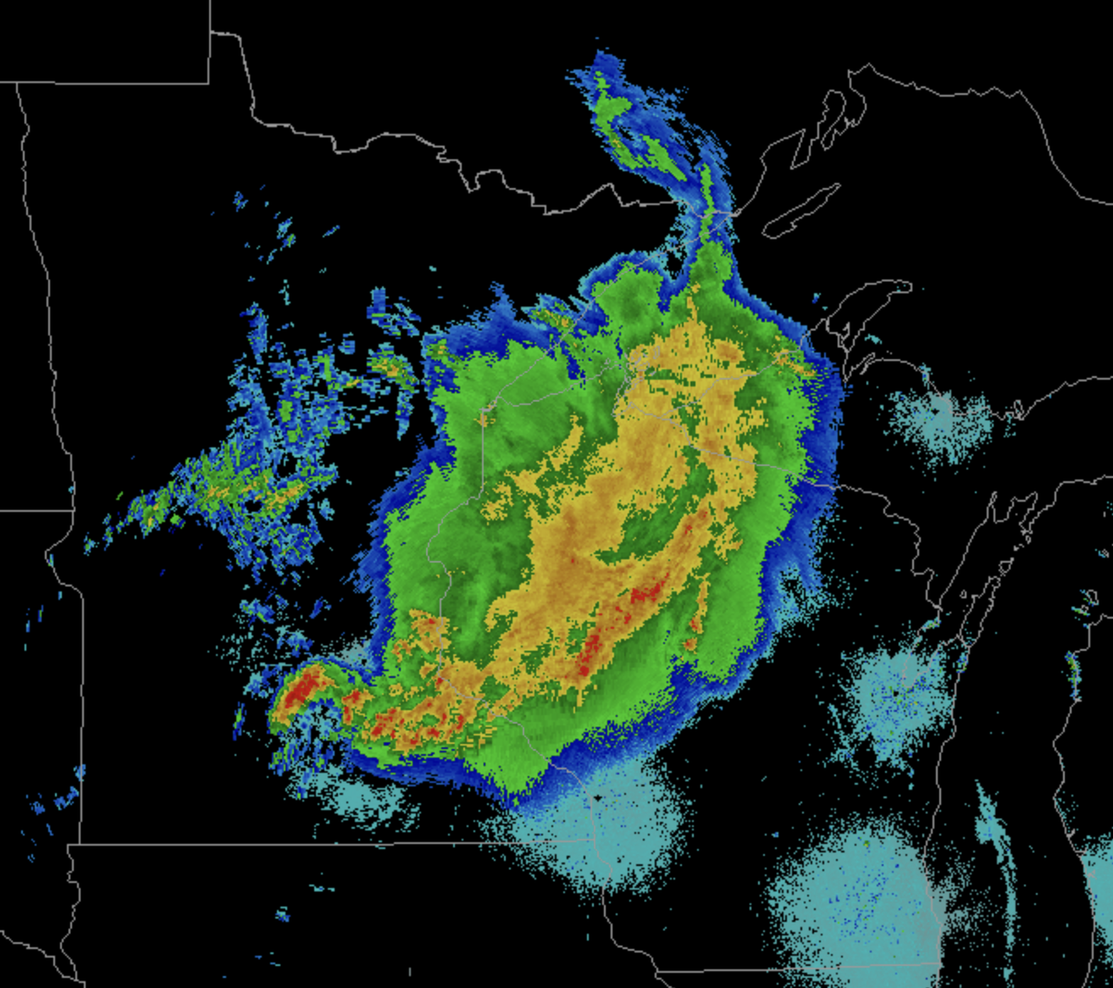
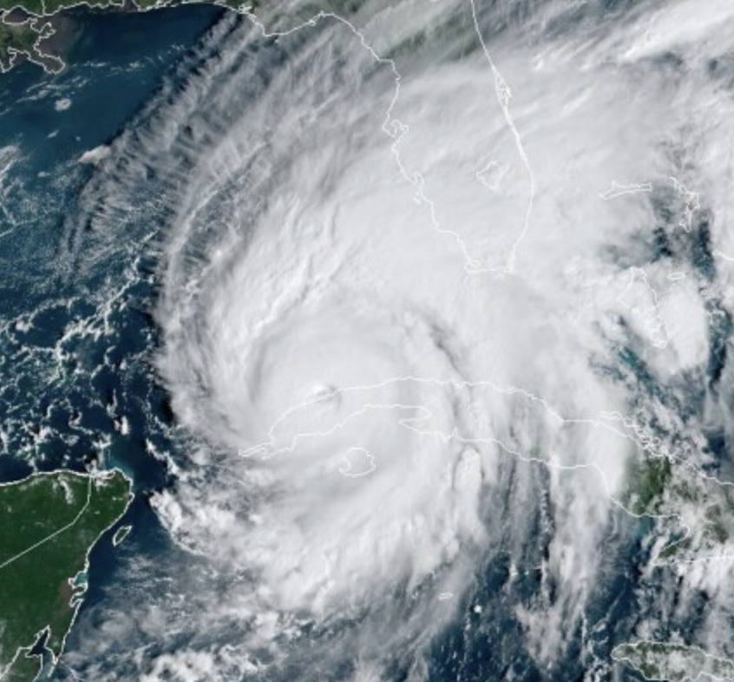
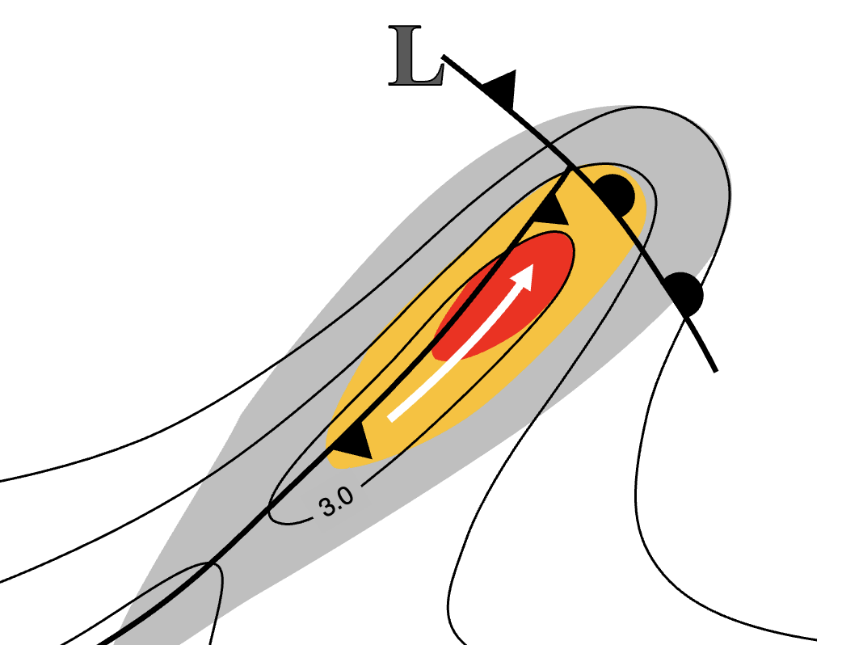
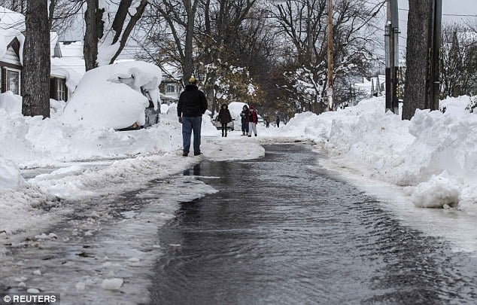
Precipitation and Flooding in the Northeast and Mid-Atlantic
Dougherty and Rasmussen (2019; MWR)
Short-duration,
high-intensity
Severe/Convection
Tropical Systems
Long-duration,
lower-intensity
Days-to-weeks,
low-intensity
Cyclones, Nor’easters, Atmospheric Rivers
Snowmelt
Notes:
https://scontent-ord5-2.xx.fbcdn.net/v/t1.6435-9/153149314_2336467503166610_7354347978848032427_n.jpg?_nc_cat=103&ccb=1-7&_nc_sid=730e14&_nc_ohc=Sx5MecITMtYAX_BwxGg&_nc_ht=scontent-ord5-2.xx&oh=00_AfBNqNwT6DPJeFZiP46UrKdthIsRwmmY5OA8gFjrpj1uiA&oe=64428BFC

Slide 6
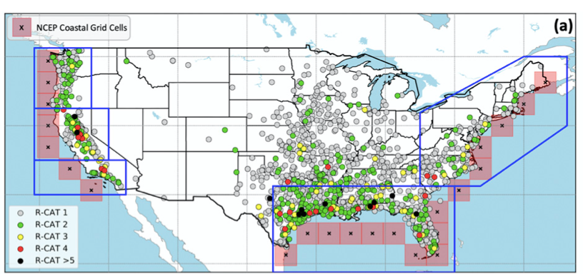
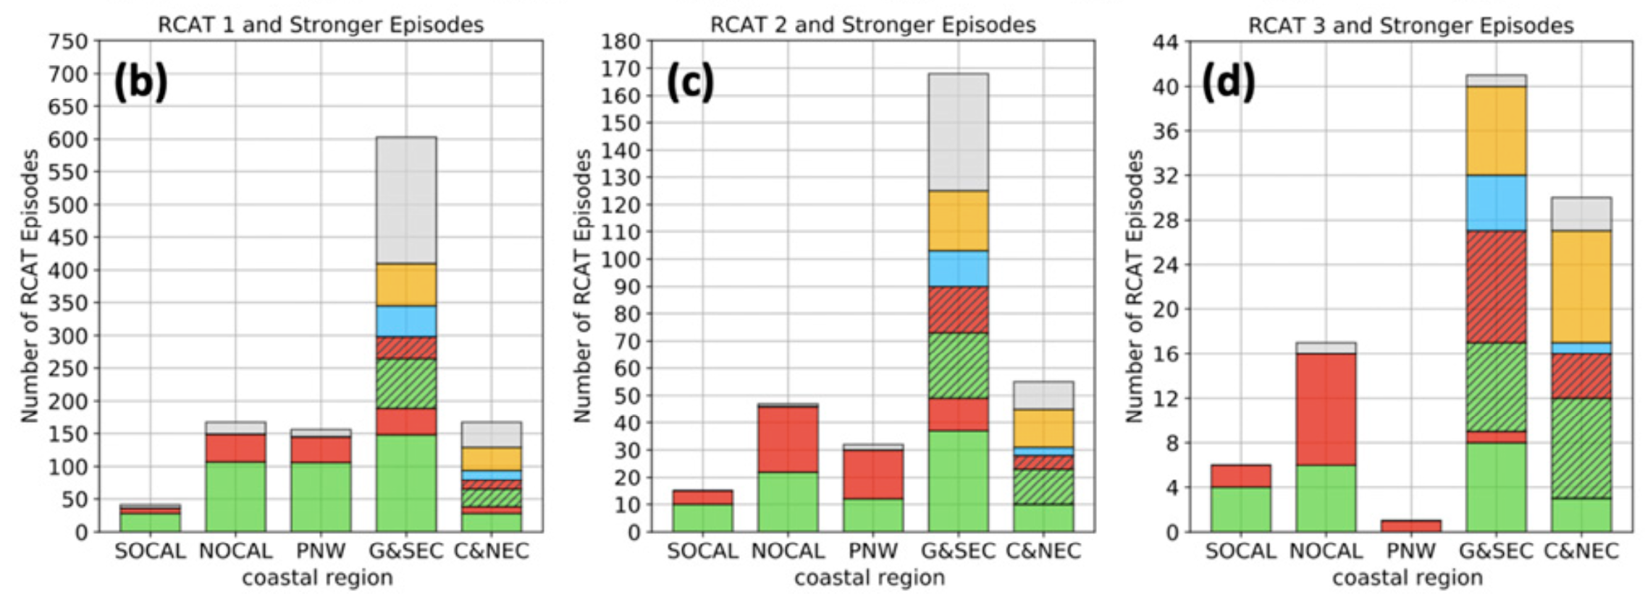
Precipitation and Flooding in the Northeast and Mid-Atlantic
a. Locations of wettest 3-d precip (“R-CAT”) events (Lamjiri et al. 2020; JHM)
b. Processes responsible over Mid-Atlantic/Northeast U.S.
>200mm
>300mm
>400mm
Other
Pure Tropical
200–300 mm
300–400 mm
400–500 mm
500–600 mm
>600 mm
Mixed ARs & Tropical
Pure ARs
Wettest 3-day Precip Events over Mid-Atlantic and Northeast U.S.
~10–20% associated with pure ARs
~30–40% associated with mixed ARs ← both AR and tropical physical processes and moisture sources
~20–30% associated with pure tropical phenomena
~10–20% associated with other (e.g., convective)

Slide 7
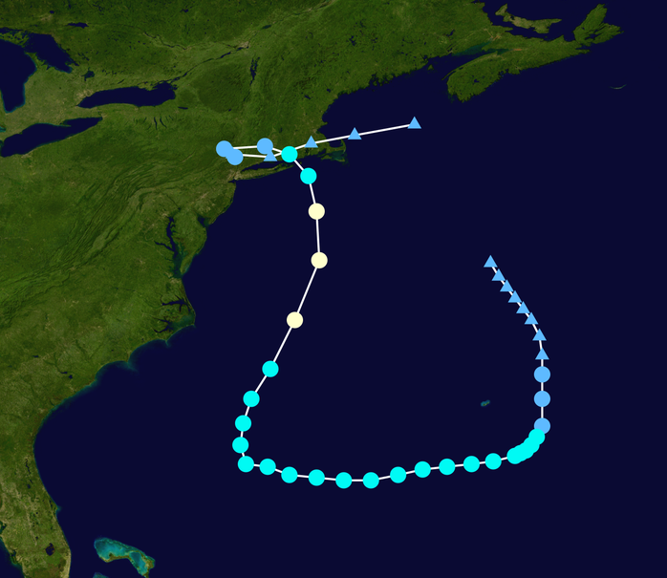
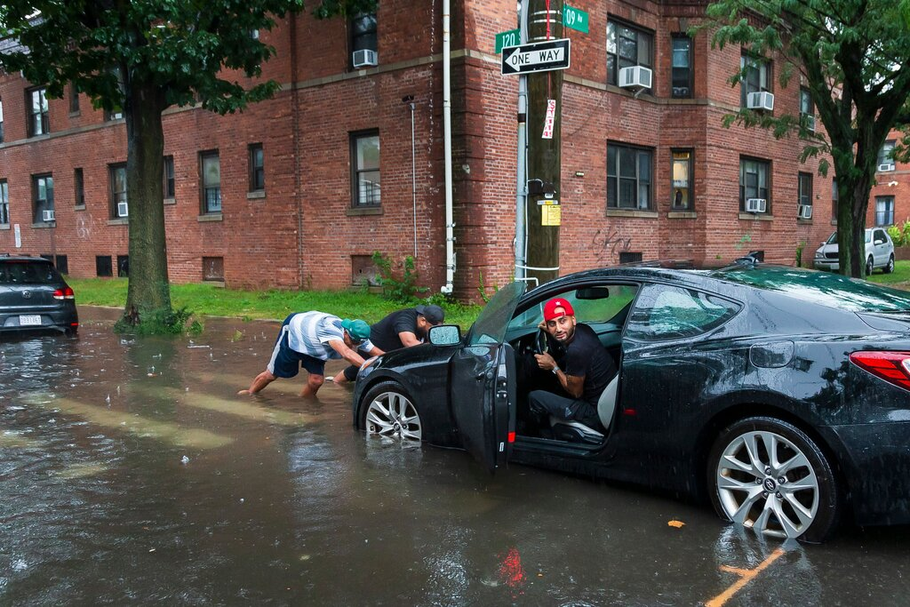
Recent Extremes – Tropical/Convective
Tropical Storm Henri (2021)
Produced 1.94” of rain in one hour at Central Park in NYC; a (then) record and wettest hourly rainfall amount in 150 years in Brooklyn!
Storm total of 7.01” was highest since Irene in 2012
Notes:
https://www.nytimes.com/2021/08/23/nyregion/nyc-rain-storm-flooding-weather.html
https://en.wikipedia.org/wiki/2021_Atlantic_hurricane_season#/media/File:Henri_2021_track.png

Slide 8
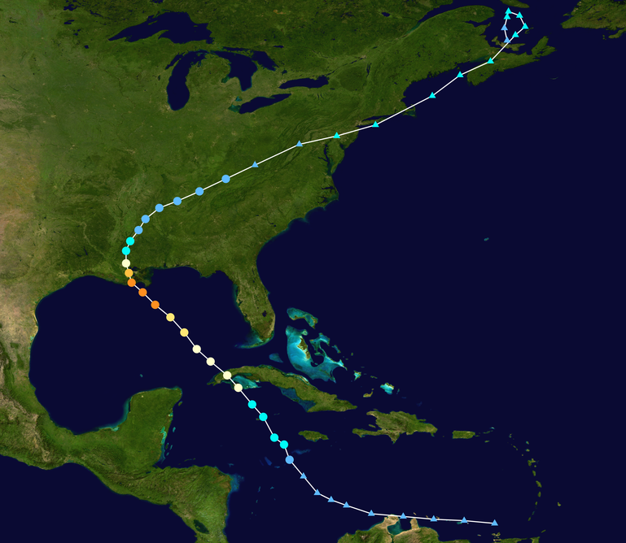
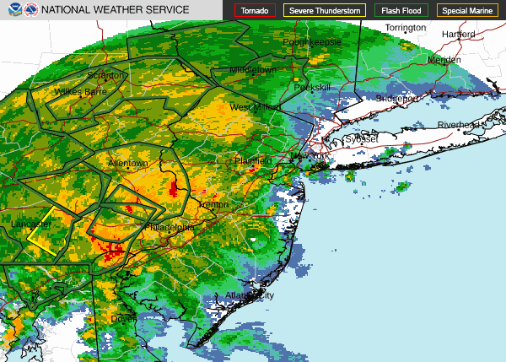
Recent Extremes – Tropical/Convective
Tropical Storm Ida (2021)
Ida broke weeks-old one-hour rainfall record in NYC with
>3.15” of rain falling in just one hour at Central Park.
This record had stood for more than 150 years,
and was broken twice in a matter of weeks
Notes:
https://en.wikipedia.org/wiki/2021_Atlantic_hurricane_season#/media/File:Ida_2021_track.png
https://upload.wikimedia.org/wikipedia/commons/thumb/c/c3/KDIX_loop_of_Ex-Ida_warnings_3.gif/210px-KDIX_loop_of_Ex-Ida_warnings_3.gif

Slide 9
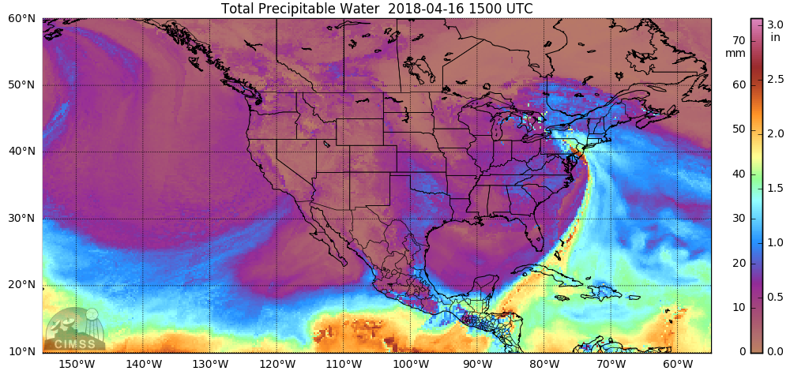
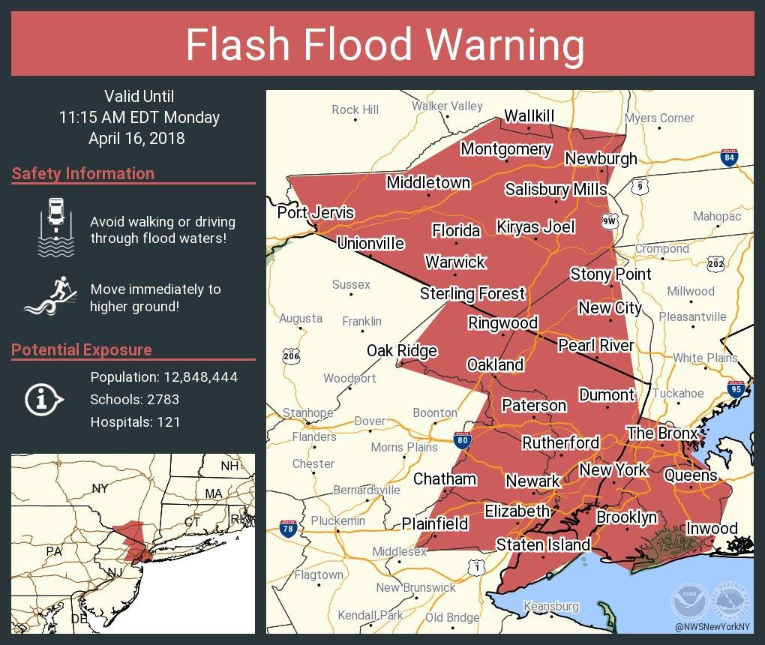
Recent Extremes – Atmospheric River
1500 UTC 16 Apr 2018
Satellite-derived Precipitable Water
CIMSS
[in.]
Atmospheric
River
An Atmospheric River in April 2018 led to flash floods in the Tri-State Area including 24-hour rainfall totals of 2–3” at EWR/LGA, 3.29” at Central Park, and 4.48” in Westwood, NJ
16 April 2018: NYC Flash Floods,
Photo: NYPD 33rd Precinct →

Slide 10
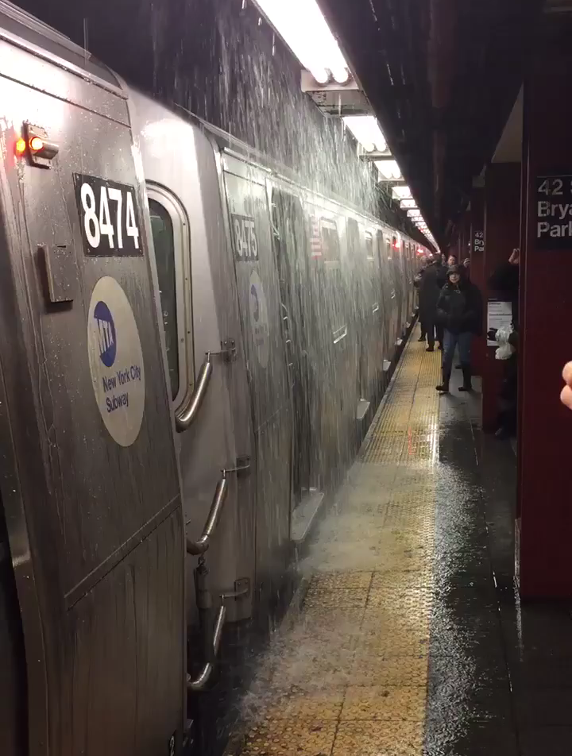
Recent Extremes – Atmospheric River
1500 UTC 16 Apr 2018
Satellite-derived Precipitable Water
CIMSS
Twitter: @jeremymbarr
[in.]
Atmospheric
River
An Atmospheric River in April 2018 led to flash floods in the Tri-State Area including 24-hour rainfall totals of 2–3” at EWR/LGA, 3.29” at Central Park, and 4.48” in Westwood, NJ
16 April 2018: NYC Flash Floods,
Photo: NYPD 33rd Precinct →

Slide 11
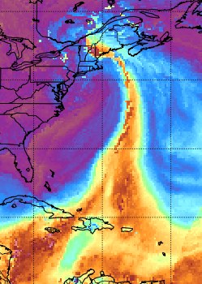

Additional Perspective on Atmospheric Rivers
#
CIMSS
ARs are as frequent or more frequent across Eastern US than Western US (Slinskey et al. 2020; Kaminski et al. 2023)
>30% of non-summer precipitation is associated with ARs across Northeast US (Slinskey et al. 2020; Kaminski et al. 2023)
>90% of non-summer extreme precipitation is associated with ARs across Northeast US (Slinskey et al. 2020; Lamjiri et al. 2020)
>85% of flood/flash flood watches, warnings, and advisories occur on day of or day after an AR over Northeast US (Glade et al. 2023)
95% of ice jam events in Northeast US influenced by ARs (Sanders et al. 2020)
1200 UTC 30 Oct 2017
Satellite-derived Precip Water
16 April 2018: NYC Flash Floods,
Photo: NYPD 33rd Precinct →

Slide 12
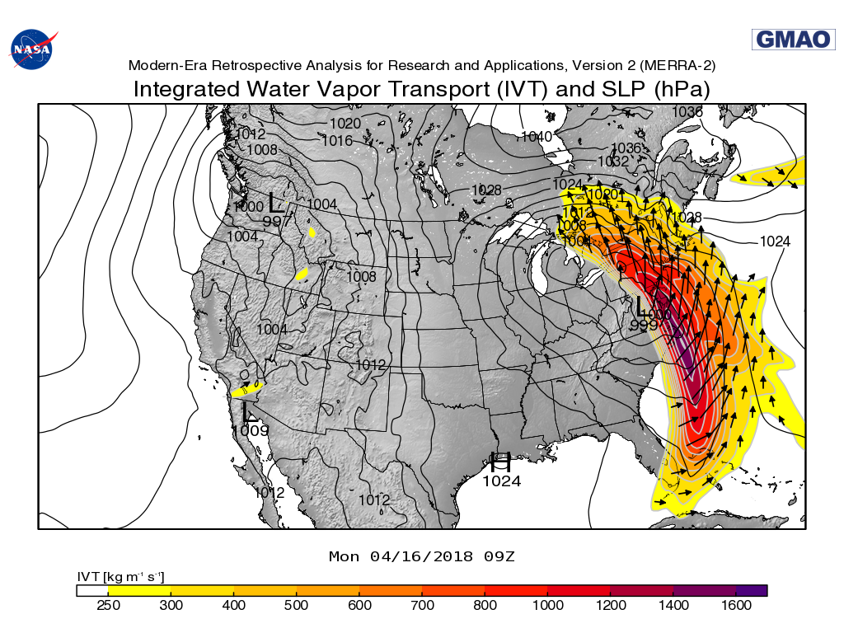
Using IVT to Identify ARs & other Precip Extremes
Ralph et al. (2019; BAMS): A Scale to Characterize the Strength and Impacts of Atmospheric Rivers
Rank (1–5)
(Denoted by color)
4
5
5
Increasingly Hazardous
1250
Increasingly Beneficial
3
4
5
1000
2
3
4
750
AR Intensity
Maximum IVT (kg m^{–1} s^{–1})
1
2
3
500
1
2
250
Not an AR
Example of an AR4 with a maximum IVT magnitude of 1010 kg/ms and duration of 25 hours
24
48
AR Duration
(IVT>250 kg m^{–1} s^{–1}) (hours)
16 April 2018: NYC Flash Floods,
Photo: NYPD 33rd Precinct →

Slide 13
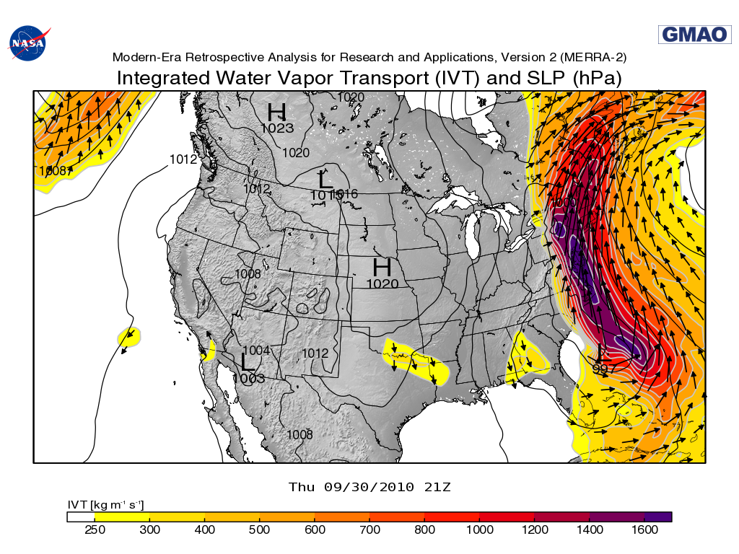
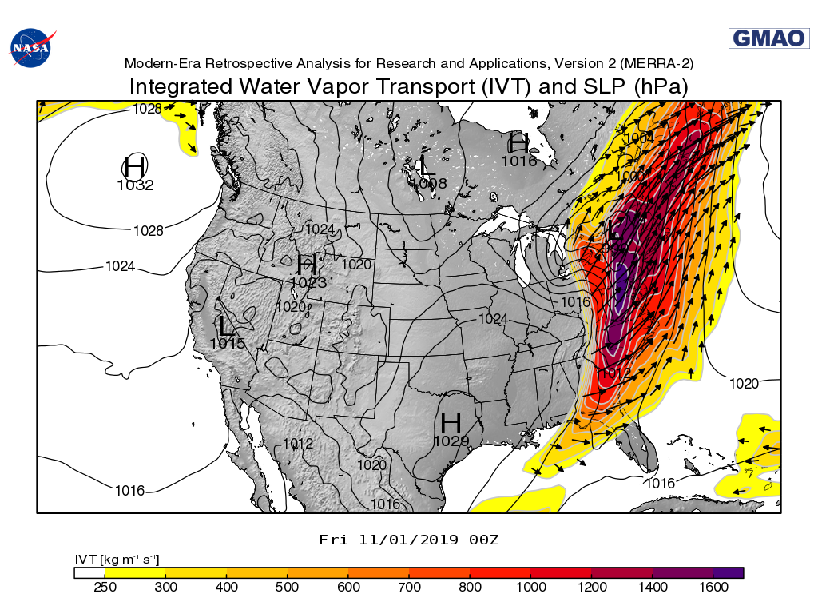
Using Integrated Vapor Transport to Identify ARs and other Precip Extremes
30 September 2010
1 November 2019
Example of an AR5 with a maximum IVT magnitude of 1640 kg/ms and duration of 39 hours (remnants of TS Nicole)
Example of an AR5 with a maximum IVT magnitude of 1625 kg/ms and duration of 32 hours
16 April 2018: NYC Flash Floods,
Photo: NYPD 33rd Precinct →

Slide 14
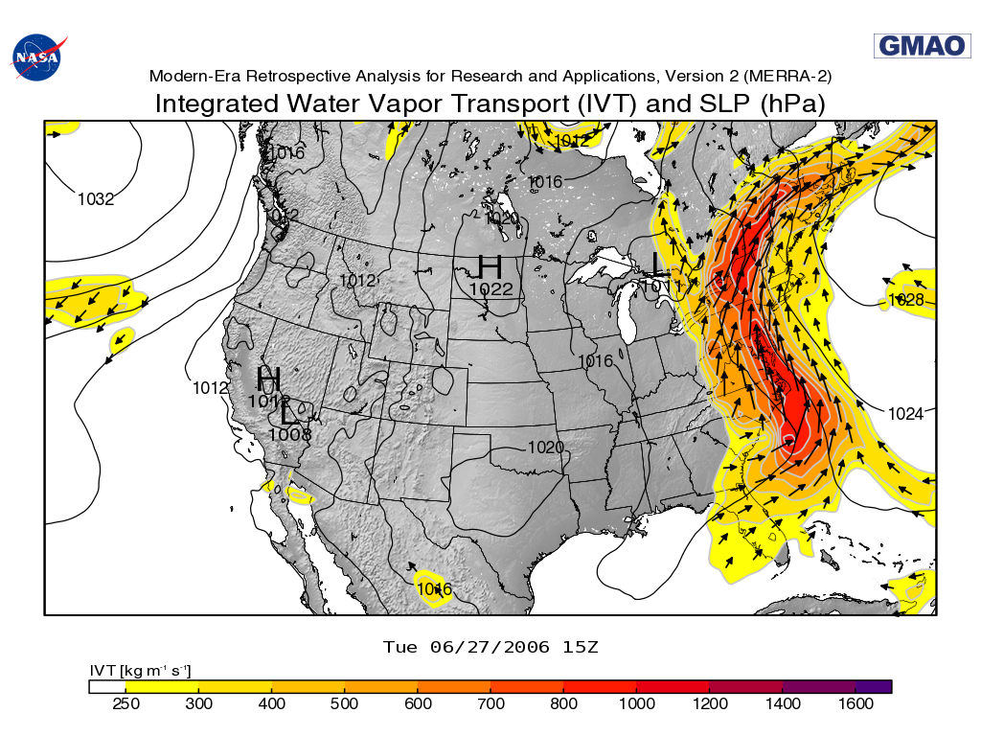
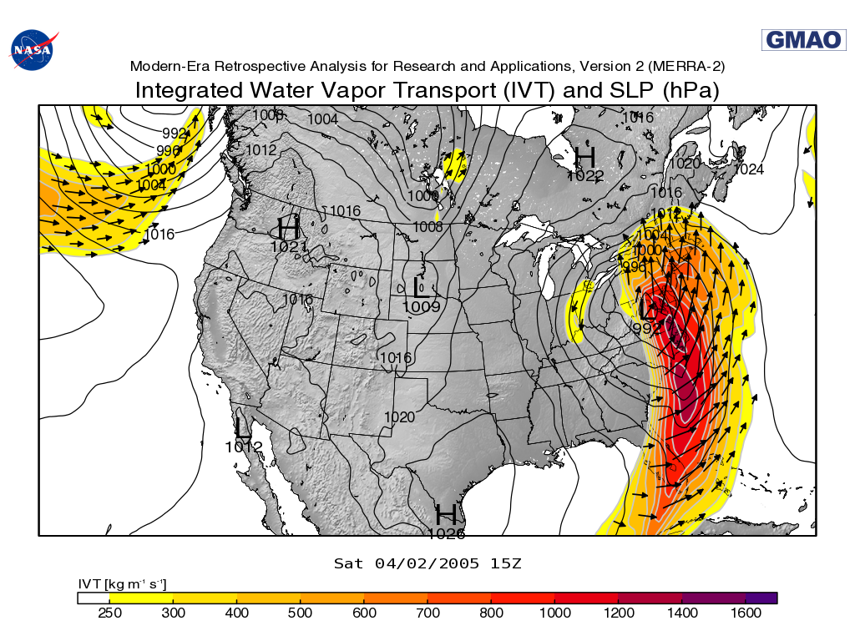
Using Integrated Vapor Transport to Identify ARs and other Precip Extremes
27 June 2006
2 April 2005
Example of an AR4 with a maximum IVT magnitude of 917 kg/ms and duration of 64 hours
Example of an AR2 with a maximum IVT magnitude of 826 kg/ms and duration of 21 hours
16 April 2018: NYC Flash Floods,
Photo: NYPD 33rd Precinct →

Slide 15
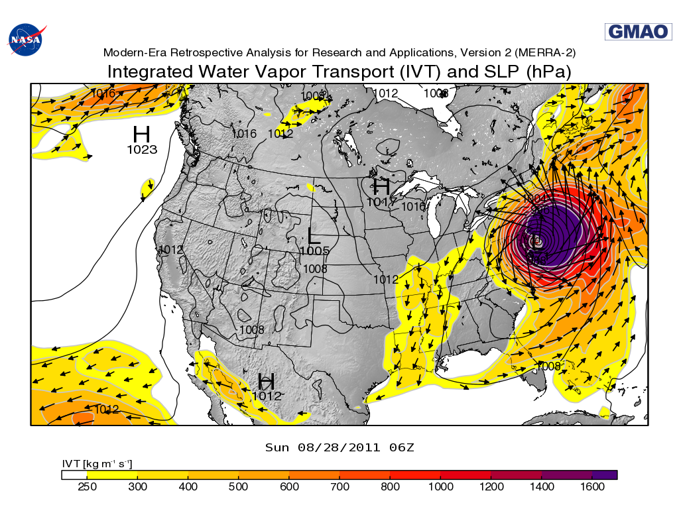
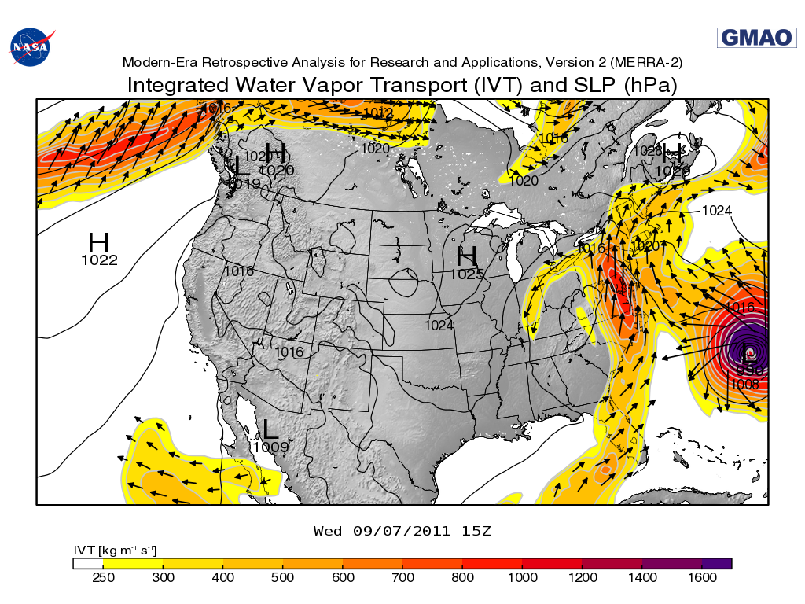
Using Integrated Vapor Transport to Identify ARs and other Precip Extremes
28 August 2011
7 September 2011
Hurricane Irene
Remnants of Tropical Storm Lee
AR4 with max IVT mag. of 826 kg/ms and duration of 21 hours
16 April 2018: NYC Flash Floods,
Photo: NYPD 33rd Precinct →

Slide 16
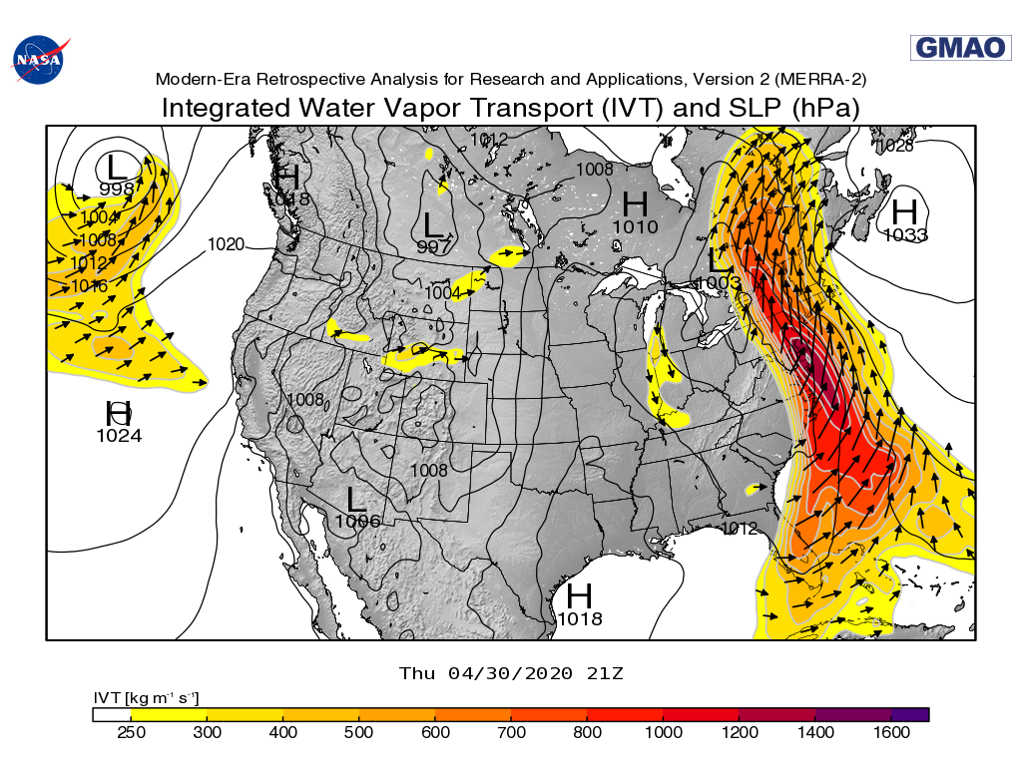
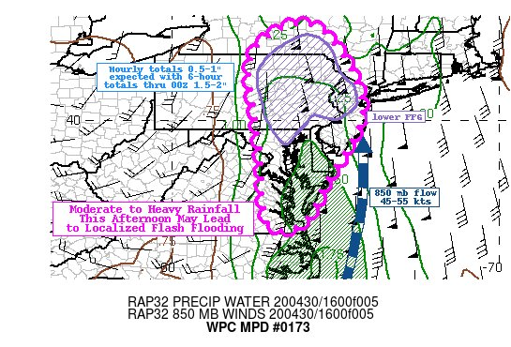
Using Integrated Vapor Transport to Identify ARs and other Precip Extremes
National Weather Service Weather Prediction Center
Mesoscale Precipitation Discussion 30 April 2020
30 April 2020
Example of an AR3 with a maximum IVT magnitude of 908 kg/ms and a duration of 35 hours
16 April 2018: NYC Flash Floods,
Photo: NYPD 33rd Precinct →

Slide 17
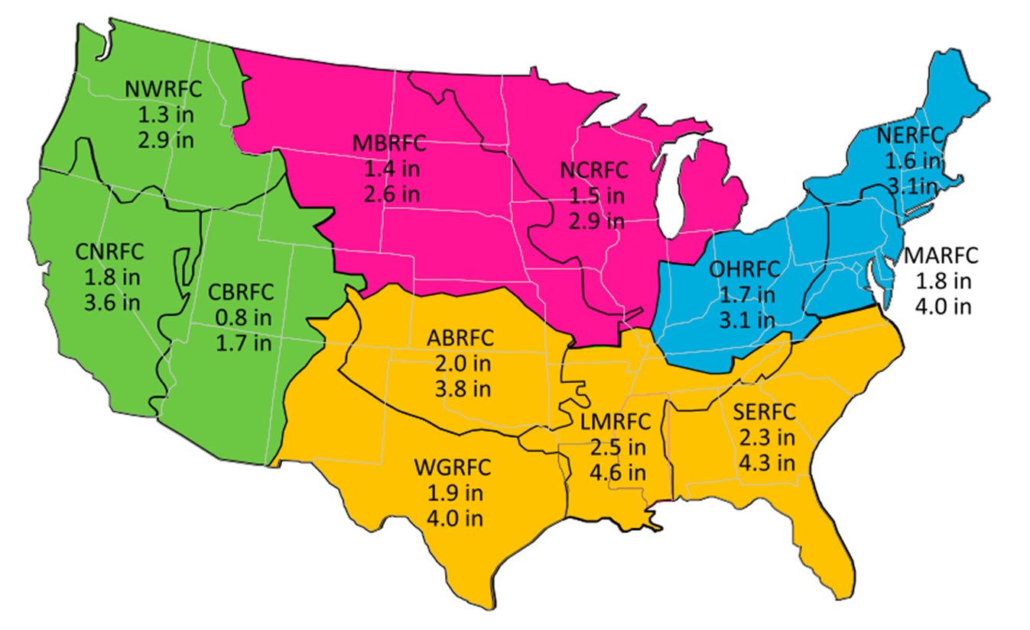
Perspectives on U.S. Extreme Precipitation
Regional thresholds for
Top 1% and 0.1% heaviest daily precipitation
Top 1% and top 0.1% of wet days
(i.e., extreme precipitation) in
Mid-Atlantic River Forecast Center (MRFC) region are comparable to regional extremes in western RFC regions (on average)
Top 1.0% MARFC = CNRFC
Top 0.1% MARFC > CNRFC
Used 32-km gridded NCEP/WPC QPE 2001–2011 (>12M wet days)
Sukovich et al. (2014, WAF): Extreme quantitative precipitation forecast performance at the Weather Prediction Center from 2001 to 2011 (contact: F. M. Ralph, mralph@ucsd.edu)

Slide 18
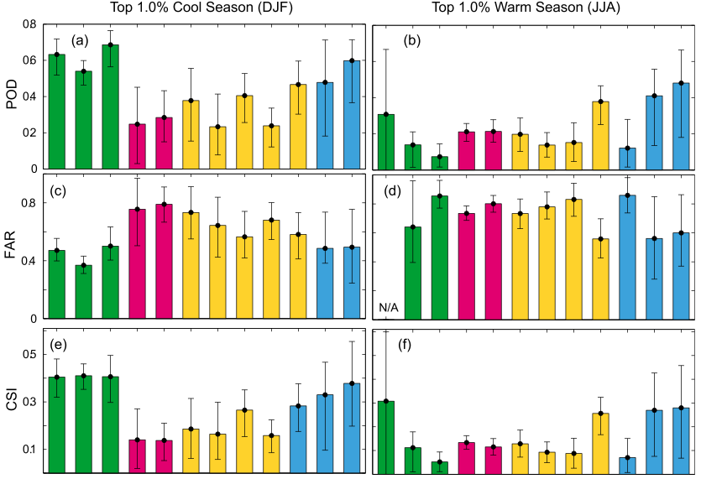
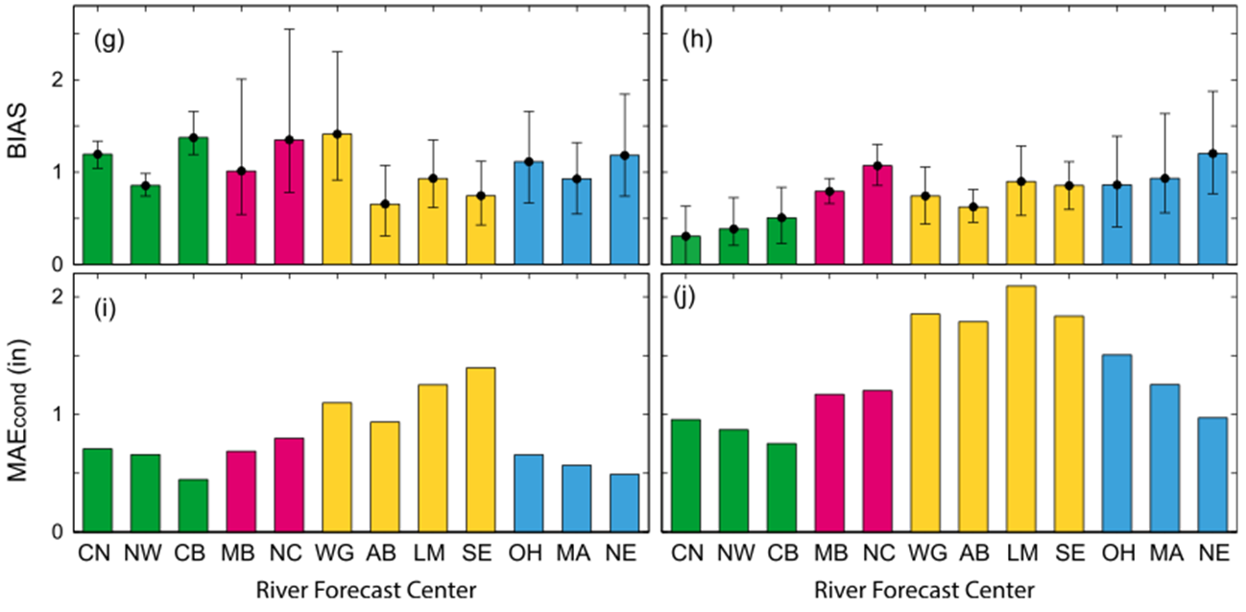
Perspectives on U.S. Precipitation Forecast Skill
Top 1.0% Dec-Jan-Feb
Top 1.0% Jun-Jul-Aug
Probability of Detection
QPF forecast skill highest, with lowest false alarm ratio, over Western U.S. and Mid-Atlantic/ Northeast
False Alarm Ratio
Critical Success Index
Used 32-km gridded NCEP/WPC QPE/QPF from 2007–2011 for 1-d lead time.

Slide 19
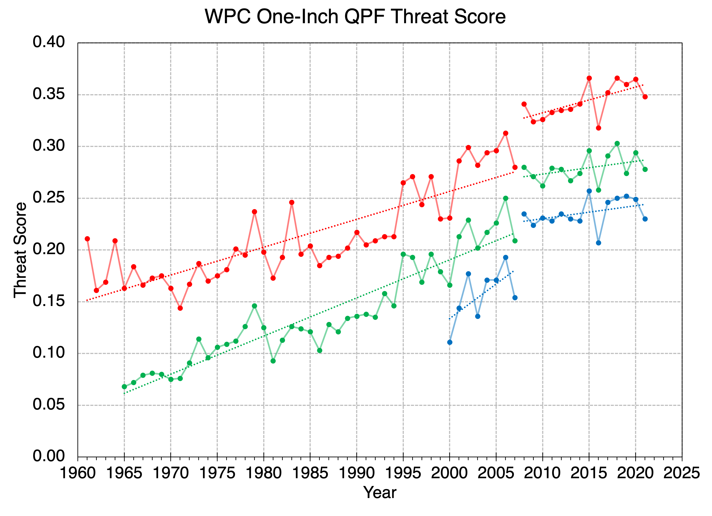
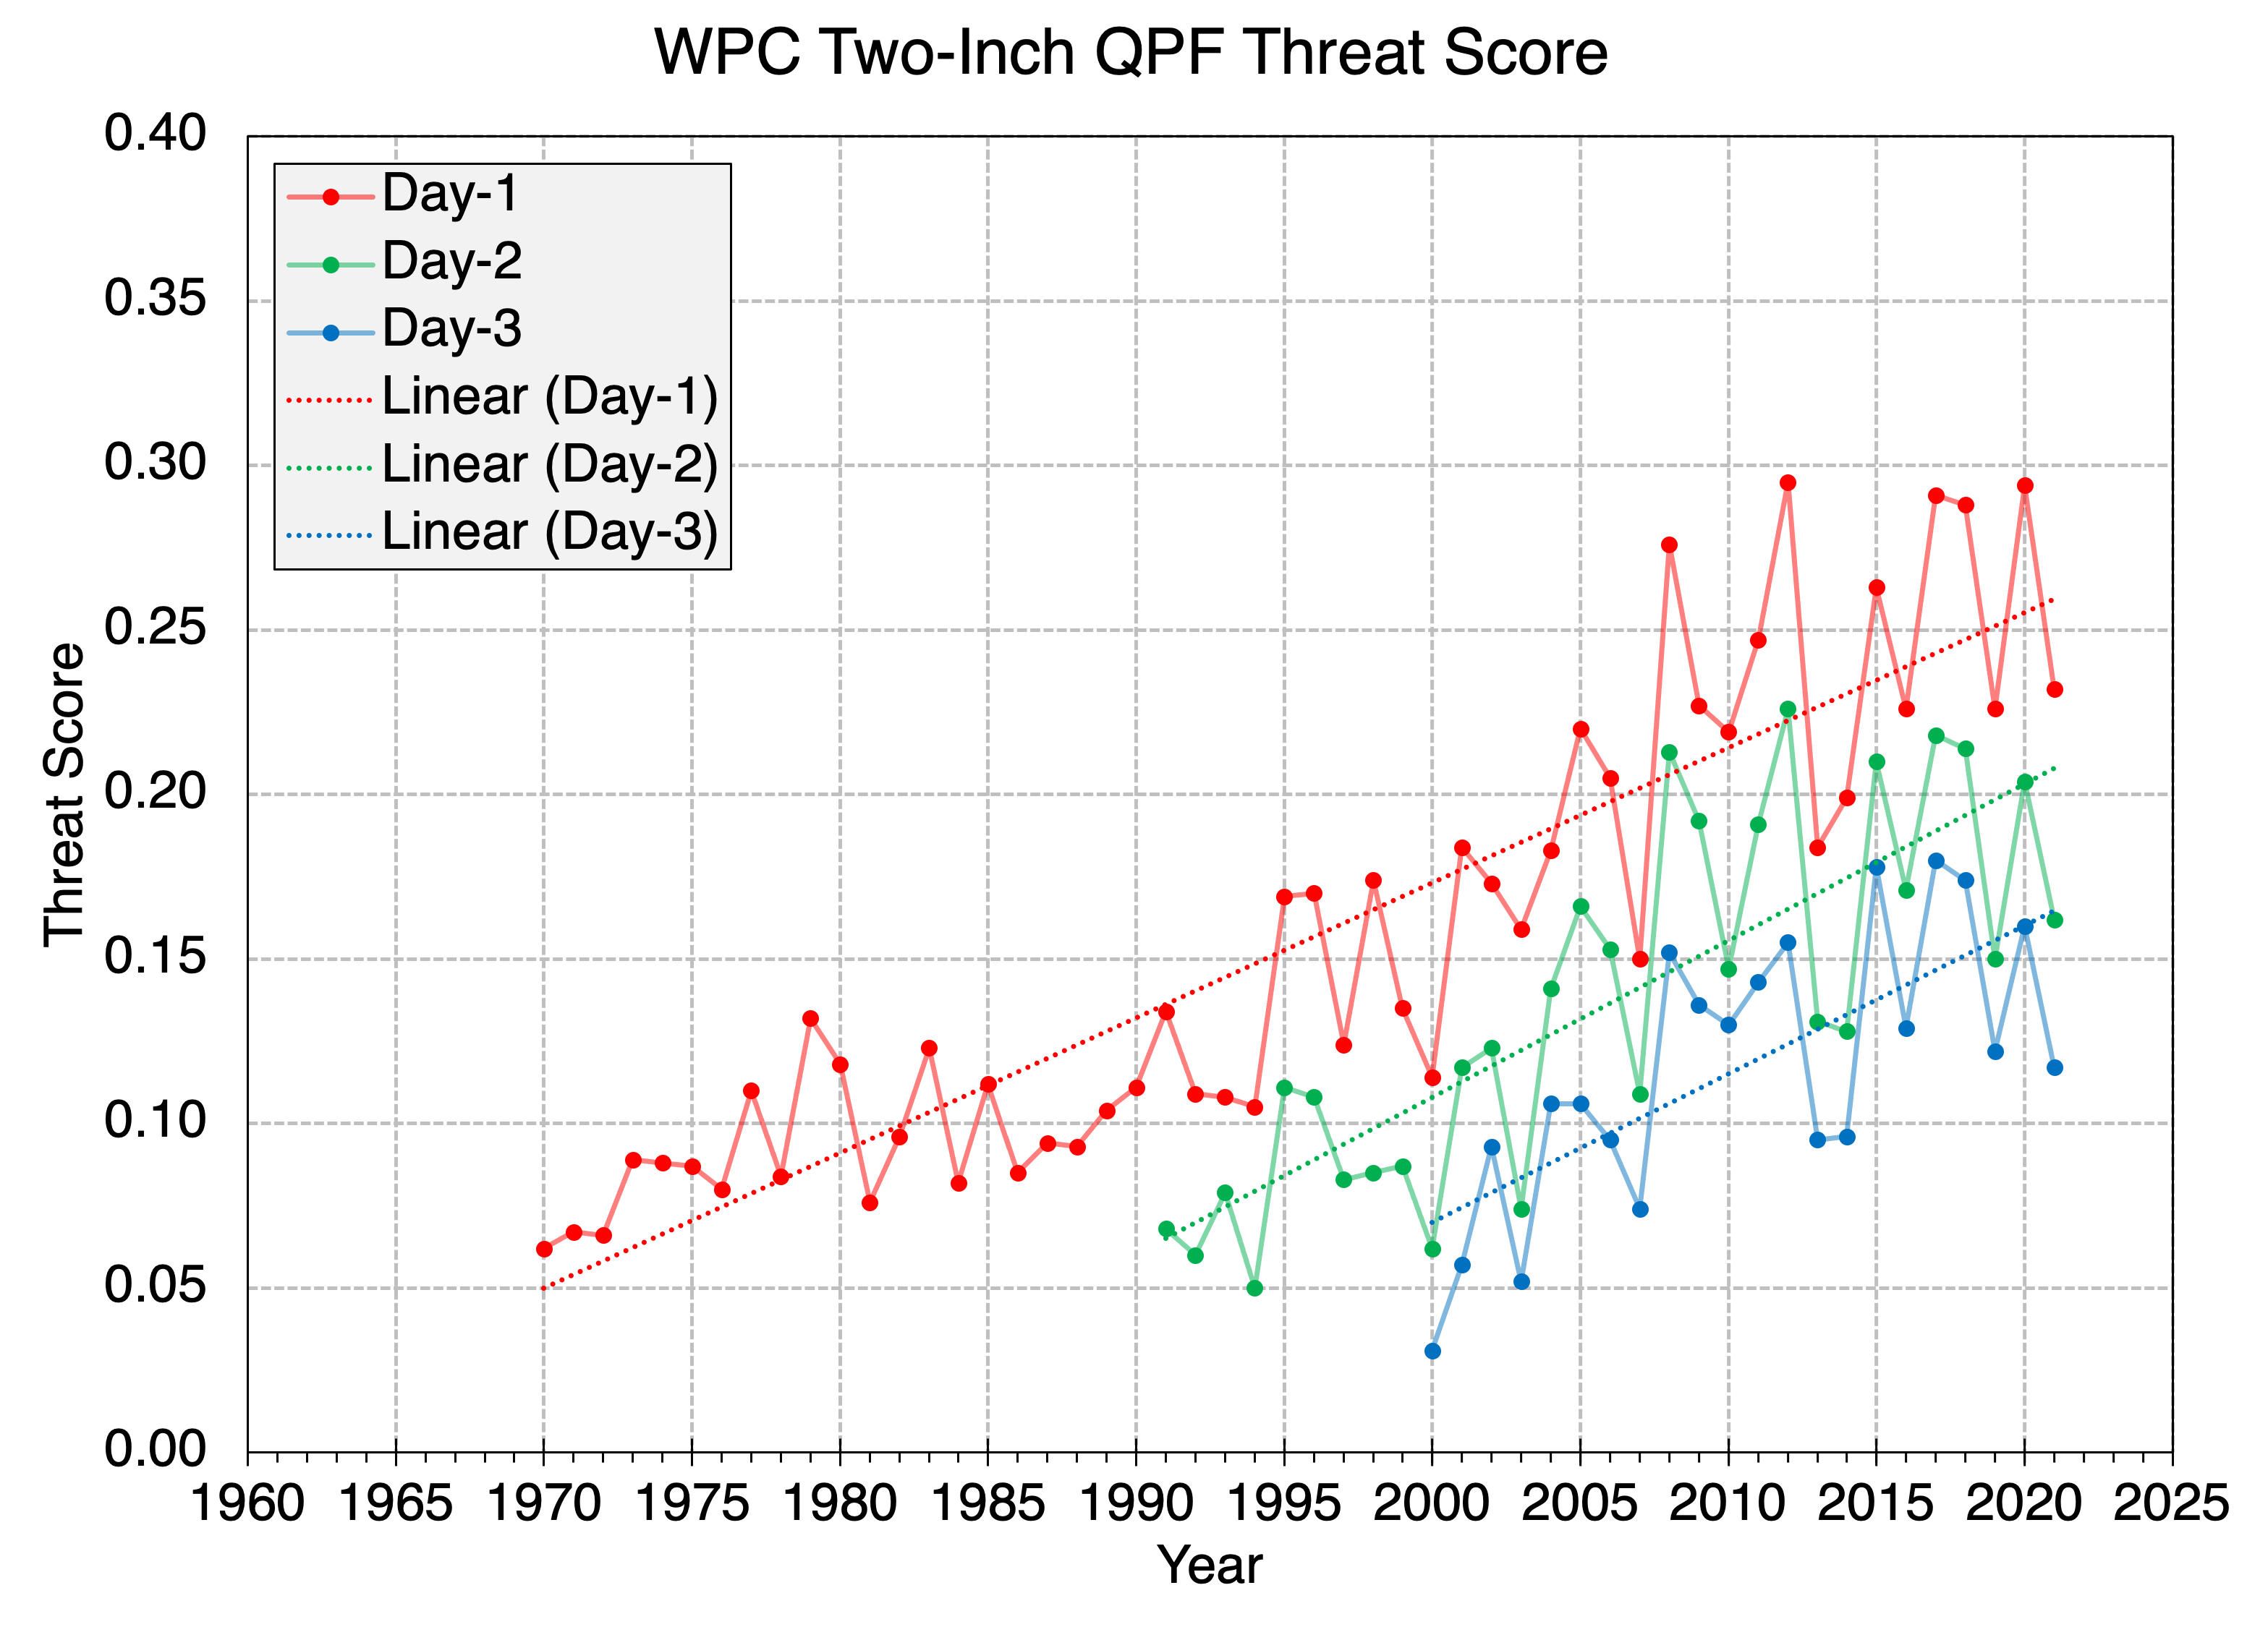
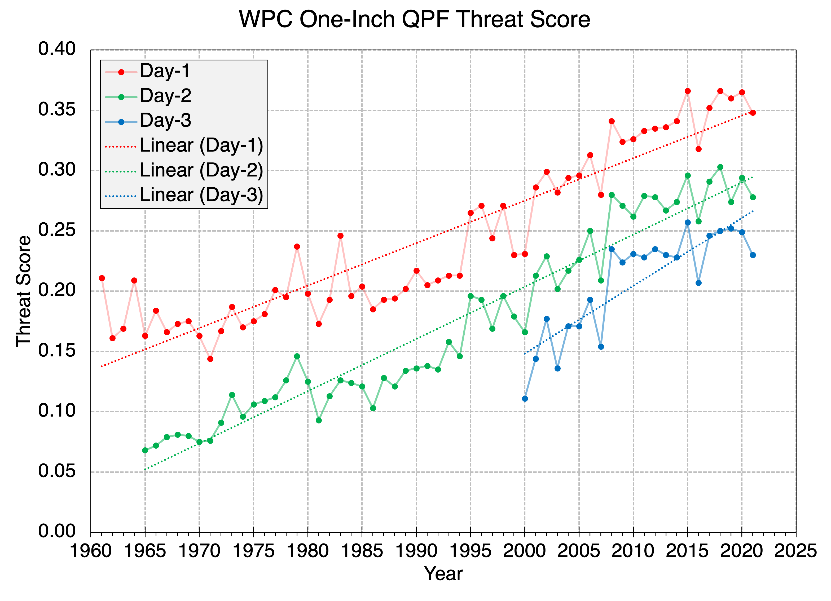
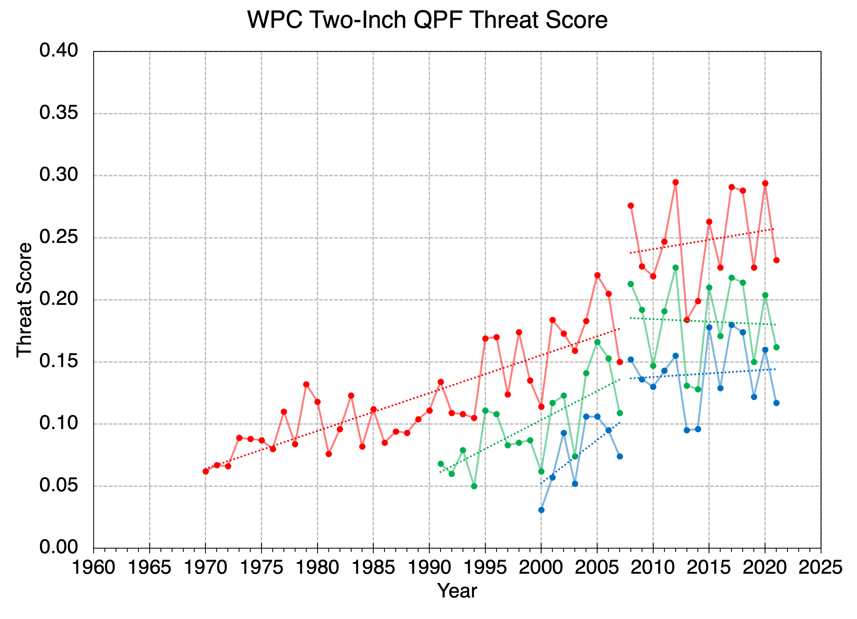

U.S. Precipitation Forecast Skill
Analyzing NOAA Weather Prediction Center Quantitative Precipitation Forecast (QPF) Skill
Day-1, Day-2, and Day-3 QPF Threat Score for the Continental US at 1-inch and 2-inch thresholds
QPF Threat Scores have increased steadily at lead times of 1–3 days but have leveled off during the last 10–15 years.
Day-1
Day-2
Day-3
Up to 2007
2008–2021
Day-1
Day-2
Day-3
Up to 2007
2008–2021
Data provided by the NOAA/Weather Prediction Center
Data provided by the NOAA/Weather Prediction Center

Slide 20
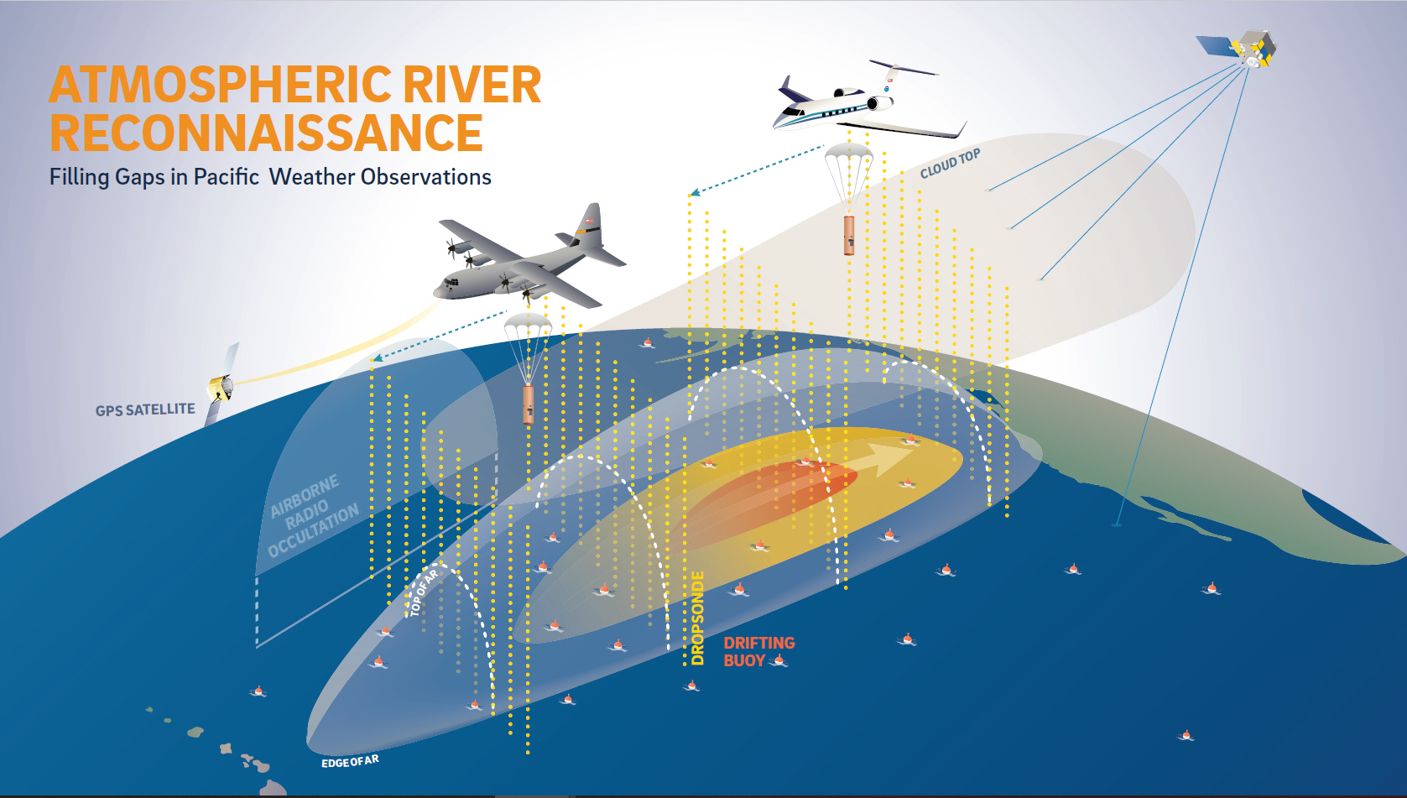

Improving QPF Skill via Atmospheric River Reconnaissance
Fast Facts about AR Recon:
AR Recon is a Research and Operations Partnership (RAOP)
AR Recon is part of the National Winter Season Operations Plan
AR Recon dropsonde observations reduce overall errors in AR water vapor flux and inland precipitation at forecast lead times of 1–6 days*
AR Recon observations produce the largest improvement of inland precipitation forecast skill with back-to-back flights every other day.
AR Recon observations improve geographical distribution of forecasted precipitation in GFS model at lead times of ~3–5 days by 5–15% over full western US and by 10–20% over Pacific Northwest and Northern California**
*Zheng et al., 2021
**Lord et al., 2022
F. Martin Ralph (UCSD/SIO/CW3E) - PI
Vijay Tallapragada (NWS/NCEP) - Co-PI
Selected Publications:
Lavers et al. 2018 GRL
Ralph et al. 2019 BAMS
Reynolds et al. 2019 MWR
Lavers et al. 2020 Wea Fore
Lavers et al. 2020 Nature Comms
Stone et al. 2020 MWR
Cobb et al. 2021 MWR
Haase et al. 2021 JGR
Prince et al. 2021 GRL
Zheng et al. 2021 BAMS
Zheng et al. 2021 JGR-A
Zhang and Ralph 2021 MWR
Cobb et al. 2022 WAF
Lord et al. 2022a,b WAF
Sun et al. 2022 AtmRes
Wilson et al. 2022 BAMS
Reynolds et al. 2023 MWR

Slide 21
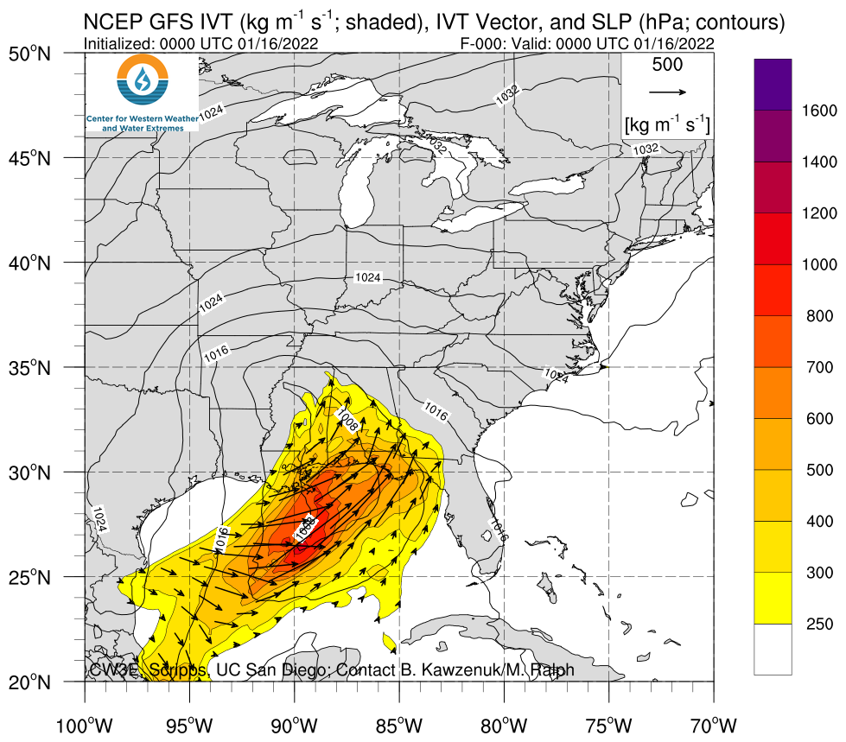
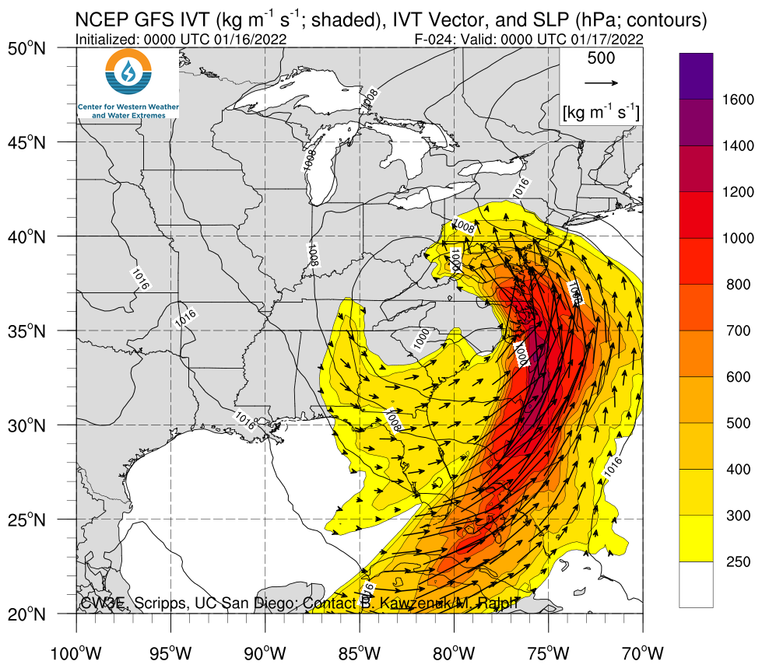
Expanding AR Recon to East Coast to Improve Regional QPF skill
Location where obs sought to improve QPF
Developing AR
AR4 with
Max IVT
1200 kg/ms
46 special radiosondes at 18 sites
C130 flight and 10 dropsondes

Slide 22
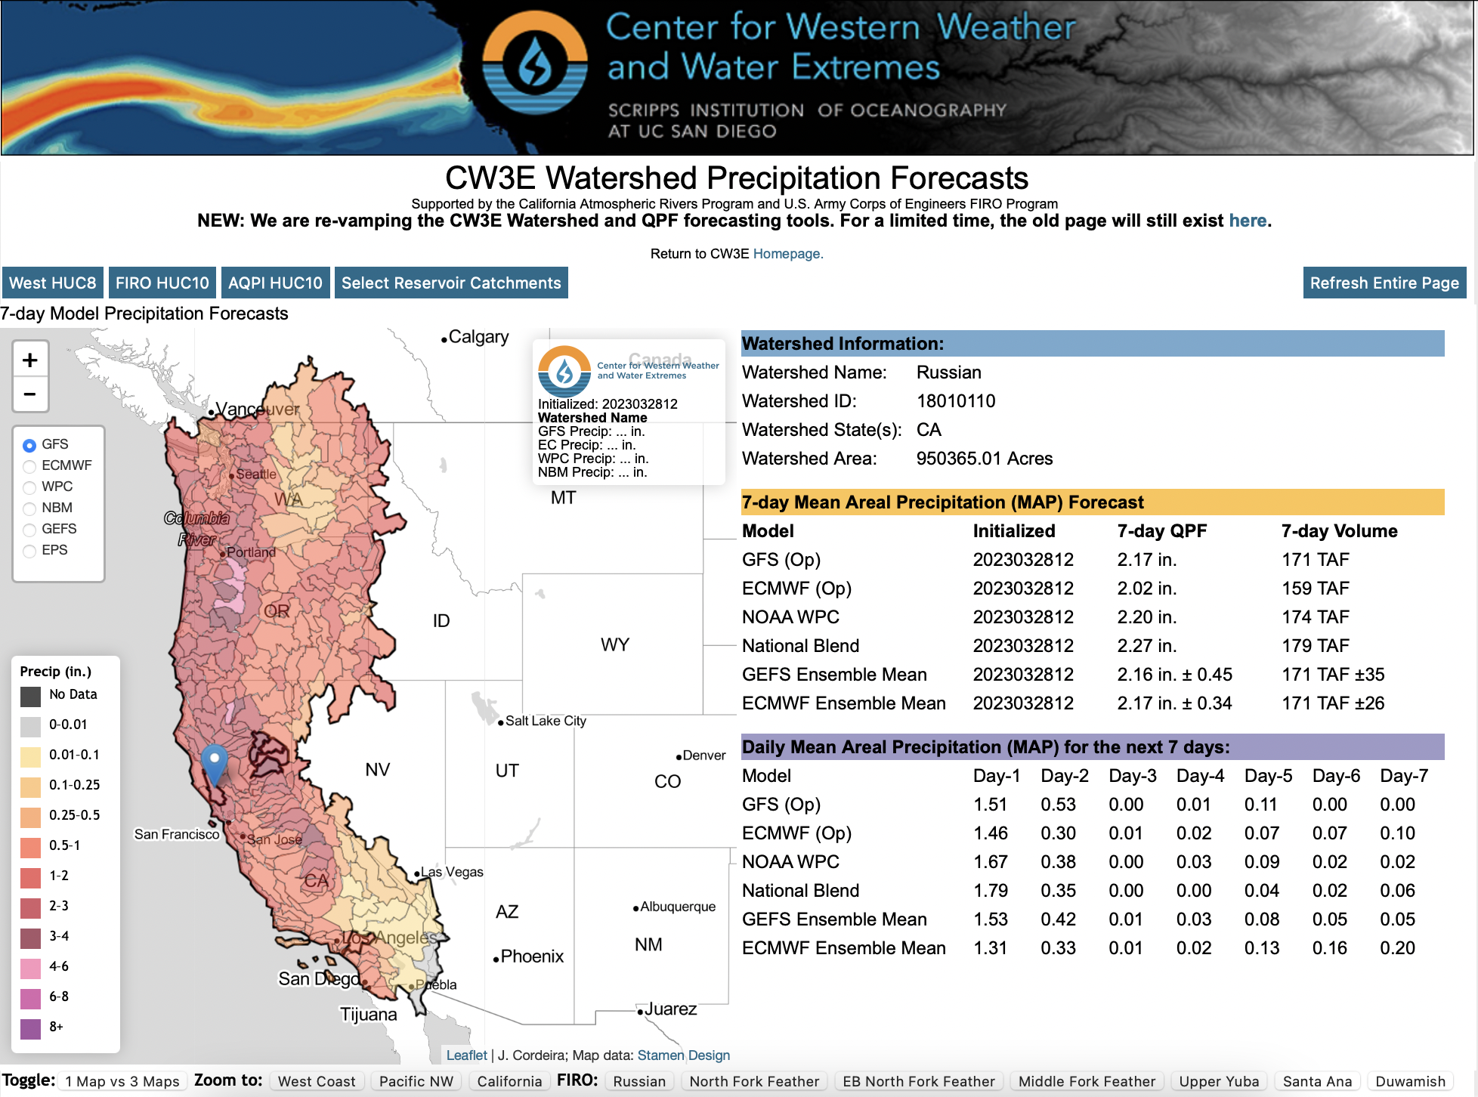
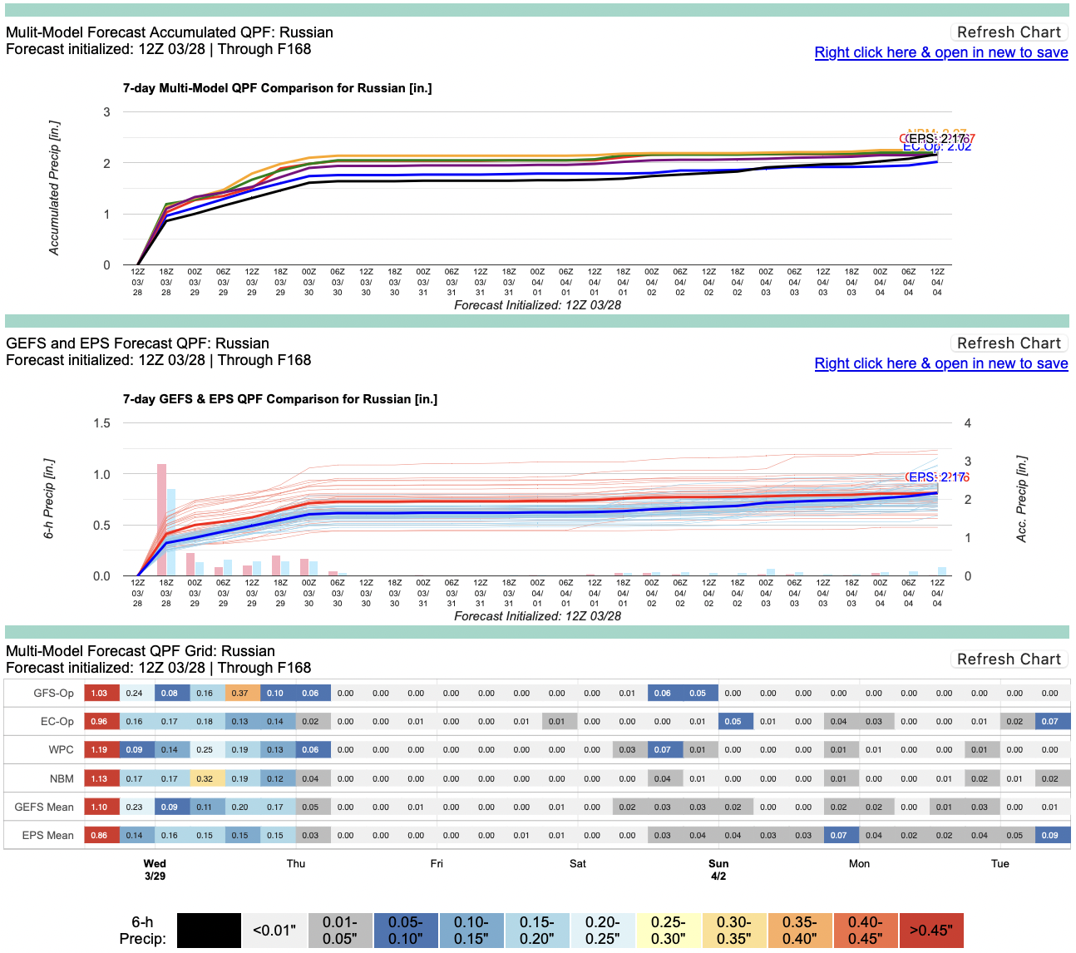
Improving QPF Forecasting and Situational Awareness at CW3E
Development of tools to that illustrate watershed precipitation (and total precip volume) across many models and operational forecasts to aid in decision support. https://cw3e.ucsd.edu/Projects/QPF/QPF.html

Slide 23
Northeast currently faces high regional risk of flooding w/ increasing trend
Flood risk across scales from short-duration, high-intensity precipitation mechanisms to long-duration, lower intensity precipitation mechanisms; modulated by snowmelt
Two prominent flood and flash flood processes: Tropical systems and atmospheric rivers
Precipitation forecast skill is highest in Western, Mid-Atlantic, and Northeast U.S., but has stagnated 10–15 years
Storm-based sampling of West Coast ARs have led to improved precipitation forecast skill
Jay Cordeira
jcordeira@ucsd.edu

Slide 24
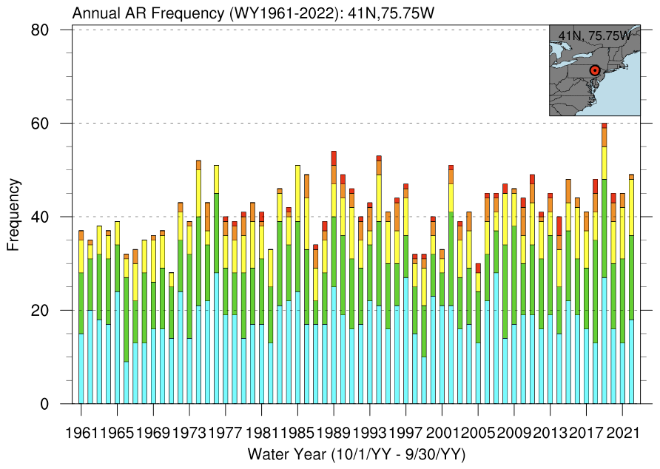
Using IVT to Identify ARs & other Precip Extremes
Rank (1–5)
(Denoted by color)
4
5
5
Increasingly Hazardous
1250
Increasingly Beneficial
3
4
5
1000
2
3
4
750
AR Intensity
Maximum IVT (kg m^{–1} s^{–1})
1
2
3
500
1
2
250
Not an AR
24
48
Slope = 0.1475 (over 63 years = +23 per century)
AR Duration
(IVT>250 kg m^{–1} s^{–1}) (hours)
16 April 2018: NYC Flash Floods,
Photo: NYPD 33rd Precinct →

Slide 25
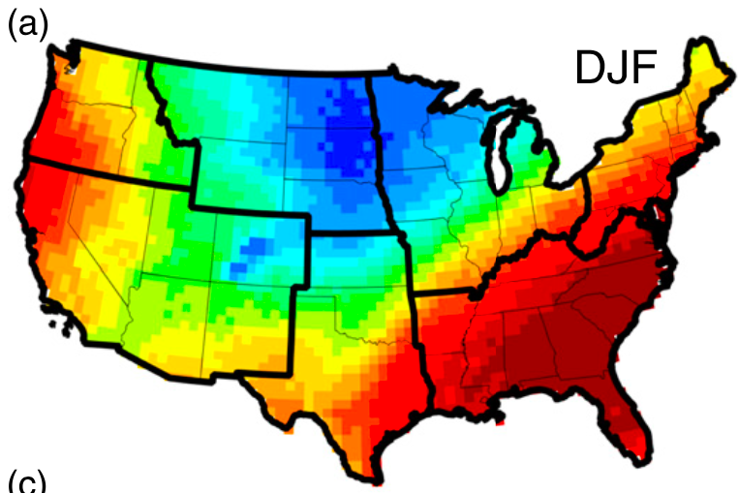

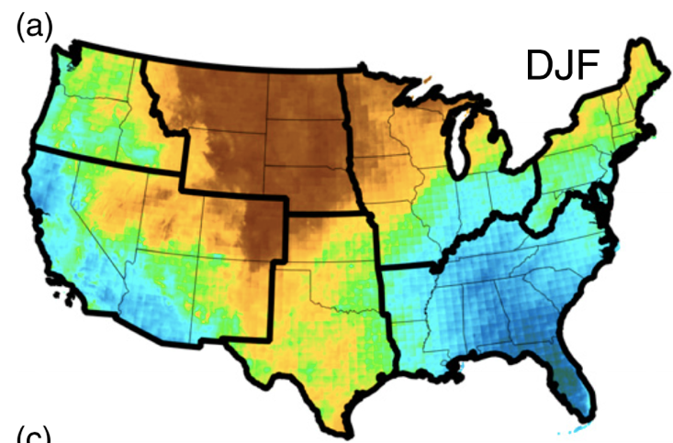

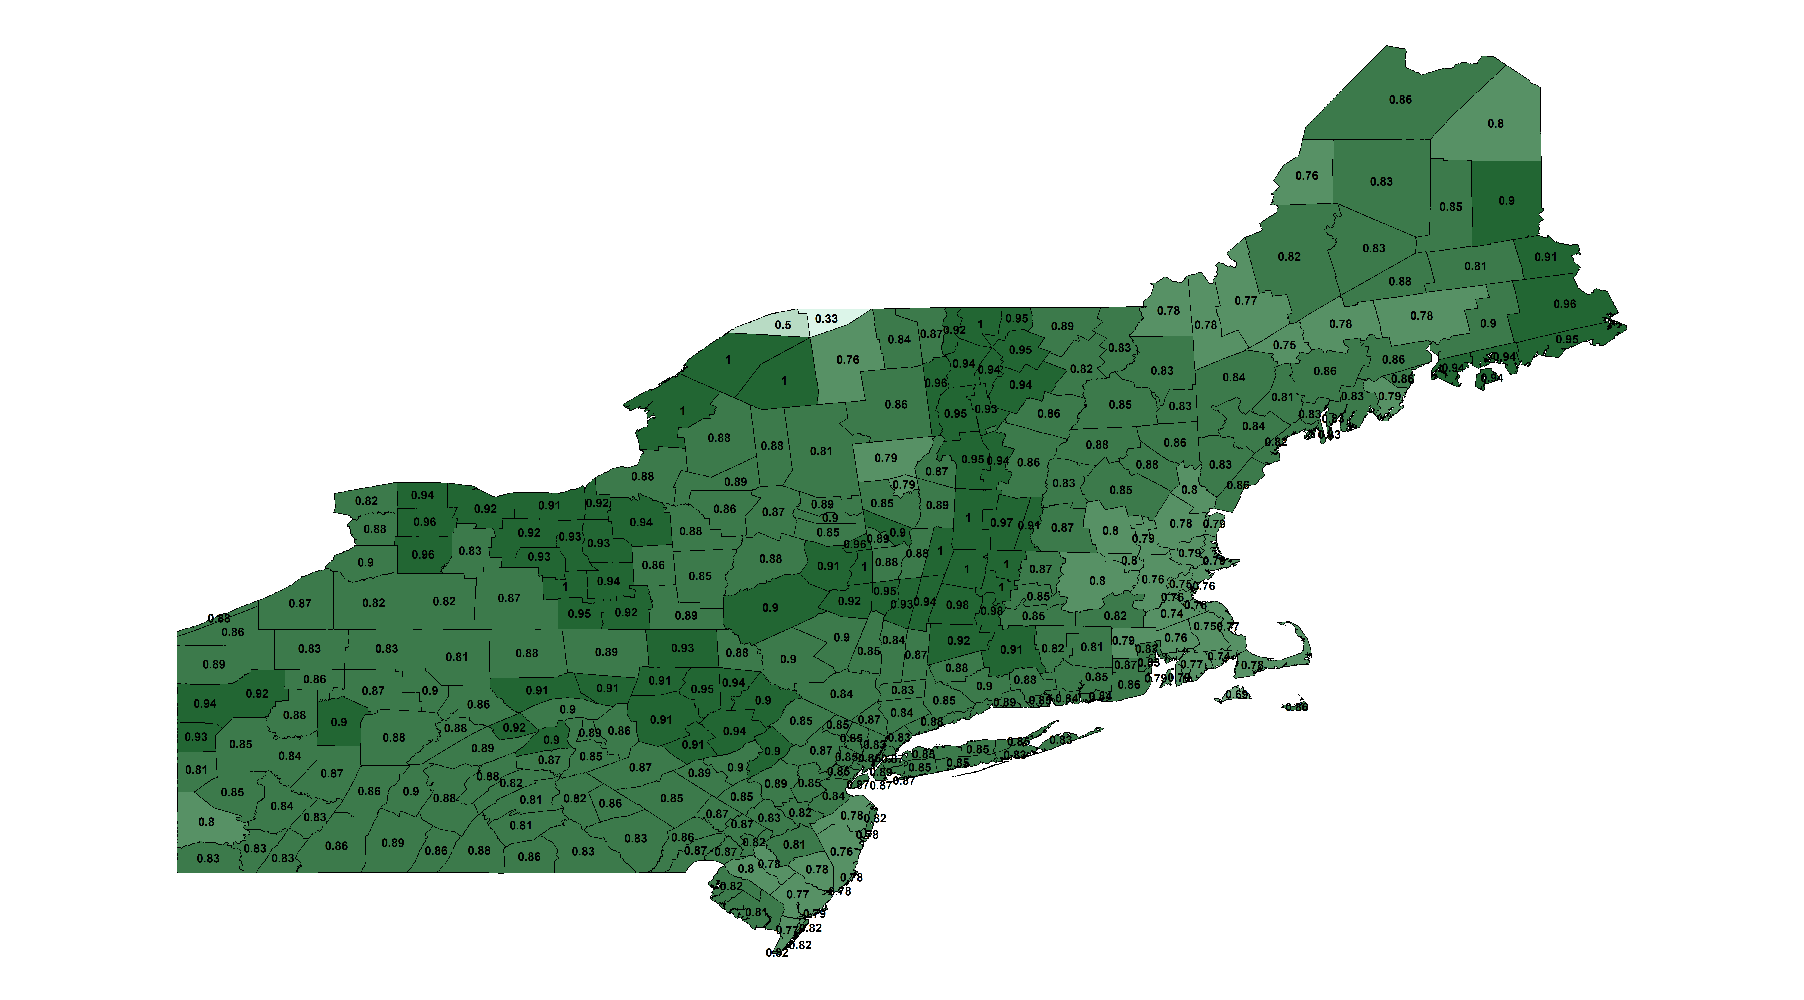
Additional Perspective on Atmospheric Rivers
a. Frequency of ARs
#
ARs are as frequent or more frequent across Eastern US than Western US
(Slinskey et al. 2020; Kaminski et al. 2023) – Fig. panel (a)
Slinskey et al. (2020)
>30% of non-summer precipitation is associated with ARs across Northeast US
(Slinskey et al. 2020; Kaminski et al. 2023) – Fig. panel (b)
b. Fraction of Precip. assoc. w/ ARs
>90% of non-summer extreme precipitation is associated with ARs across Northeast US
(Slinskey et al. 2020; Lamjiri et al. 2020)
Slinskey et al. (2020)
c. Fraction of Floods/FF w/ ARs
>85% of flood and flash flood watches, warnings, and advisories occur on day of or day after an ARs over the Northeast US (Glade et al. 2023) – Fig. panel (c)
75%
100%
85%
95% of ice jam events in Northeast US influenced by ARs
(Sanders et al. 2020)
Glade et al. (2023)
16 April 2018: NYC Flash Floods,
Photo: NYPD 33rd Precinct →

