Slide 1


Atmospheric Rivers
F. Martin (Marty) Ralph, Ph.D.
Director, Center for Western Weather & Water Extremes (CW3E) at UCSD
NYC Water/USACE FIRO Discussion
Tuesday 21 March 2023

Slide 2
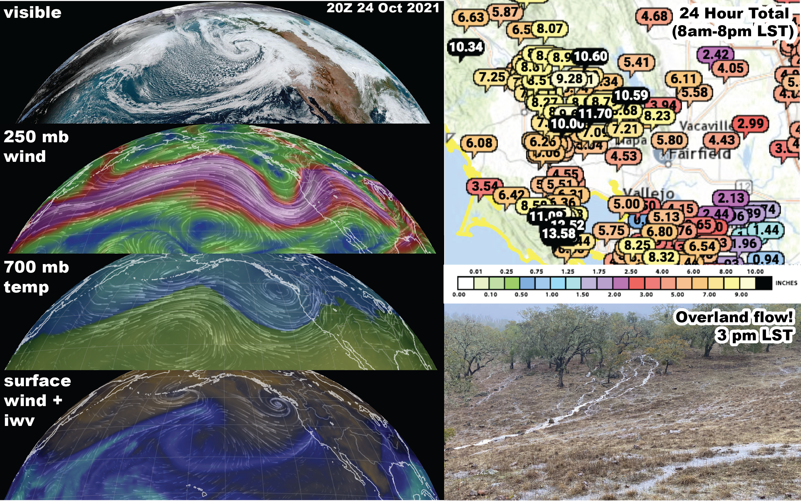
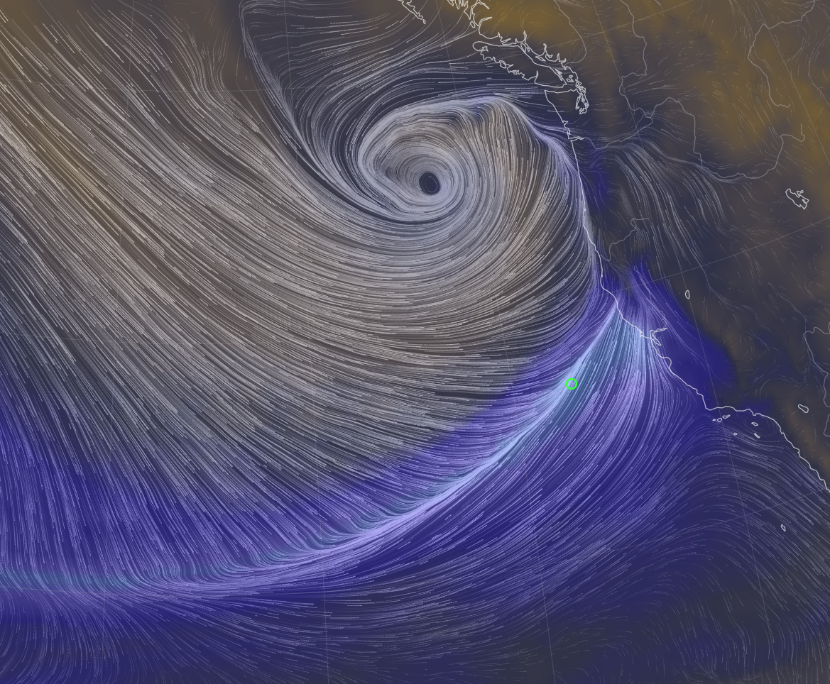

Atmospheric River
F. Martin Ralph
mralph@ucsd.edu

Slide 3
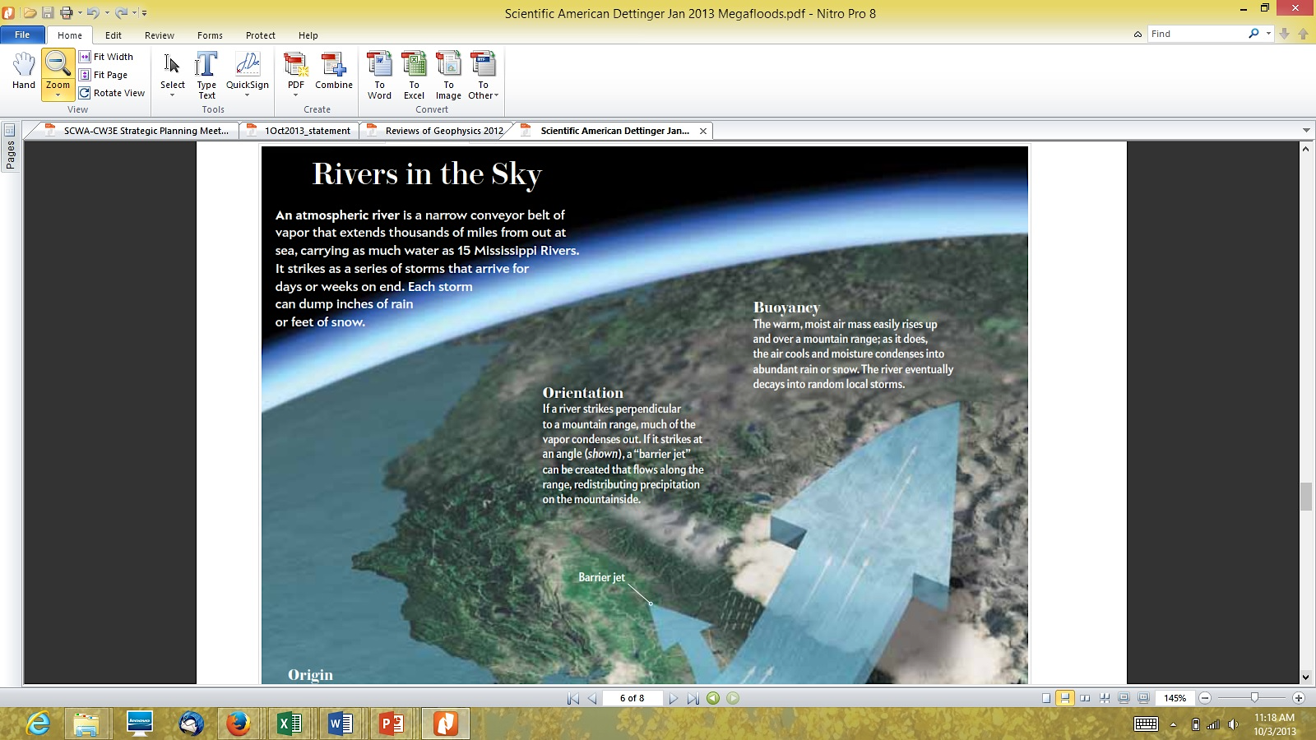
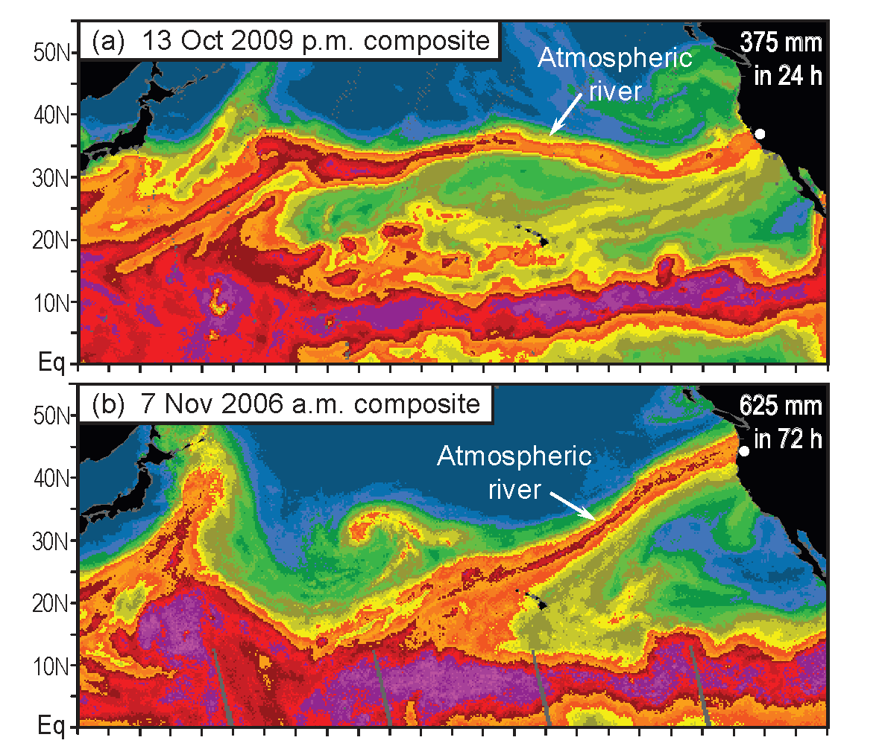
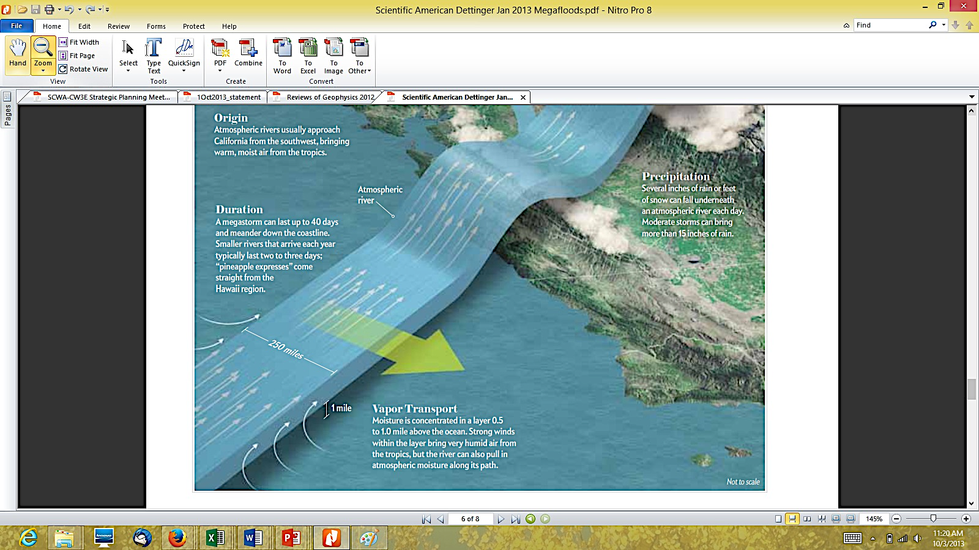

Key Science result: Atmospheric Rivers: Primary Source of Moisture for Precipitation in the region; useable predictive skill
Atmospheric Rivers (ARs) are Rivers in the Sky, i.e., long narrow bands of airborne water vapor, carrying as much water as 25 Mississippi Rivers*.
An AR that hit Washington & Oregon produced 25 inches of rain in 3 days.
ARs Can produce extreme precipitation and flooding.
However, ARs also provide up to half of annual precipitation and mountain snow that are key to water supply.
Dettinger and Ingram (2013, Sci. Amer.)
*Ralph et al. (2017)

Slide 4
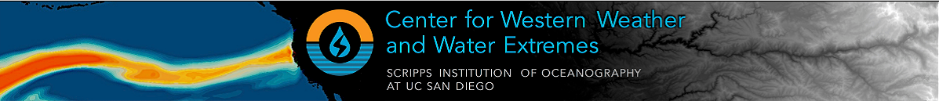
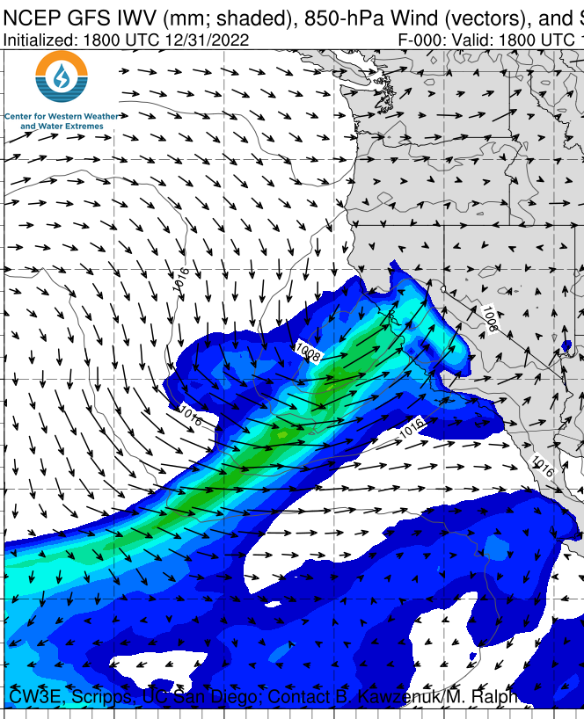
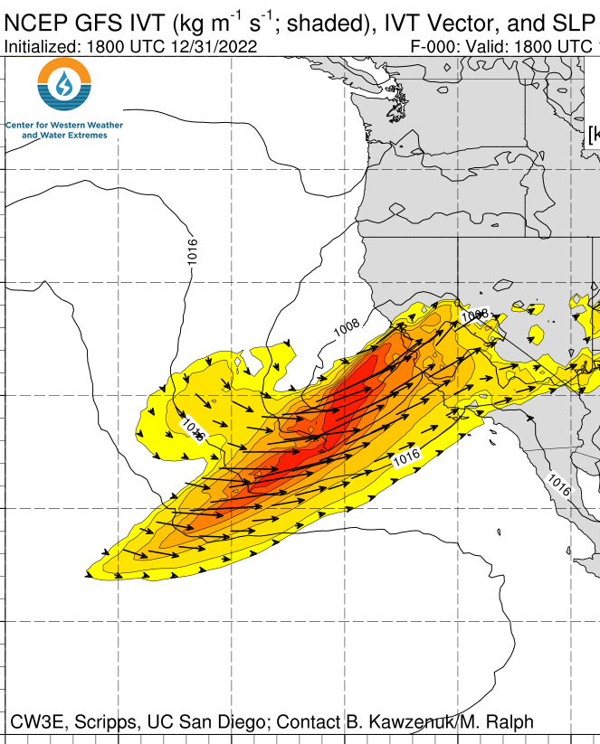
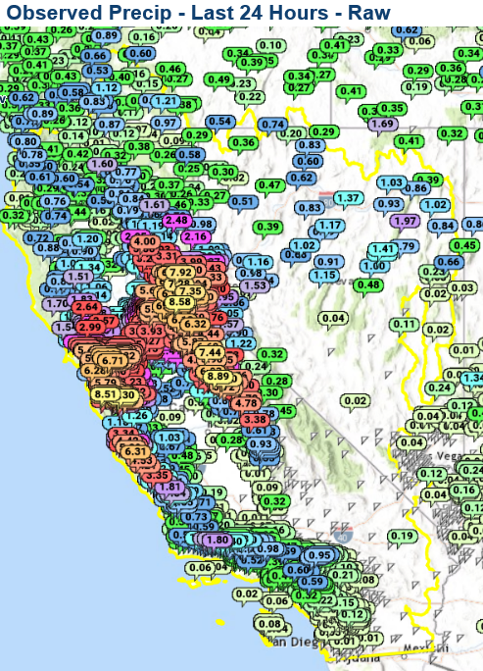
New Years Day 2023 AR

Slide 5
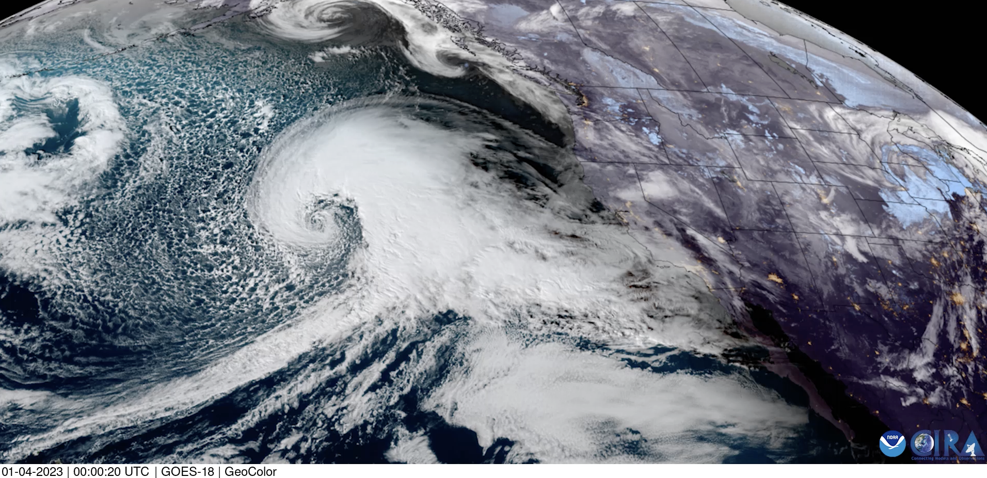
PRIORITY AREA: Atmospheric Rivers Research and Applications
Research to Understand Atmospheric River Evolution and Predictability
L
CA
4 Jan 2023
CW3E Goals
1. Monitor and Understand AR evolution
2. Identify sources and skill of AR predictability
3. Guide development of decision support tools

Slide 6
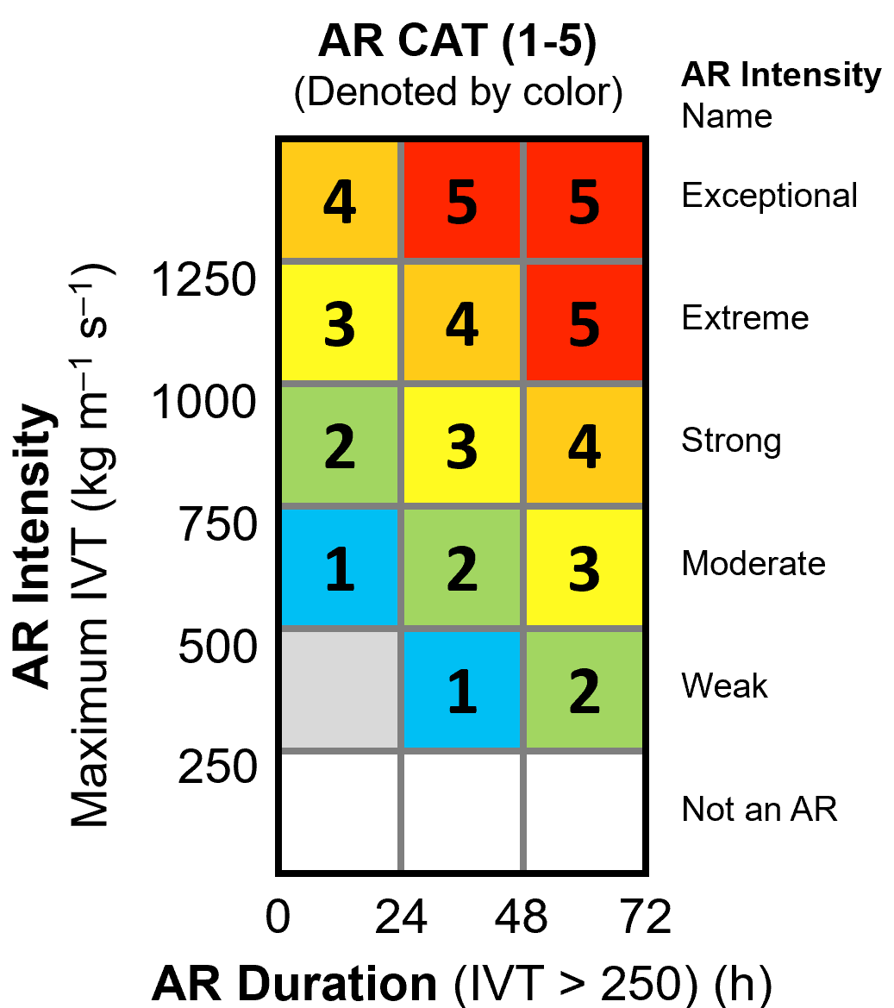
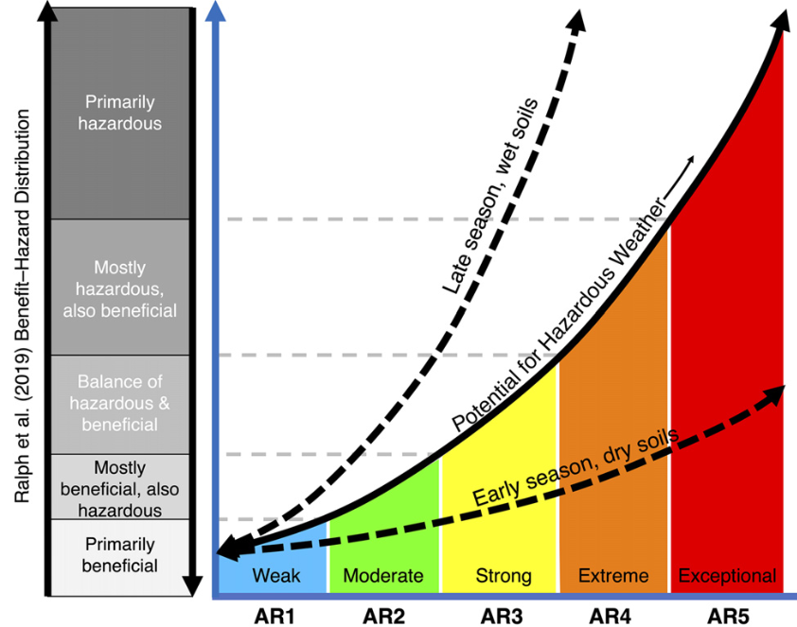
ARs drive flood damages in California and the West
Ralph et al. 2019 BAMS
AR Rank (1-5)
AR Rank
Atmospheric Rivers: Benefits and Hazards Distribution
Mostly beneficial
Antecedent conditions and presence of vulnerable communities modulate AR impacts
Mostly hazardous
Ralph et al. 2019
Bulletin of the American Meteorological Society
Corringham et al. 2019
Science Advances
Bartlett and Cordeira 2021
Weather and Forecasting
84% of All Flood Damages
over 40 years in the West
are from ARs
Flood damages increase
exponentially with AR Ranking
AR days correspond to most of the days with NWS Weather Watches, Warnings or Advisories

Slide 7
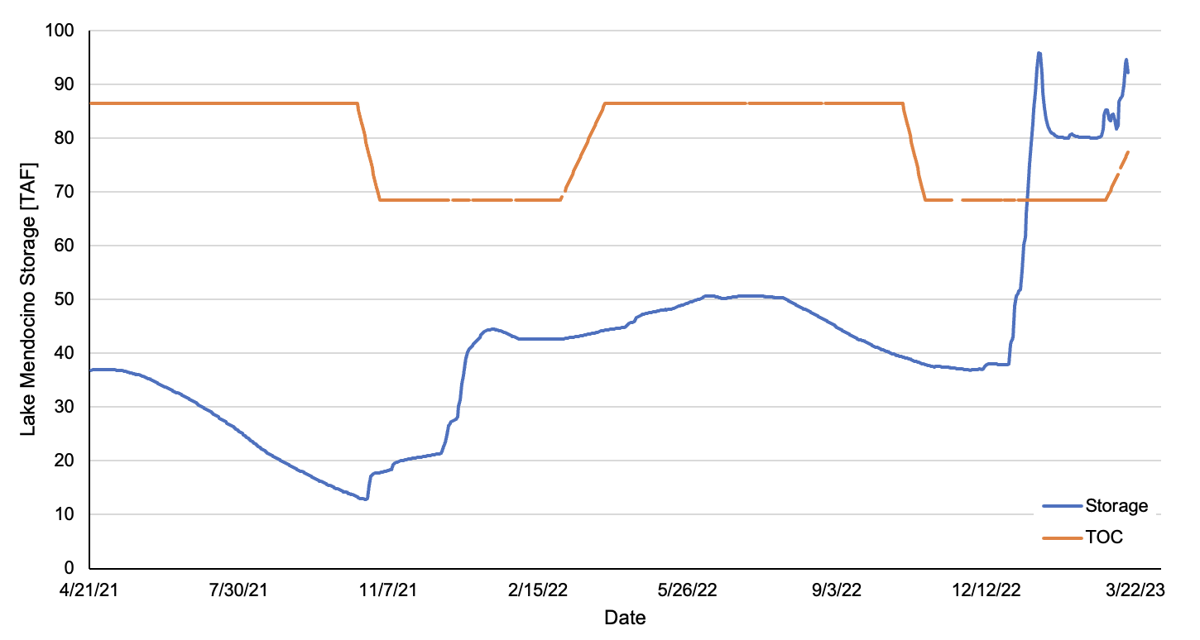
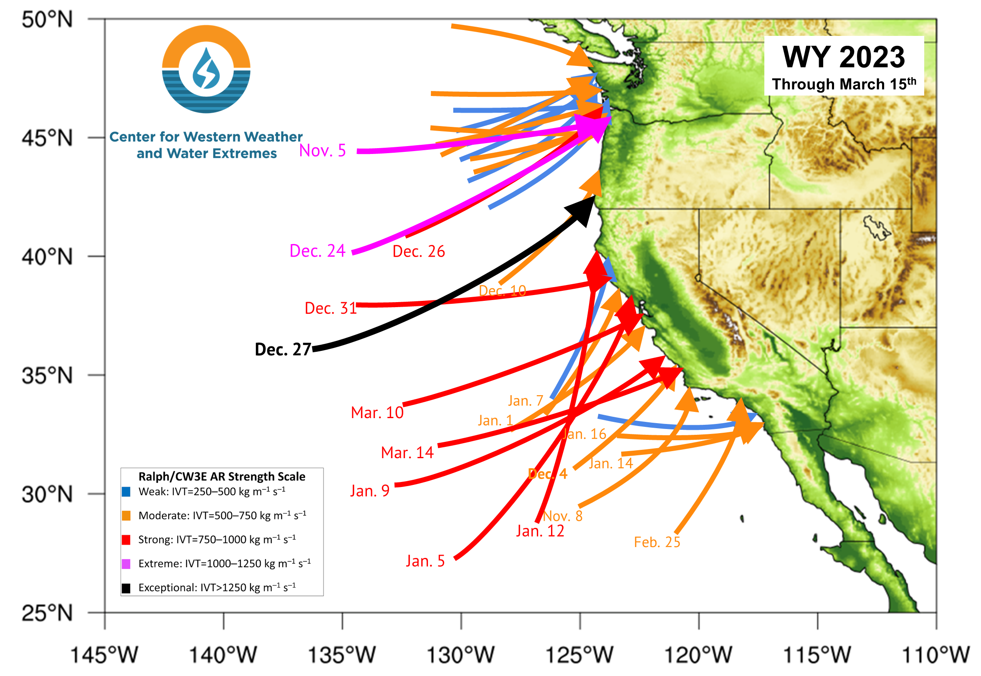
CA Gov. Newsom Press Conference on 21 April 2021 at Lake Mendocino:
Declared Regional Drought Emergency – FIRO/ARs noted as Innovative Solution
3/16/2023
Arrows illustrate AR landfall intensity and orientation based at time of maximum intensity using IVT Mag.
9 ARs made landfall in California between 26 Dec 2022 & 17 Jan 2023
2 ARs made landfall in California on 10–14 March 2023
TOC
Storage
12/4/2022
10/23/2021

Slide 8
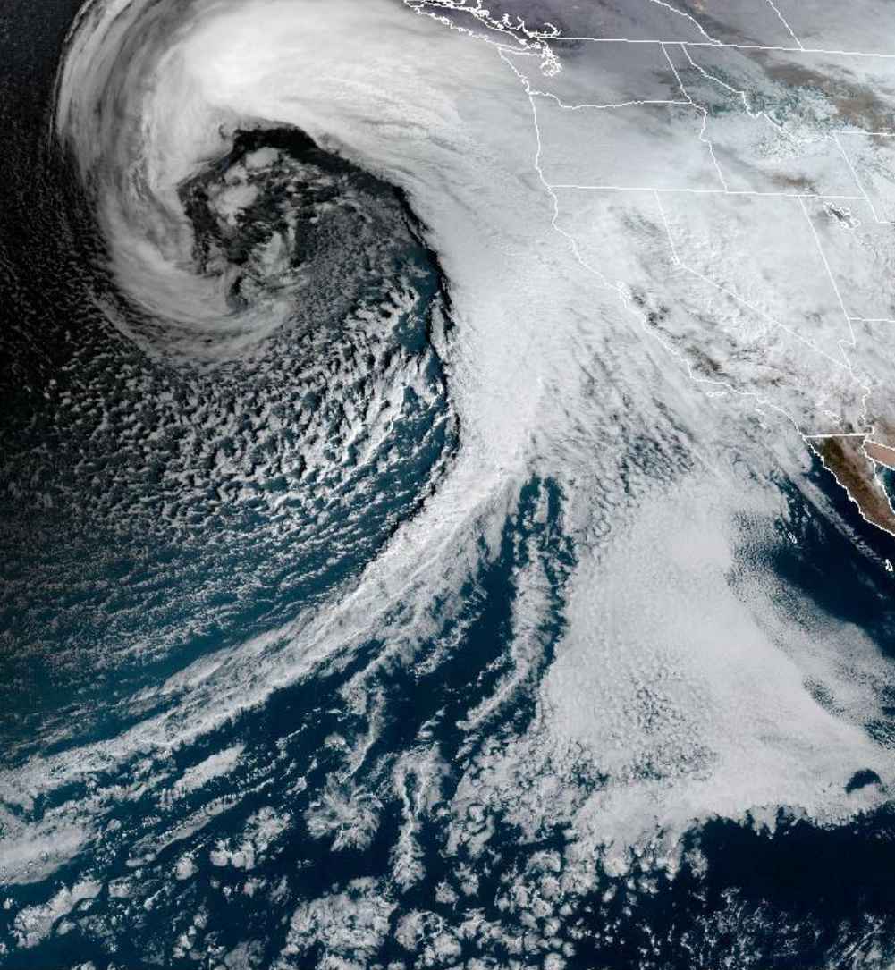
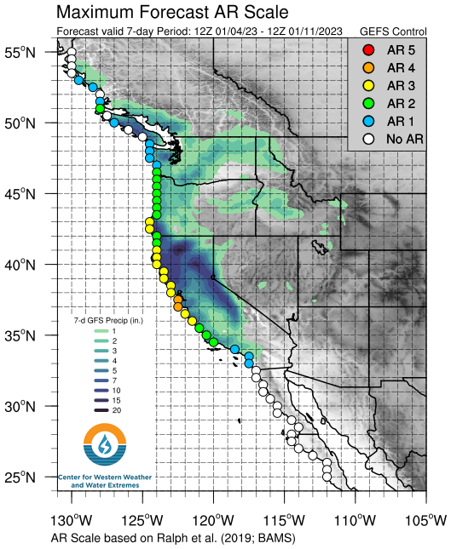
AR Usually moves east and south over a day or two
AR part of broader storm

Slide 9
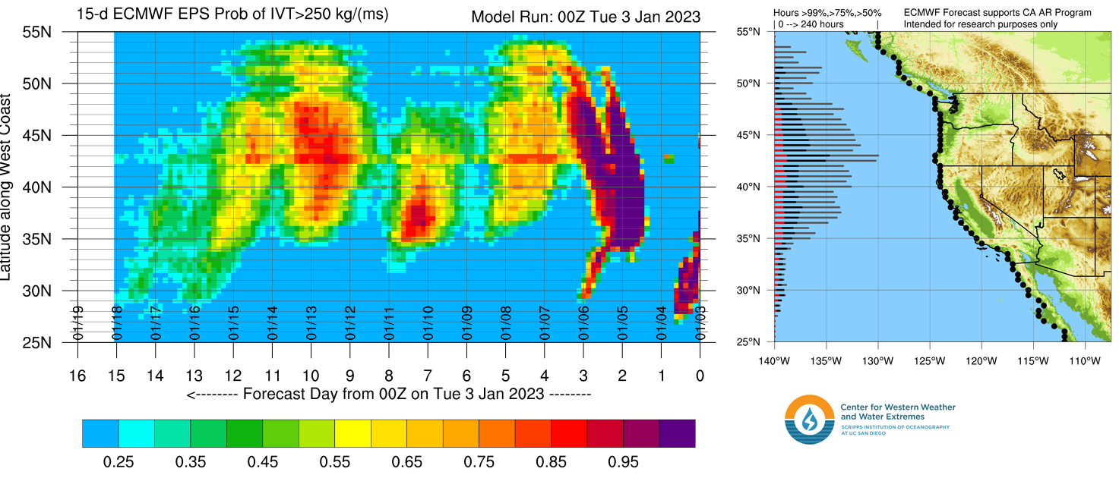
PRIORITY AREA: Atmospheric Rivers Research and Applications
How far in advance can we predict landfalling ARs?
Odds of a landfalling AR based on IVT magnitude (Cordeira and Ralph 2019; Stewart et al. 2022)
14/15 Jan
12/13 Jan
9/10 Jan
7 Jan
4/5 Jan

Slide 10
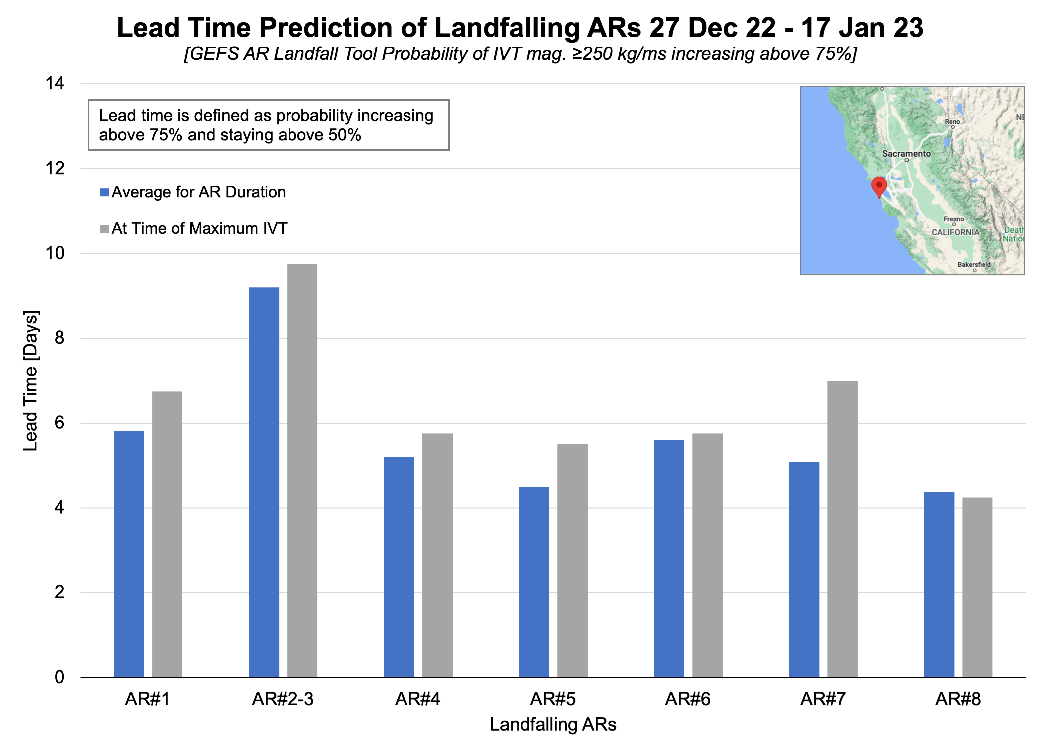

PRIORITY AREA: Atmospheric Rivers Research and Applications
How far in advance can we predict landfalling ARs?
During the impactful AR Family Dec 2022– Jan 2023 showed as much as a 9-day lead time with most ARs near 6 days lead time.

Slide 11
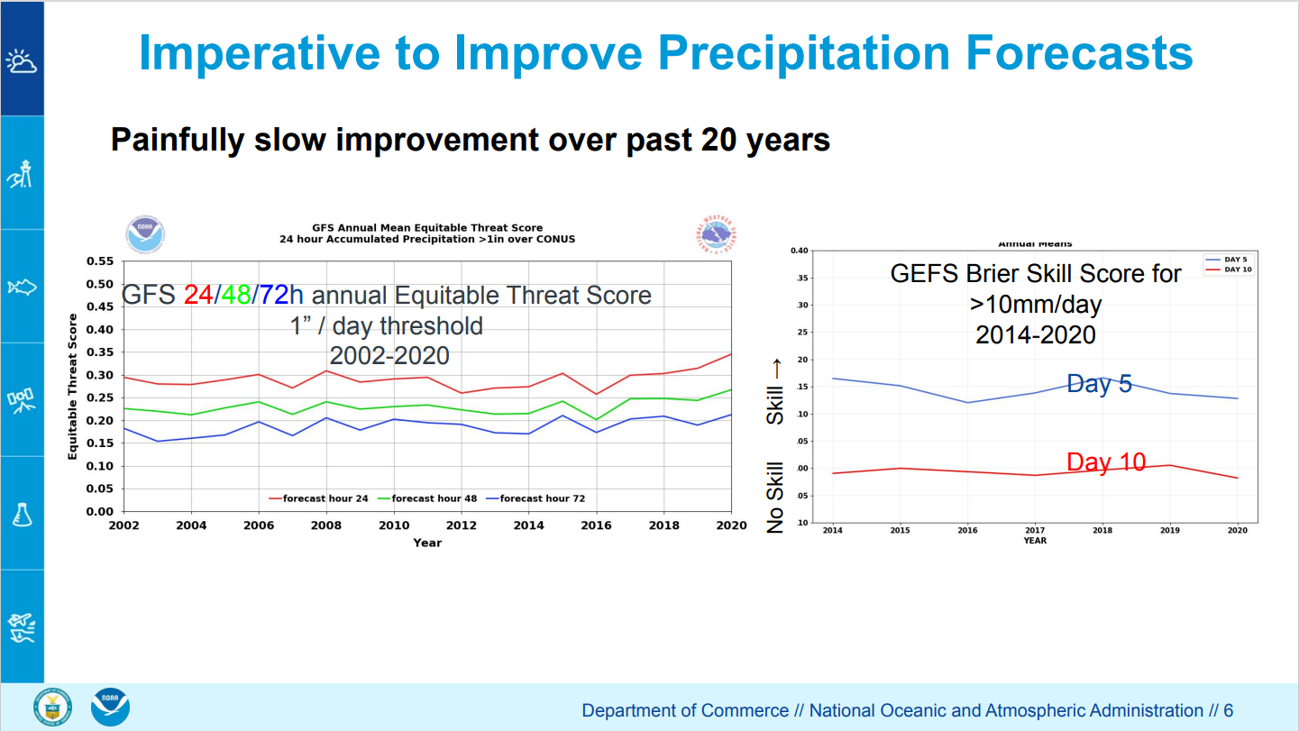
Very slow improvement in QPF using traditional methods
CW3E (via FIRO and ARP) is overcoming this by using new approaches focused on predicting the entire storm lifecycle

Slide 12
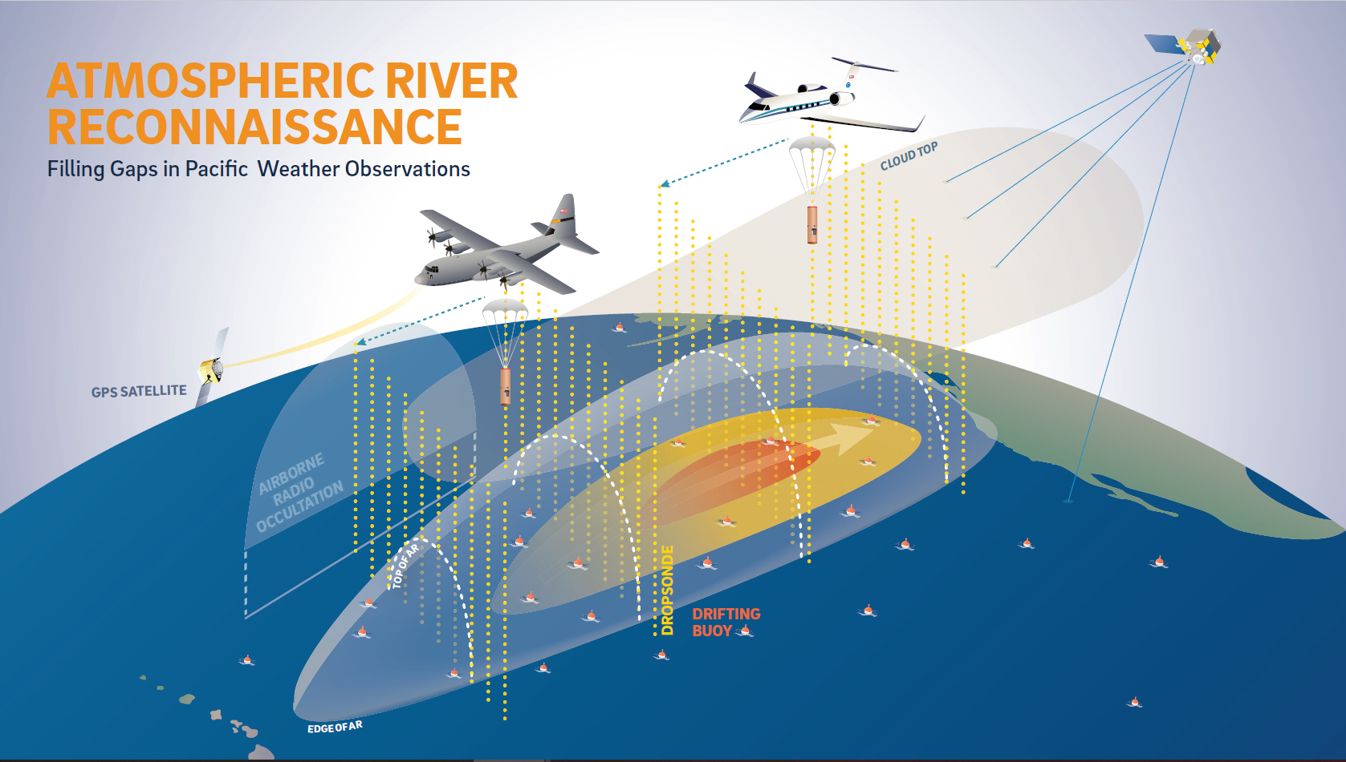

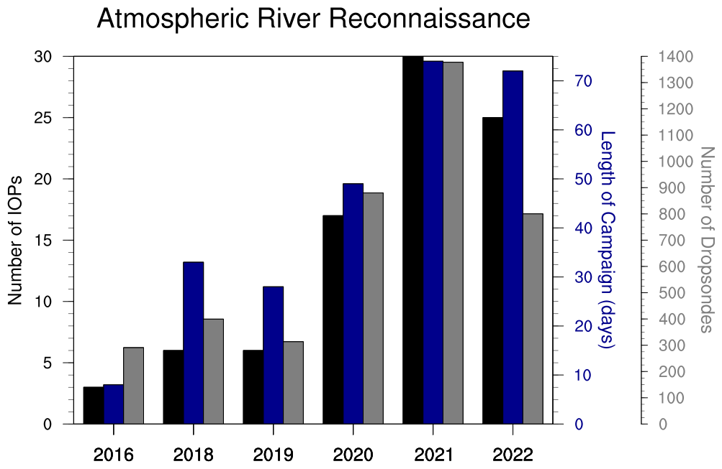
PRIORITY AREA: Atmospheric Rivers Research and Applications
How can we improve how far in advance we can predict ARs? – AR Recon
Atmospheric River Reconnaissance:
Growth from Demonstration to Operations
NWSOP Identifies AR Recon as a Long-Term Operational Requirement starting in 2020
Lavers et al. 2018 GRL
Ralph et al. 2019 BAMS
Reynolds et al. 2019 MWR
Lavers et al. 2020 Wea Fore
Lavers et al. 2020 Nature Comms
Stone et al. 2020 MWR
Cobb et al. 2021 MWR
Haase et al. 2021 JGR
Prince et al. 2021 GRL
Zheng et al. 2021 BAMS
Zhang and Ralph 2021 MWR
Cobb et al. 2022 WAF
Wilson et al. 2022 BAMS
Demonstration of AR Recon

Slide 13


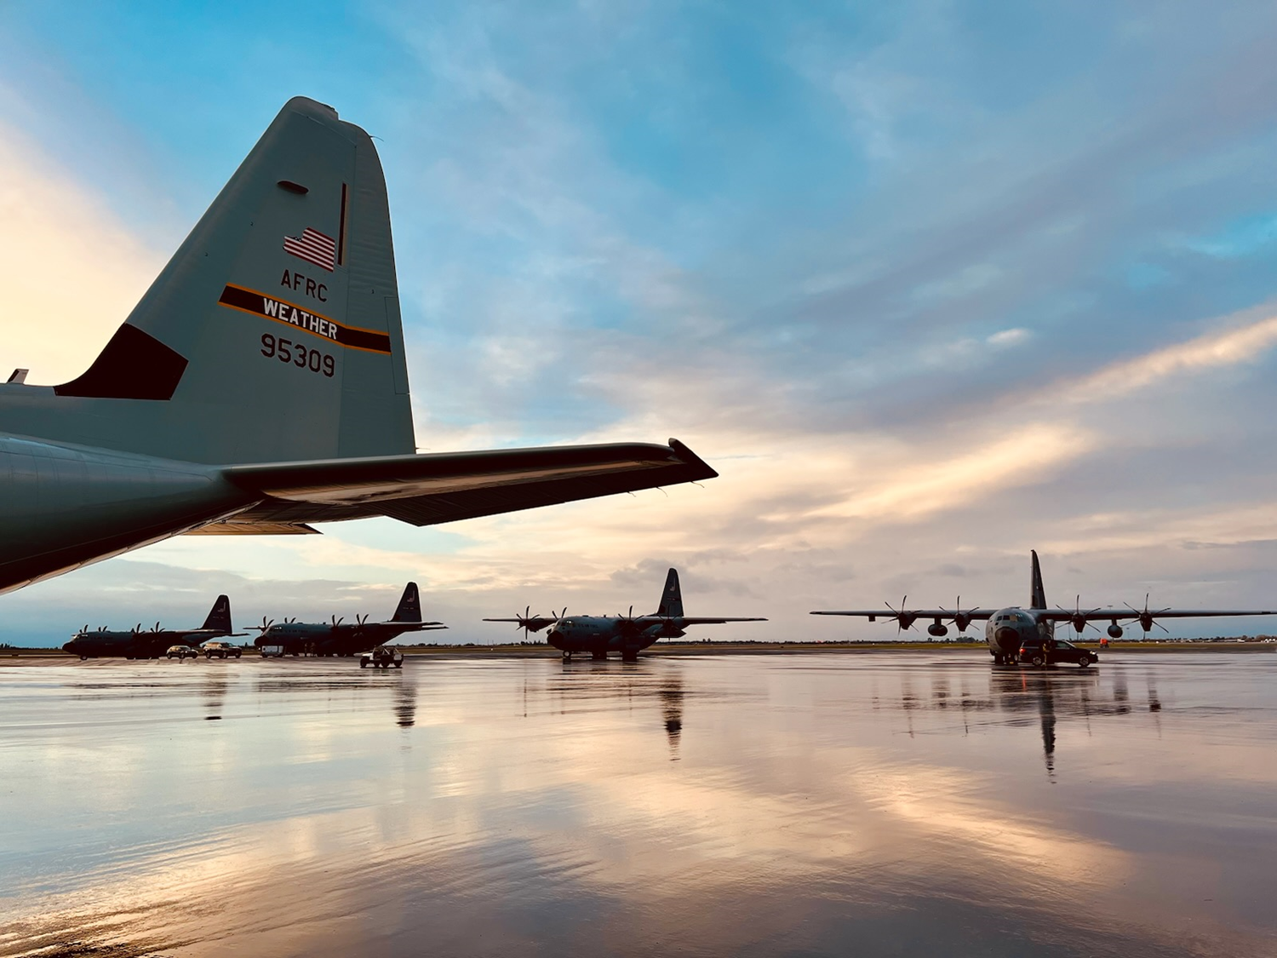
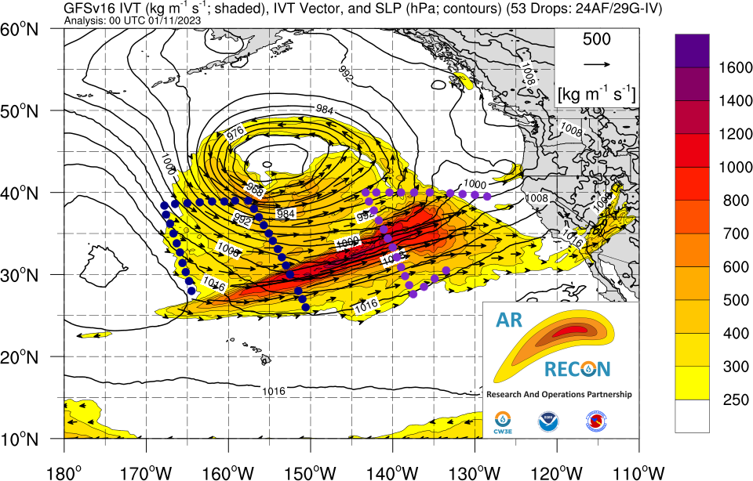
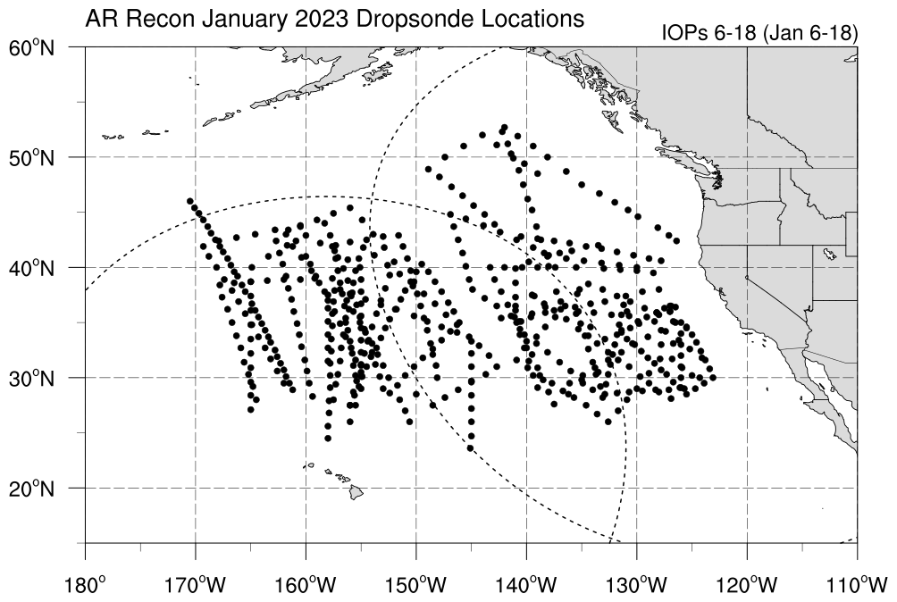




AR RECON 2023
Status 25 January 2023
4 USAF C-130 aircraft based at Mather Field in Sacramento, California
1 NOAA G-IV Jet based in Honolulu, Hawaii (through January 2023)
Jan 2023 Longest Flight Sequence on Record
included IOPs* for 13 consecutive days
Air Force C-130
NOAA G-IV
*IOP = Intensive Observing Period, indicate days when AR Recon flights are flown
Key support from California Department of Water Resources/AR Program and US Army Corps of Engineers/FIRO Program
F. Martin Ralph, PI (UC San Diego/SIO/CW3E)
Vijay Tallapragada, Co-PI (NOAA/NWS/NCEP)

Slide 14
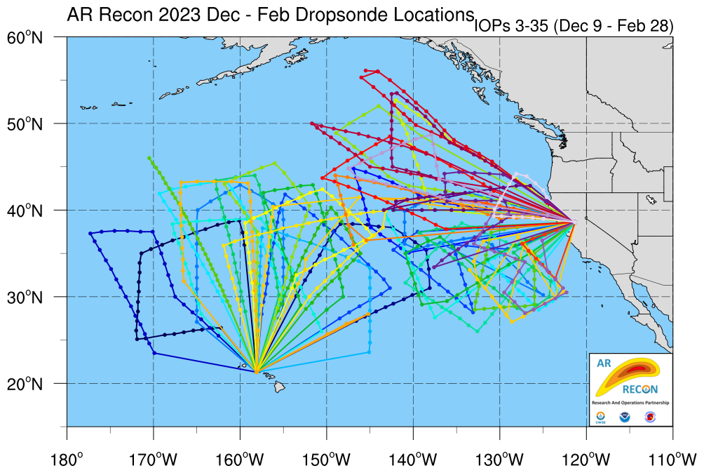
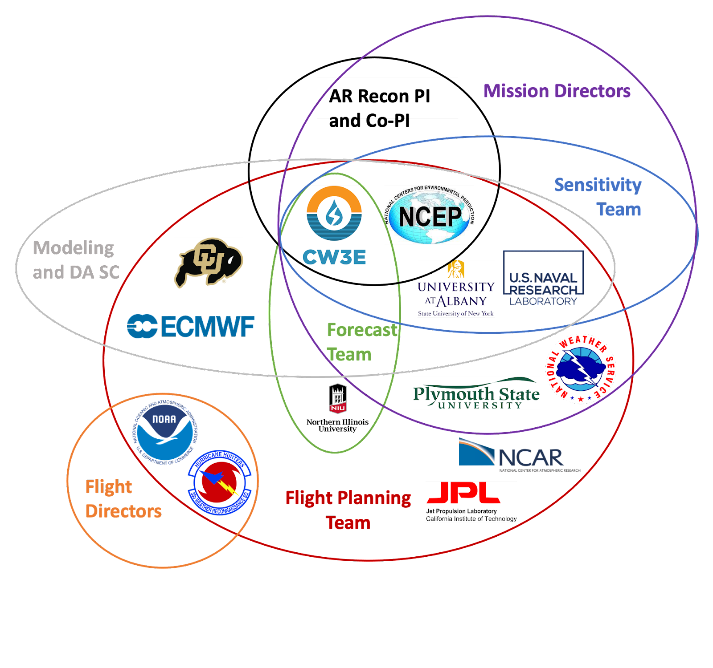
PRIORITY AREA: Atmospheric Rivers Research and Applications
How can we improve how far in advance we can predict ARs? – AR Recon

Slide 15
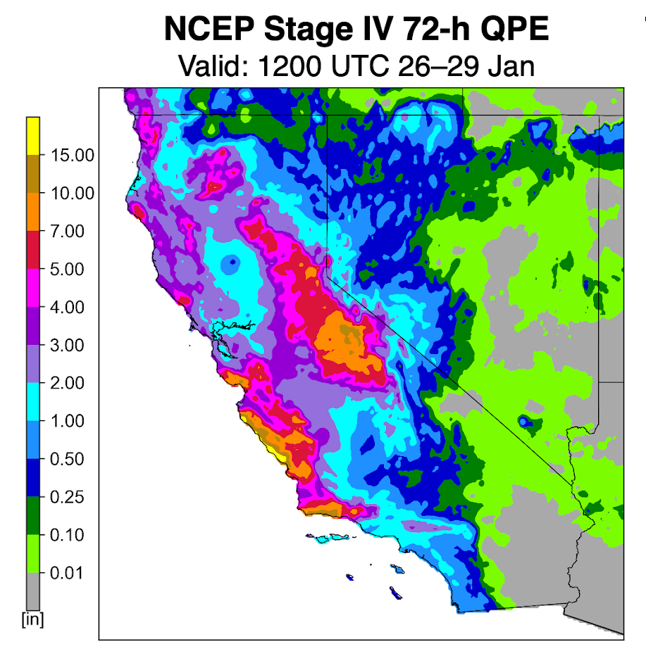
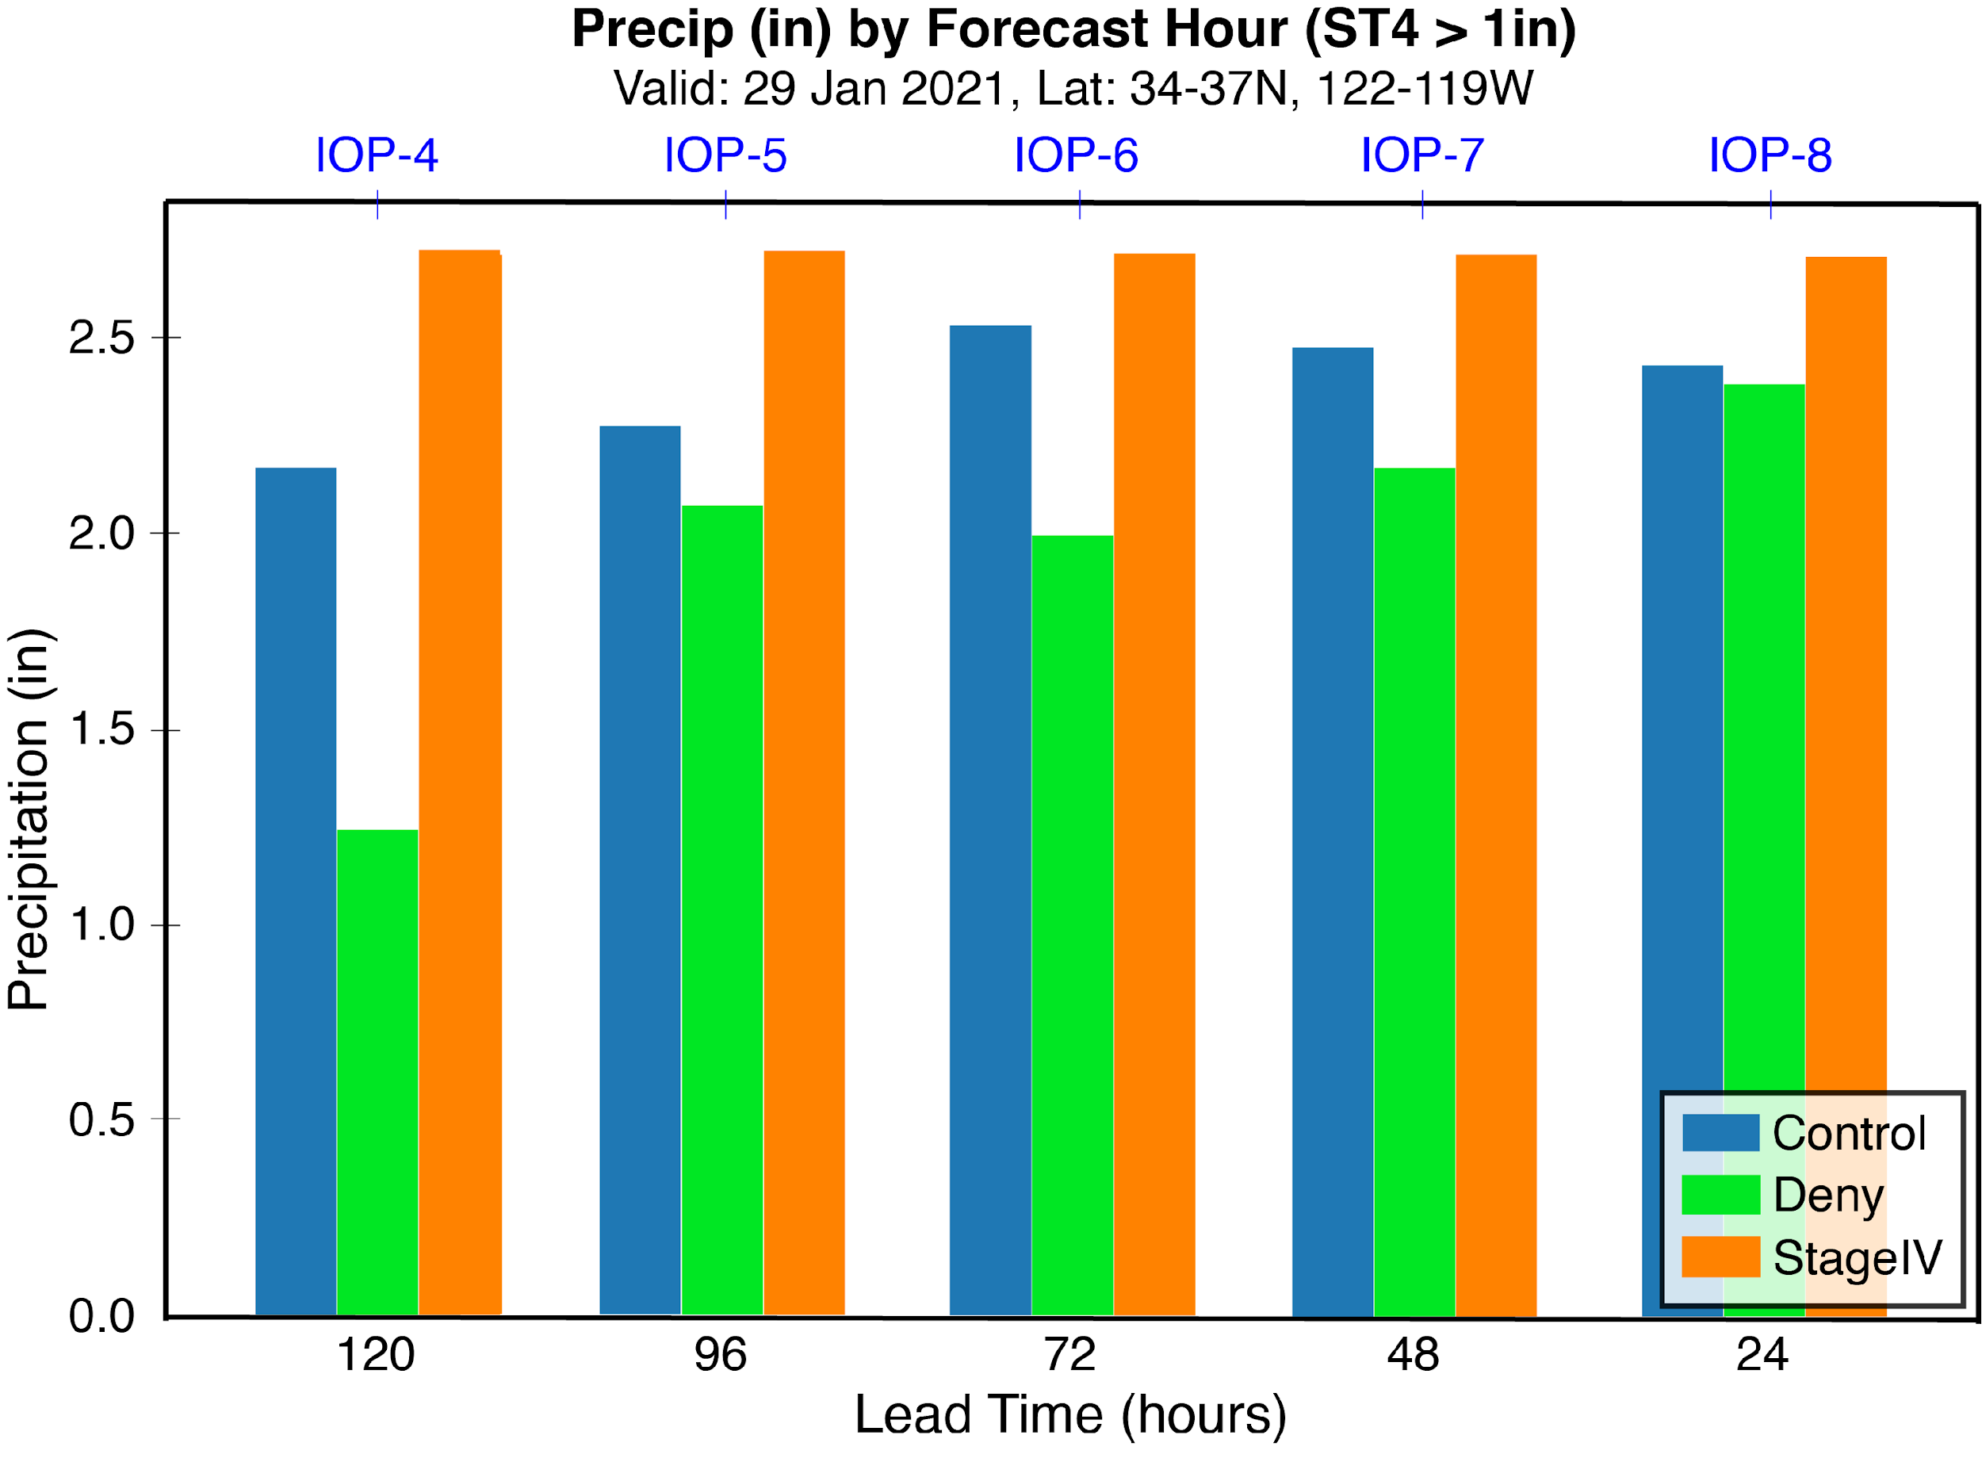
PRIORITY AREA: Atmospheric Rivers Research and Applications
How can we improve how far in advance we can predict ARs? – AR Recon
GFS Shows Continuous and Significant Precipitation Improvement by assimilating data from IOPs 4 through 7.
GFS precipitation forecast error at 120h (5-day) lead time with drops is equivalent to the 48h (2-day) error without drops.
AR Recon Data Denial Experiments
V. Tallapragada, F.M. Ralph, X. Wu, M. Zheng

Slide 16
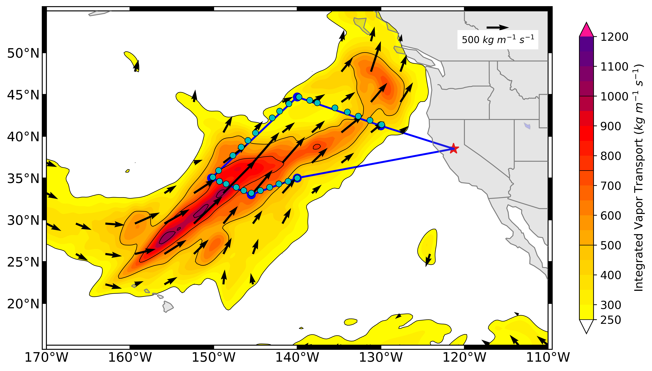


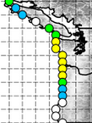
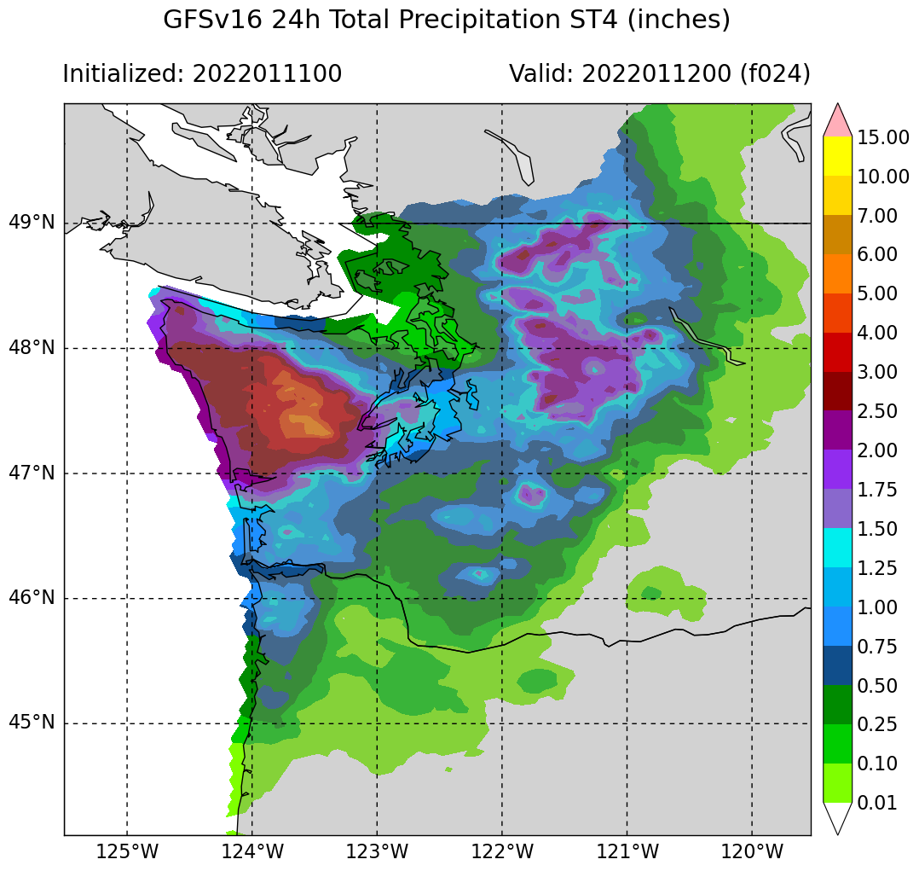
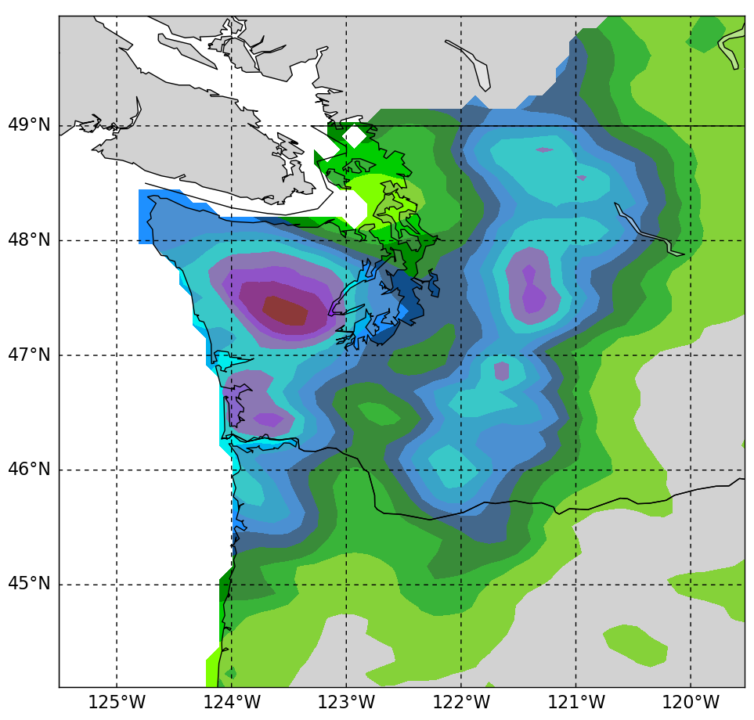
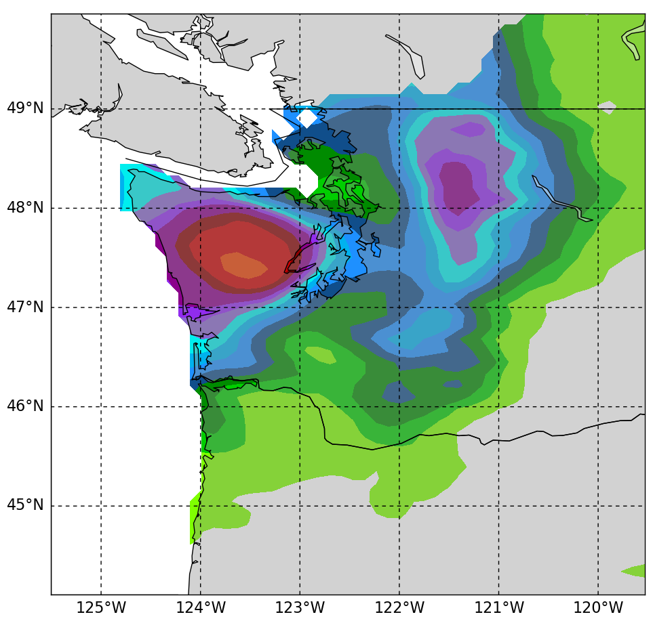
IVT
[kg m⁻¹ s⁻¹]
Atmospheric River Reconnaissance 2022
Preliminary Assessment of Impact on Heavy Precipitation Forecast in GFS During the Sequence of 3 days of AR Recon flights from 11-13 Jan 2022
00Z 11 Jan – Day 1
27 Dropsondes
AR Recon flight substantially reduced errors in the 1-2-day lead-time forecast of heavy precipitation from an AR3 storm
Air Force C130
AR3
Storm
The region had been experiencing flooding already this winter, and WA had requested a Presidential Disaster Declaration for earlier AR storms that had hit in Nov-Dec 2021, before AR Recon season began on 11 Jan 2022.
Research And Operations Partnership
F. Martin Ralph (UCSD/SIO/CW3E) - PI
Vijay Tallapragada (NWS/NCEP) - Co-PI
Max > 5 inches in 1 day
Close to what was observed
Max > 6 inches in 1 day
Max < half what was observed
Observed 24-h total precipitation
00Z 11 Jan - 00Z 12 Jan
Forecasted 24-h total precipitation
Initial time: 00Z 11 Jan
Forecasted 24-h total precipitation
Initial time: 00Z 11 Jan
24-h precip (inches)
GFS Forecast Without AR Recon
GFS Forecast With AR Recon
Observed

Slide 17
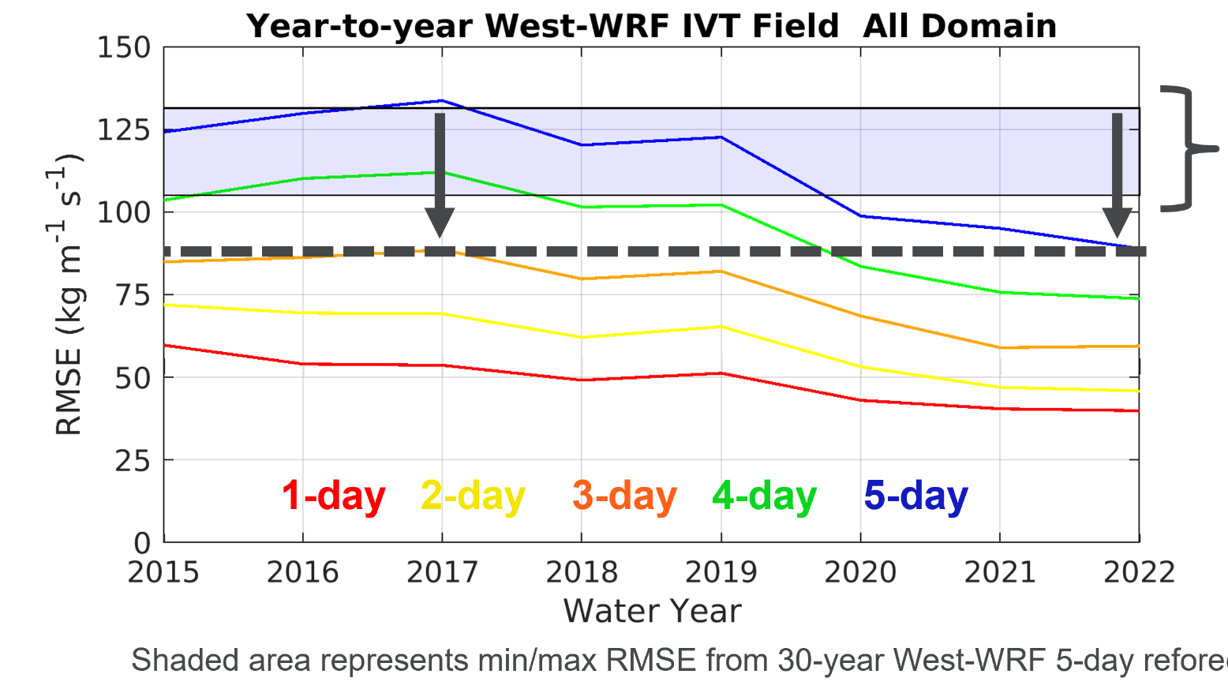
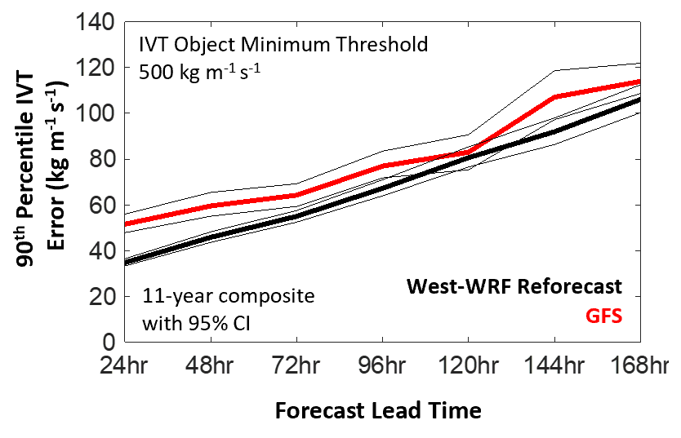
How can we improve how far in advance we can predict ARs? – West WRF
PRIORITY AREA: Atmospheric Rivers Research and Applications
Research is improving the skill of predicting ARs
WY2022 RMSE is lower than the minimum value found in the 30-year West-WRF Reforecast
5-day forecast errors are as good as 3-day forecasts were pre-WY2018 (35% reduction)
10–25% less error than GFS in predicting AR intensity at 1–7 days lead time

Slide 18
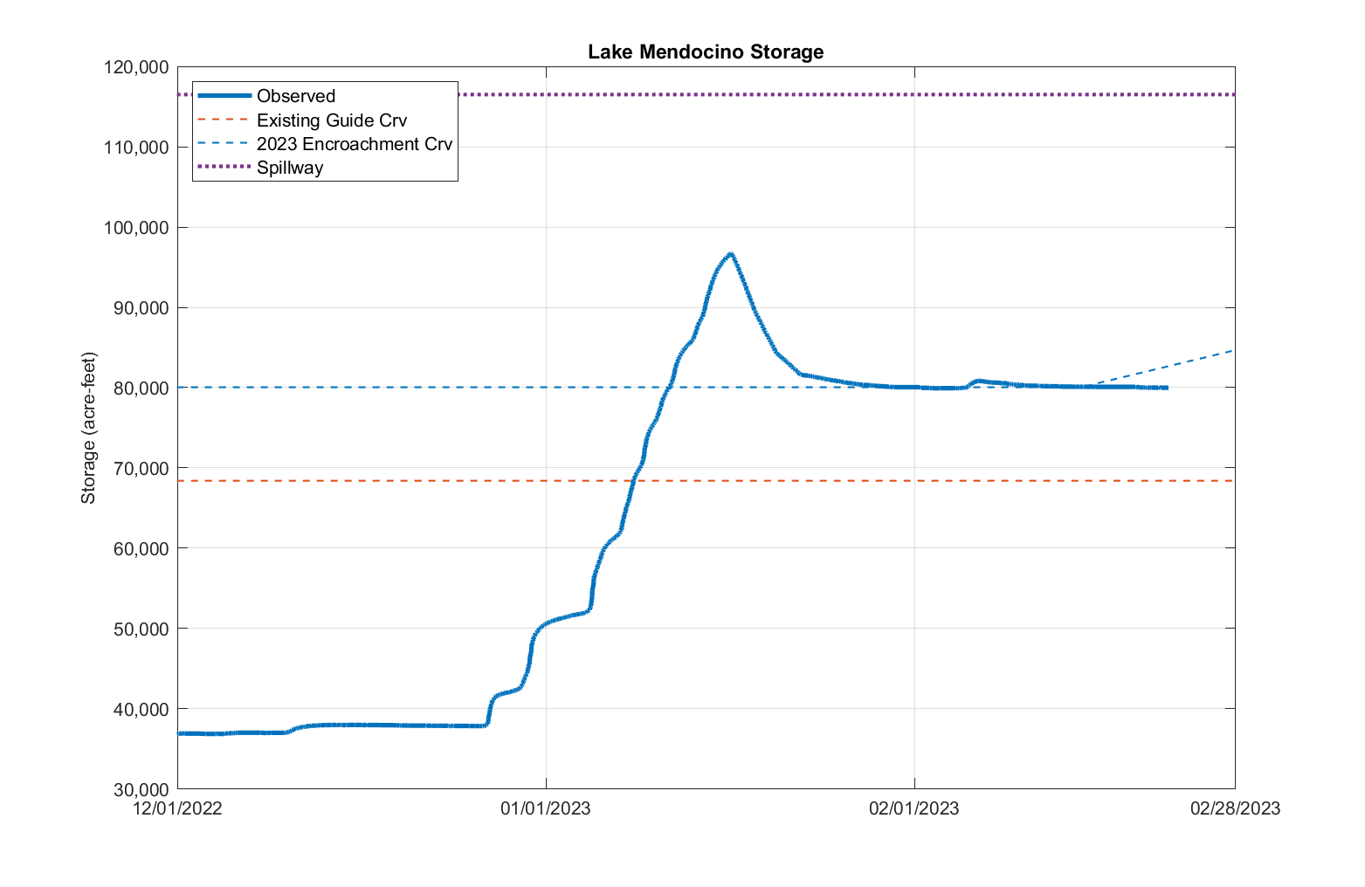
Water Year 2023 Lake Mendocino Storage
Water Year 2023
FIRO allowed retention of an extra 11,600 acre feet after the onslaught of ARs in Dec-Jan
11,600 ac-ft

Slide 19
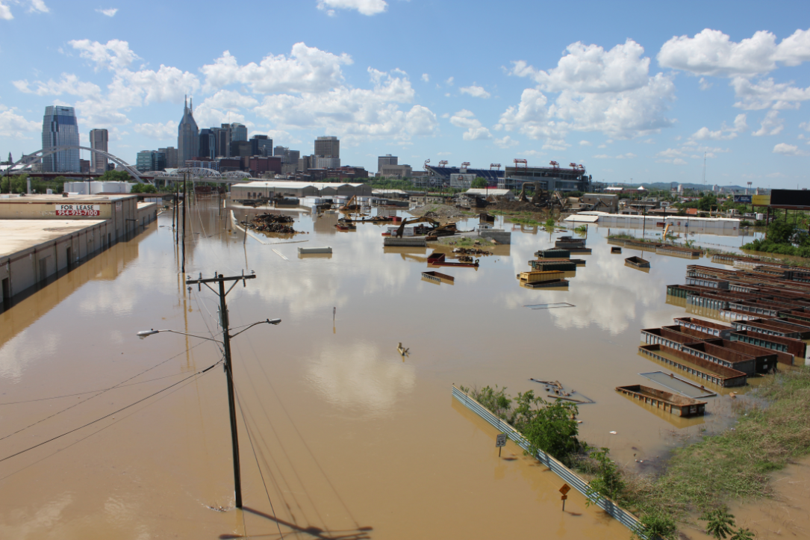
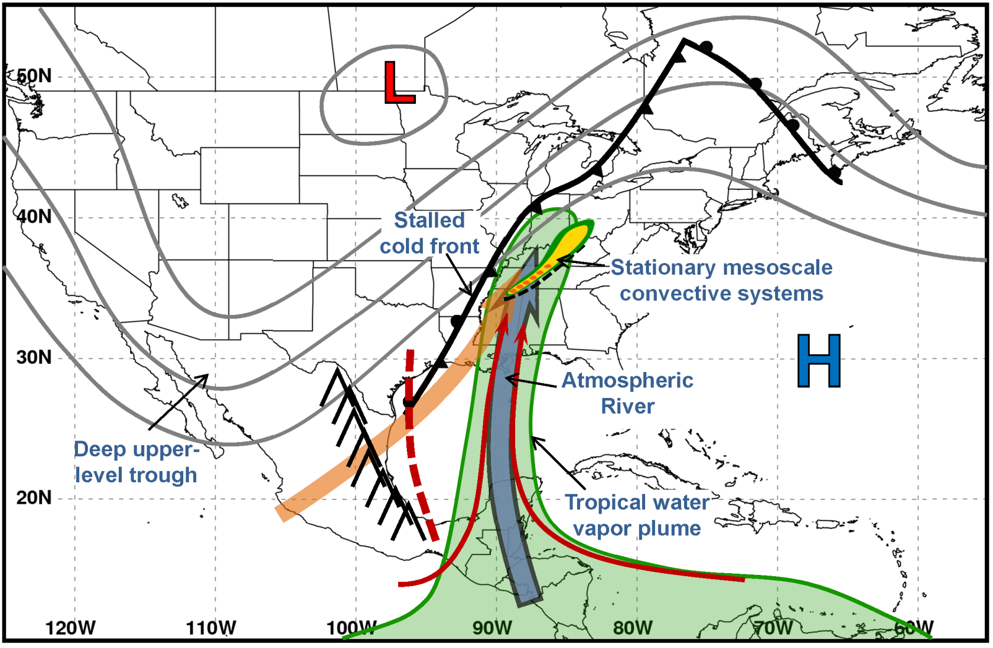
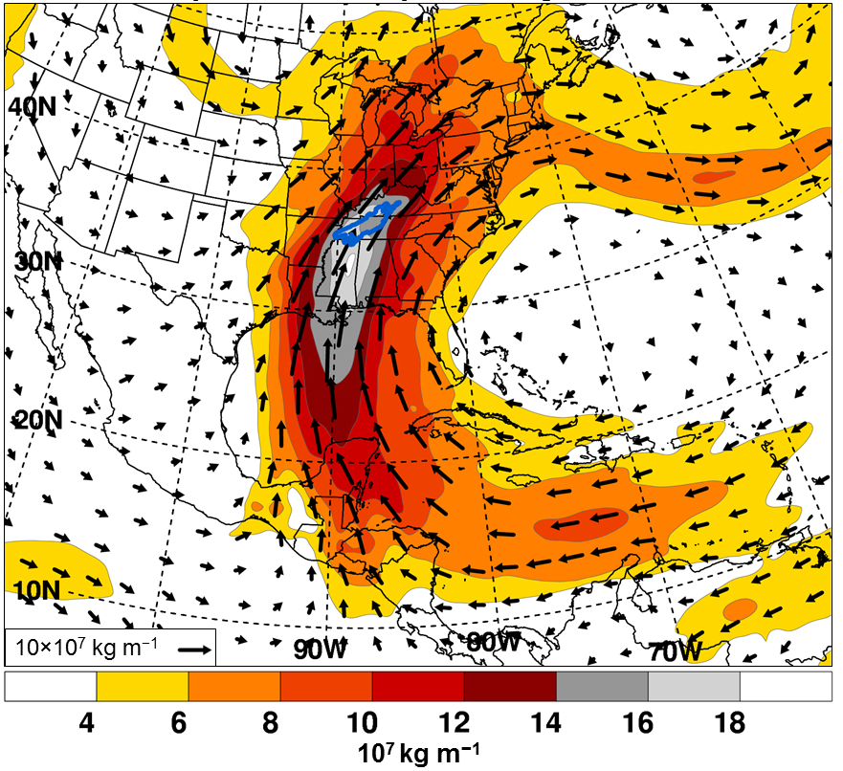
Nashville Flood of 2010 was triggered partly by an AR that stalled and fueled deep convection
Moore, Neiman, Ralph and Barthold, Monthly Weather Review, 2012
0000 UTC 1 May–0000 UTC 3 May 2010
Time-integrated IVT

Slide 20
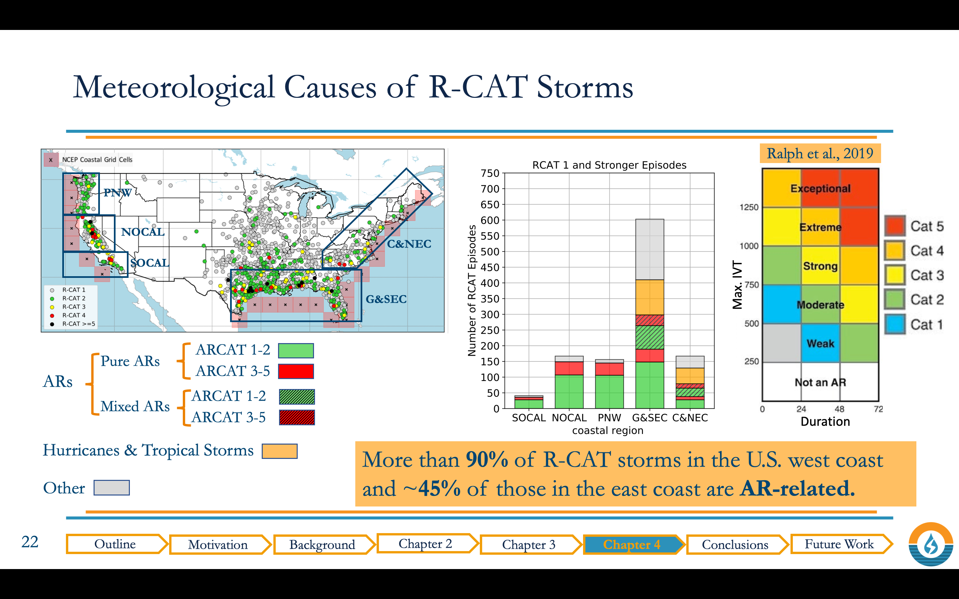
Lamjiri, Ralph, Dettinger, J. Hydrometeor. (2020)
1/4 Other Types of Storms
1/4 Hurricane/Trop Storm
1/4 Mix AR/Hurricane/Trop Storm
1/4 Atmospheric River
Roughly 45% of R-CAT storms in the
US East Coast are AR related

Slide 21
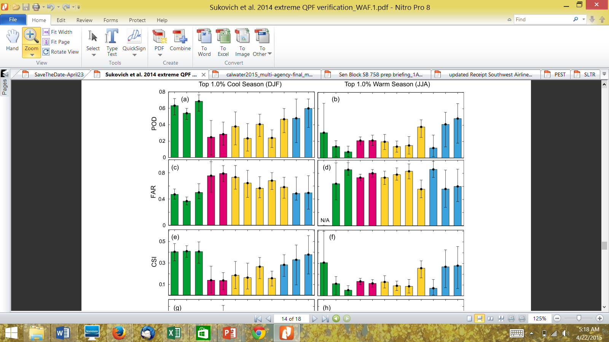
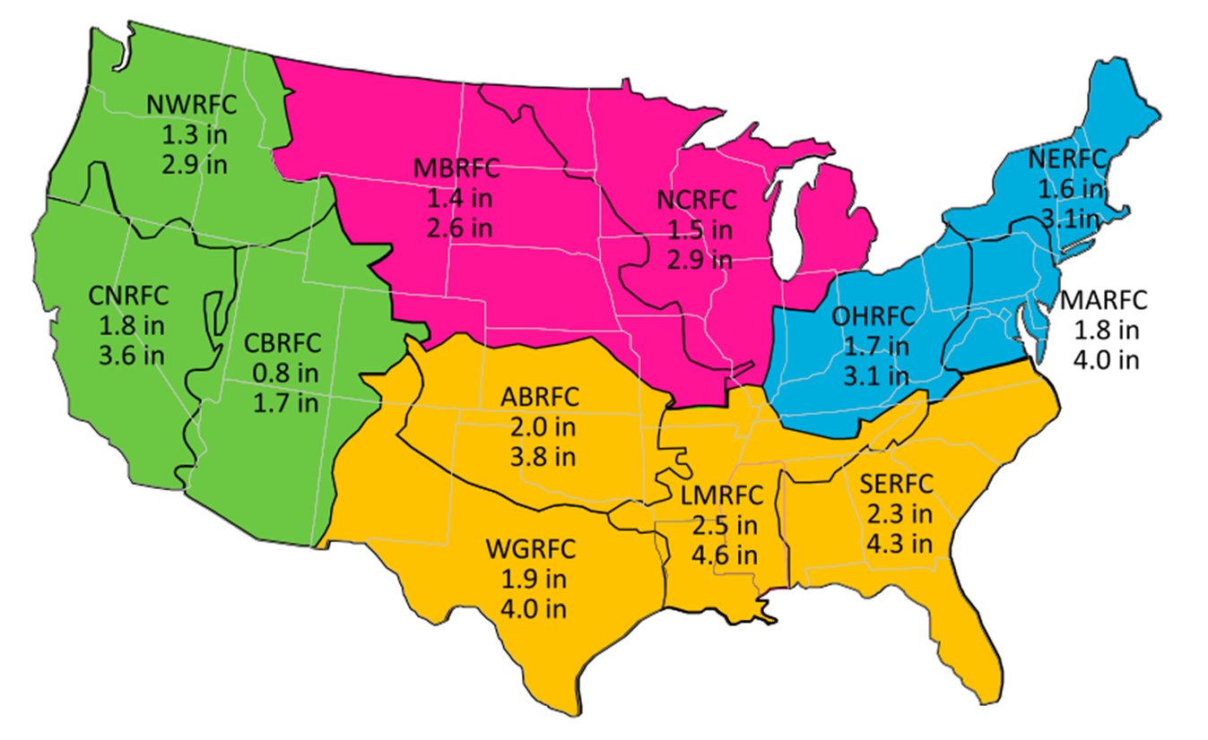
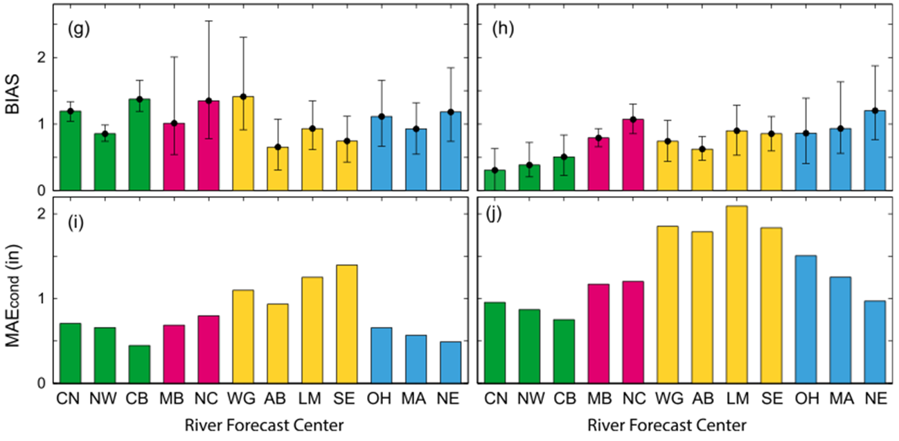
Extreme quantitative precipitation forecast performance
at the Weather Prediction Center from 2001 to 2011
Contact:
Marty Ralph
mralph@ucsd.edu
Sukovich, E. M., F. M. Ralph, F. E. Barthold, D. W. Reynolds and D. R. Novak Wea. Forecast. (2014)
Regional thresholds for
Top 1% and 0.1% heaviest daily precipitation
Used 32 km gridded QPE from NCEP/WPC from 2001-2011
>12,000,000 wet days
Used 32 km gridded QPE and QPF from NCEP/WPC from 2007-2011.
For 1-day lead time.

Slide 22
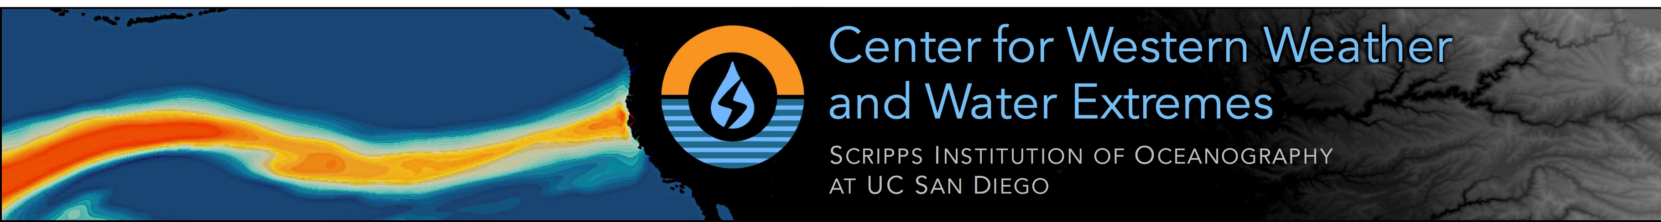
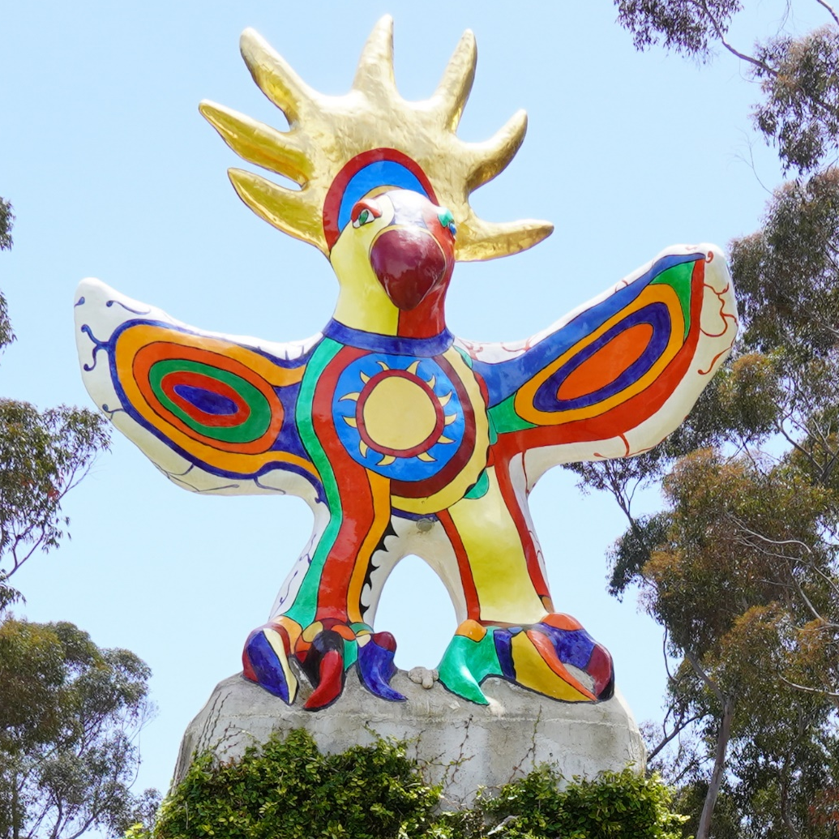

2022 CW3E Annual Meeting
CW3E Director : F. Martin Ralph (mralph@ucsd.edu) cw3e.ucsd.edu

Slide 23
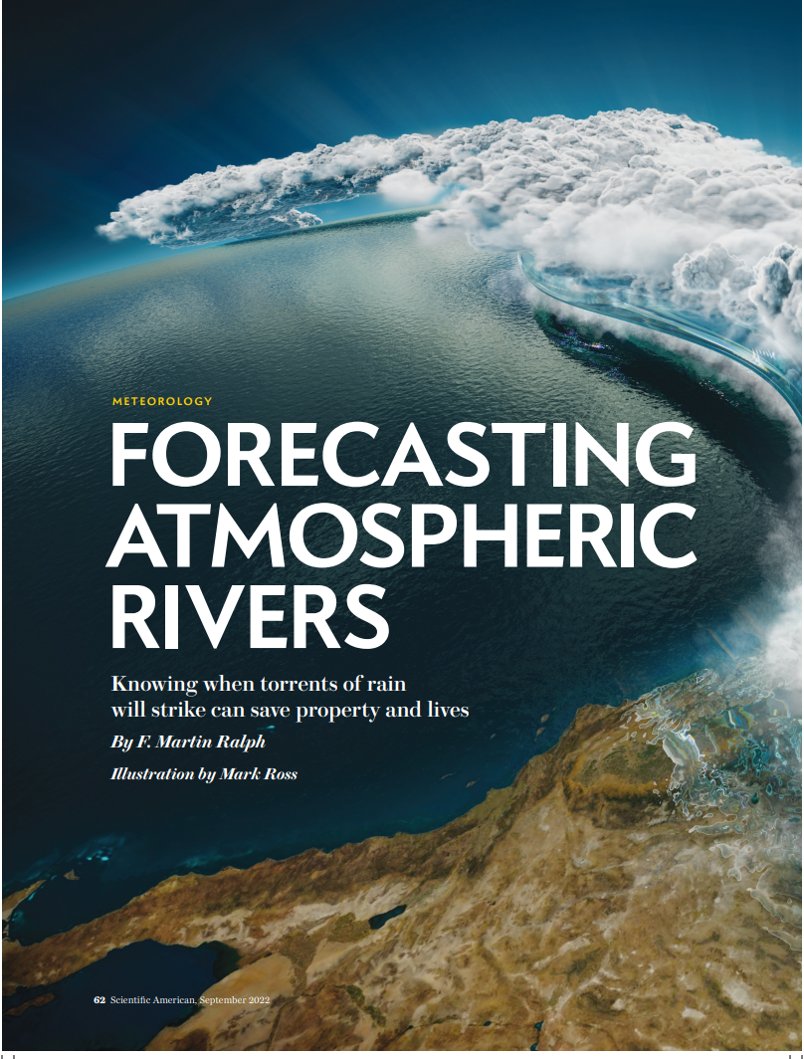
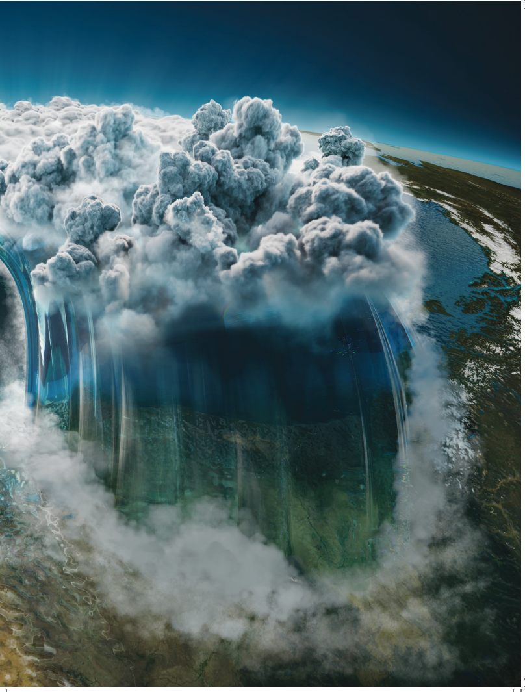
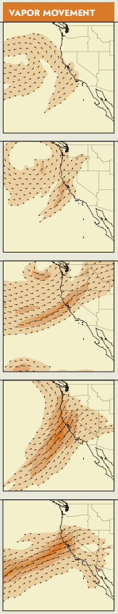
Scientific American, September 2022
F. Martin Ralph
AR1
AR2
AR3
AR Scale(examples)
THANK YOU
Contact: F. Martin Ralph, mralph@ucsd.edu
Center for Western Weather and Water Extremes
Web: cw3e.ucsd.edu
Twitter: @CW3E_Scripps
AR4
AR5

