Slide 1
CalWater 2015 Implementation – Measurements and Payload on the NOAA WP-3D
Ryan Spackman (STC/ESRL) and Allen White (ESRL)

Slide 2
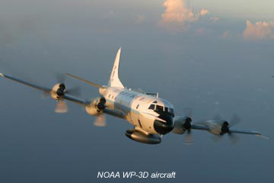
P-3 Operations
Aircraft: NOAA WP-3D N43RF
When: Jan-Feb 2015
Flight hours:
  80 flight, CalWater 2
  90 flight hours, Ocean Winds
Nominal Range: 3000 nmi
Base of Operations:
Pacific NW (Seattle/Vancouver)
NorCA (Travis AFB, McClellan)
Dropsondes: 150 for CalWater 2
Coordinated flights with NOAA G-IV offshore
Coordinated flights with DOE G-1 onshore?

Slide 3
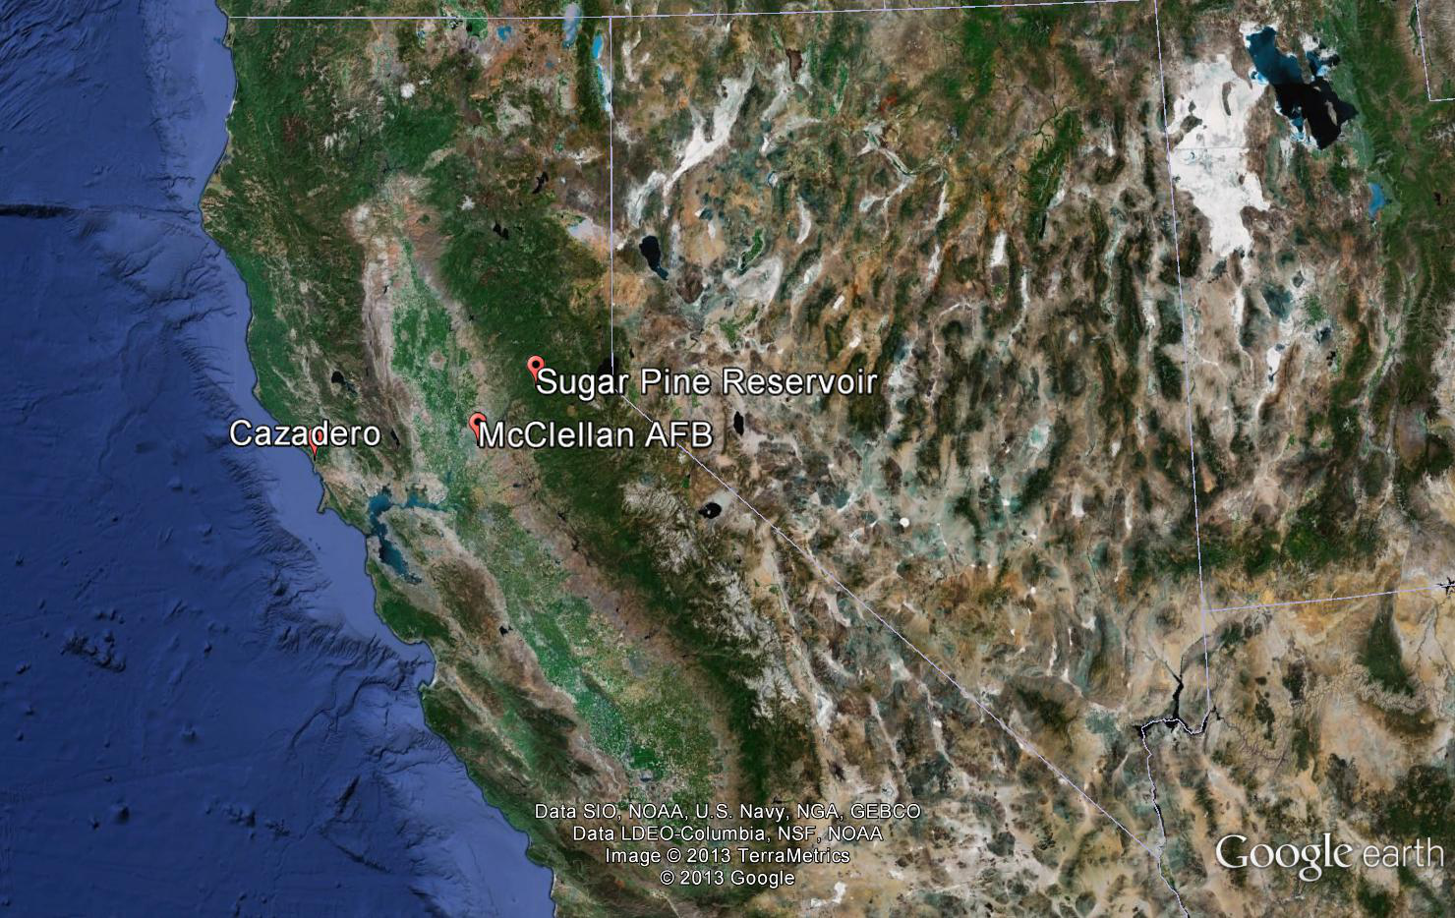
Base of Operations
Central
Valley
Sierra
Nevadas
Coastal
Range
Travis AFB
McClellan
Monterey

Slide 4
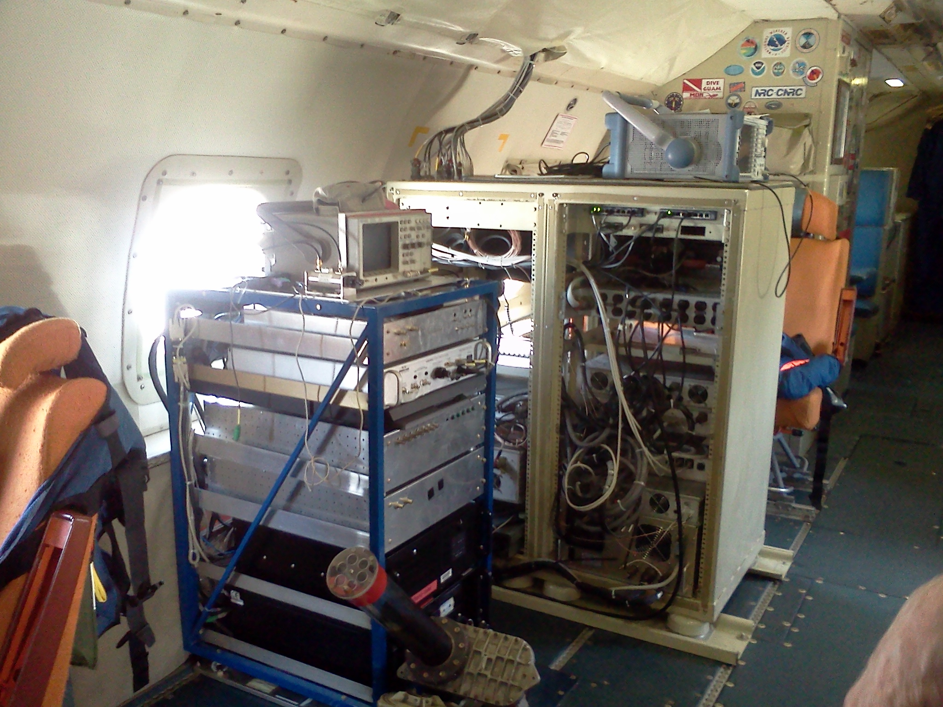
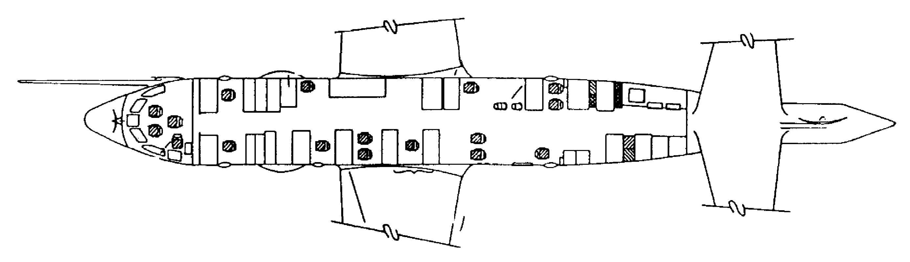
P-3 Measurements and Payload
  Meteorology and Microphysics Payload
  Dropsondes (AOC)
  W-Band Radar (ESRL/PSD, Fairall)
  IWRAP Radar (UMass Amherst)
  Tail Doppler Radar (AOC)
  Cloud Probes (AOC)
  SFMR (AOC)
W-Band and IWRAP Payloads

Slide 5
N43RF layout – CalWater 2015
Station 6
W-Band Radar
Station C3X
AMPS Pod
Station 5 Dropsondes
Station 5 Dropsondes
Station 7
IWRAP
TDL H₂O
Station 8
Aerosol low
turbulence
inlet (LTI)
CCN?
CO Pod
Station 3
Station 4
Station 2
Cloud
Probes
Notes:
Ocean Winds – 3 to 4 scientist
CalWater 2 – requesting 2
CSD – no room for seats
AMPS pod cannot fly for ocean winds

Slide 6
N42RF layout - SENEX 2013
NOAA-CSD version 4 11-09-2012
NO, NO₂, NO_{y}, O₃
iWAS2; NMASS
SO₂
CO₂, CH₄
Acid
CIMS
ACES glyoxal
NH₃; HNO₃
TDL H₂O
PTR-MS
HCHO
Aerosol low
turbulence
inlet (LTI)
CCN
CO
jNO₂, jO₃
NO₃, N₂O₅
WLOPC
SP2; AMS
PANs
CRD-AES; PAS
PSAP; UHSAS
Operator seats:
NO_{y}O₃: C3X
CRDS: Sta. 2
PILS/AMS: Sta. 3
CIMS: Galley
rotating: Galley
cloud
probes
Non CSD collaborators
CCN: Nenes
HCHO: Hanisco/Keutsch
Acid CIMS: Thornton
Notes:
Ocean Winds – 3 to 4 scientist
CalWater 2 – requesting 2
CSD – no room for seats
AMPS pod cannot fly for ocean winds

Slide 7
N42RF layout - SENEX 2013
NOAA-CSD version 4 11-09-2012
NO, NO₂, NO_{y}, O₃
iWAS2; NMASS
SO₂
CO₂, CH₄
Acid
CIMS
ACES glyoxal
NH₃; HNO₃
TDL H₂O
PTR-MS
HCHO
Aerosol low
turbulence
inlet (LTI)
CCN
CO
jNO₂, jO₃
NO₃, N₂O₅
WLOPC
SP2; AMS
PANs
CRD-AES; PAS
PSAP; UHSAS
Operator seats:
NO_{y}O₃: C3X
CRDS: Sta. 2
PILS/AMS: Sta. 3
CIMS: Galley
rotating: Galley
cloud
probes
Non CSD collaborators
CCN: Nenes
HCHO: Hanisco/Keutsch
Acid CIMS: Thornton

Slide 8
Aerosol-Precip Science Objectives
Investigate how aerosols modulate precipitation in ARs and extratropical cyclones:
Identify the types of aerosols (organics, sulfates, BC, etc) that nucleate water vapor or ice
Determine the types of clouds (mixed-phase, warm, ice) in which aerosols nucleate water vapor or ice
Assess to what extent aerosols suppress or enhance precipitation and in what environments (e.g., off-shore or during landfall)
To what extent does the large-scale flow influence the interaction of aerosols and precipitation?

Slide 9
Proposed Aerosol and Tracer Payload for NASA DC-8
Aerosol contextual information (size and composition) below the aircraft (HSRL)
Particle composition (ATOFMS with CVI)
Ice nuclei (IN) number concentration (CFDC or IN counter)
Cloud condensation nuclei (CCN) number concentration (CCN counter)
Fine and coarse-mode total aerosol (UHSAS, WLOPC, or similar)
Single-particle black carbon (SP2)
Aerosol sonde (balloon-borne OPC)
Co-emitted trace gas species: CO, CO₂, CH₄, O₃

Slide 10
N42RF layout - SENEX 2013
NOAA-CSD version 4 11-09-2012
NO, NO₂, NO_{y}, O₃
iWAS2; NMASS
SO₂
CO₂, CH₄
Acid
CIMS
ACES glyoxal
NH₃; HNO₃
TDL H₂O
PTR-MS
HCHO
Aerosol low
turbulence
inlet (LTI)
CCN
CO
jNO₂, jO₃
NO₃, N₂O₅
WLOPC
SP2; AMS
PANs
CRD-AES; PAS
PSAP; UHSAS
Operator seats:
NO_{y}O₃: C3X
CRDS: Sta. 2
PILS/AMS: Sta. 3
CIMS: Galley
rotating: Galley
cloud
probes
Non CSD collaborators
CCN: Nenes
HCHO: Hanisco/Keutsch
Acid CIMS: Thornton

Slide 11
N42RF layout - SENEX 2013
NOAA-CSD version 4 11-09-2012
NO, NO₂, NO_{y}, O₃
iWAS2; NMASS
SO₂
CO₂, CH₄
Acid
CIMS
ACES glyoxal
NH₃; HNO₃
TDL H₂O
PTR-MS
HCHO
Aerosol low
turbulence
inlet (LTI)
CCN
CO
jNO₂, jO₃
NO₃, N₂O₅
WLOPC
SP2; AMS
PANs
CRD-AES; PAS
PSAP; UHSAS
Operator seats:
NO_{y}O₃: C3X
CRDS: Sta. 2
PILS/AMS: Sta. 3
CIMS: Galley
rotating: Galley
cloud
probes
Non CSD collaborators
CCN: Nenes
HCHO: Hanisco/Keutsch
Acid CIMS: Thornton

Slide 12
N42RF layout - SENEX 2013
NOAA-CSD version 4 11-09-2012
NO, NO₂, NO_{y}, O₃
iWAS2; NMASS
SO₂
CO₂, CH₄
Acid
CIMS
ACES glyoxal
NH₃; HNO₃
TDL H₂O
PTR-MS
HCHO
Aerosol low
turbulence
inlet (LTI)
CCN
CO
jNO₂, jO₃
NO₃, N₂O₅
WLOPC
SP2; AMS
PANs
CRD-AES; PAS
PSAP; UHSAS
Operator seats:
NO_{y}O₃: C3X
CRDS: Sta. 2
PILS/AMS: Sta. 3
CIMS: Galley
rotating: Galley
cloud
probes
Non CSD collaborators
CCN: Nenes
HCHO: Hanisco/Keutsch
Acid CIMS: Thornton

Slide 13
CalWater 2 – Ocean Winds
FY15 Implementation Plan
Chris Fairall (ESRL), Paul Chang (NESDIS),
Allen White (ESRL), Ryan Spackman (STC/ESRL), Marty Ralph (Scripps)

Slide 14
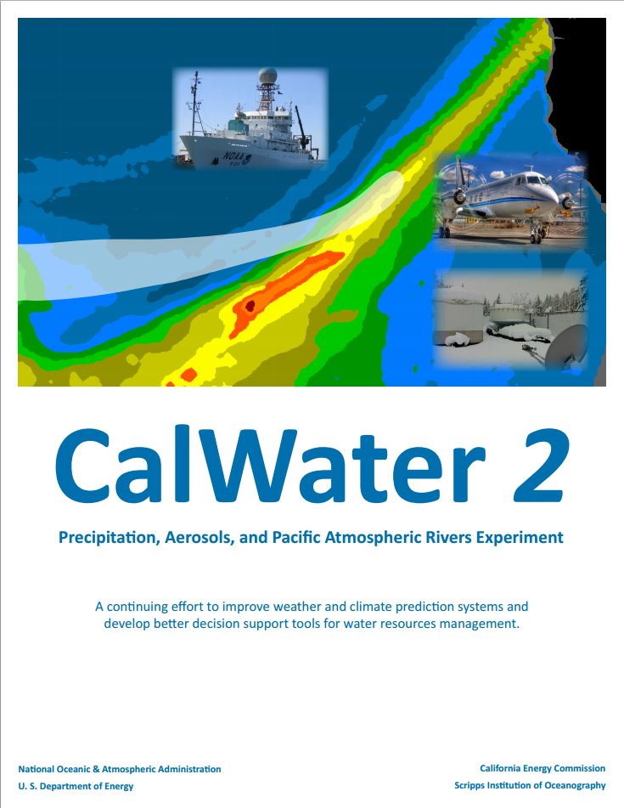
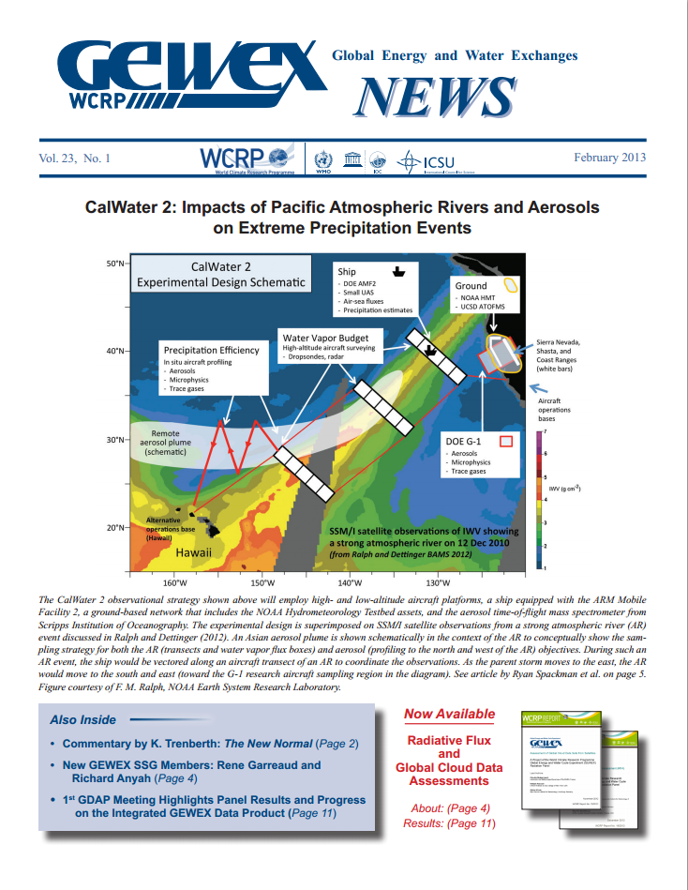
CalWater 2015 – Ocean Winds Implementation Plan
NOAA WP-3D Flights
Purpose: Define the framework for addressing CalWater 2 science objectives and Ocean Winds cal/val goals for the joint field campaign
Strategy:
  Overlapping science enables OAR and NESDIS to leverage and better use limited resources in NOAA
  Ship-based observations including from DOE AMF2 will provide normally unavailable ocean surface data to Ocean Winds program
  CalWater 2 NOAA G-IV dropsonde observations will further support Ocean Winds cal/val objectives
    CalWater 2 is a 5-year broad interagency vision to address key water cycle science gaps along the US West Coast
    CalWater 2 white paper is at http://esrl.noaa.gov/psd/calwater

Slide 15
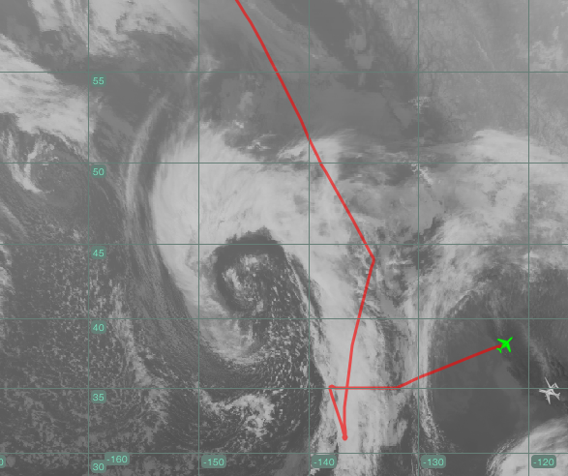
CalWater 2 – Ocean Winds P-3 Implementation Plan
Co-Located Science: Areas of interest are typically within 500 km (~1 h on P-3) of each other
Ocean Winds Goal – Survey high low-level winds over the ocean located:
  In the S/SW quadrant of the extratropical cyclone
  Along the AR
CalWater 2 Goals:
  Observe the development and evolution of ARs
  Observe sea spray
  Observe aerosol-cloud-precipitation interactions in and upstream of ARs
Atmospheric River (AR) and 976 hPa Low
Flight Track from NOAA G-IV Flight
Anchorage to Travis AFB, 24 Feb 2014
Ocean Winds and CalWater 2 Science
Vancouver
L
1 hr
Travis
AFB
Ocean Winds and Sea Spray
Atmospheric Rivers and Ocean Winds
Aerosols
500 km

Slide 16
CalWater 2 – Ocean Winds P-3 Implementation Plan
Atmospheric River (AR) and 976 hPa Low
Flight Track from NOAA G-IV Flight
Anchorage to Travis AFB, 24 Feb 2014
170 Total Flight Hours
  90 h (dedicated NESDIS-Ocean Winds)
  80 h (dedicated OAR-CalWater 2)
Joint PIs
  Ocean Winds: P. Chang
  CalWater 2: A. White (with designated Platform Scientist R. Spackman on the P-3)
Proposed Deployment Sites
  Primary – Vancouver/Seattle
  Secondary – Travis AFB (or McClellan) in CA
Dropsondes
  75 (NESDIS-Ocean Winds)
  150 (OAR-CalWater 2)
Ocean Winds and CalWater 2 Science
Vancouver
L
1 hr
Travis
AFB
Ocean Winds and Sea Spray
Atmospheric Rivers and Ocean Winds
Aerosols
500 km

