Slide 1
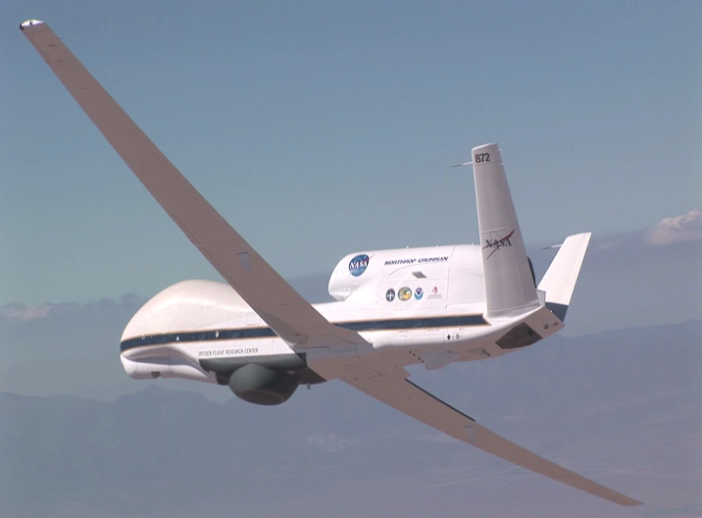
The NOAA Unmanned Aircraft Systems (UAS) Program: Status and Activities
Sensing Hazards with Operational Unmanned Technology (SHOUT) to Mitigate the Risk of Satellite Observing Gaps
Gary Wick
Robbie Hood, Program Director
Robbie E. Hood (NOAA), Michael Black (NOAA), Gary Wick (NOAA), Philip Kenul (TriVector Services), JC Coffey (Cherokee Nation) and Philip Hall (NOAA)

Slide 2
SHOUT Objectives
Overall Goal
Objective 1
Objective 2
Demonstrate and test prototype UAS concept of operations that could be used to mitigate the risk of diminished high impact weather forecasts and warnings in the case of polar-orbiting satellite observing gaps
Conduct data impact studies
Observing System Experiments (OSE) using data from UAS field missions
Observing System Simulation Experiments (OSSE) using simulated UAS data
Evaluate cost and operational benefit through detailed analysis of life-cycle operational costs and constraints

Slide 3
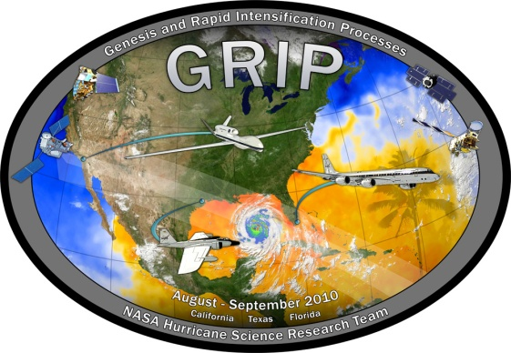
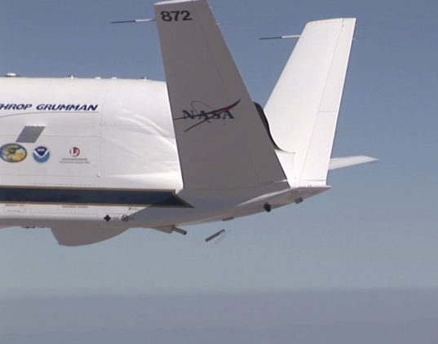
Progression of Global Hawk Successes
NASA / NOAA Global Hawk Pacific (2010)
First Global Hawk science mission
Long duration and range; latitudes from 12 to 85 deg N
NASA Genesis and Rapid Intensification Processes (2010)
Safe overflights of tropical cyclones for extended durations
Real-time data delivery
Ability to change flight plans during flight
Coordination of the Global Hawk with other aircraft
NOAA Winter Storm Pacific and Atmospheric Rivers (2011)
First operational dropsonde deployment, 177 sondes total
First dropsonde in the Arctic since 1950s
Real time changes of drop locations
NASA Hurricane and Severe Storm Sentinel (2011 – 2014)
Remote deployment of the Global Hawk
Use of 2 Global Hawks
Introduction of new instruments
Dropsonde data processed and delivered in real-time to NWS and NHC
G-IV dropsonde intercomparison
Increased flight planning/modification flexibility

Slide 4
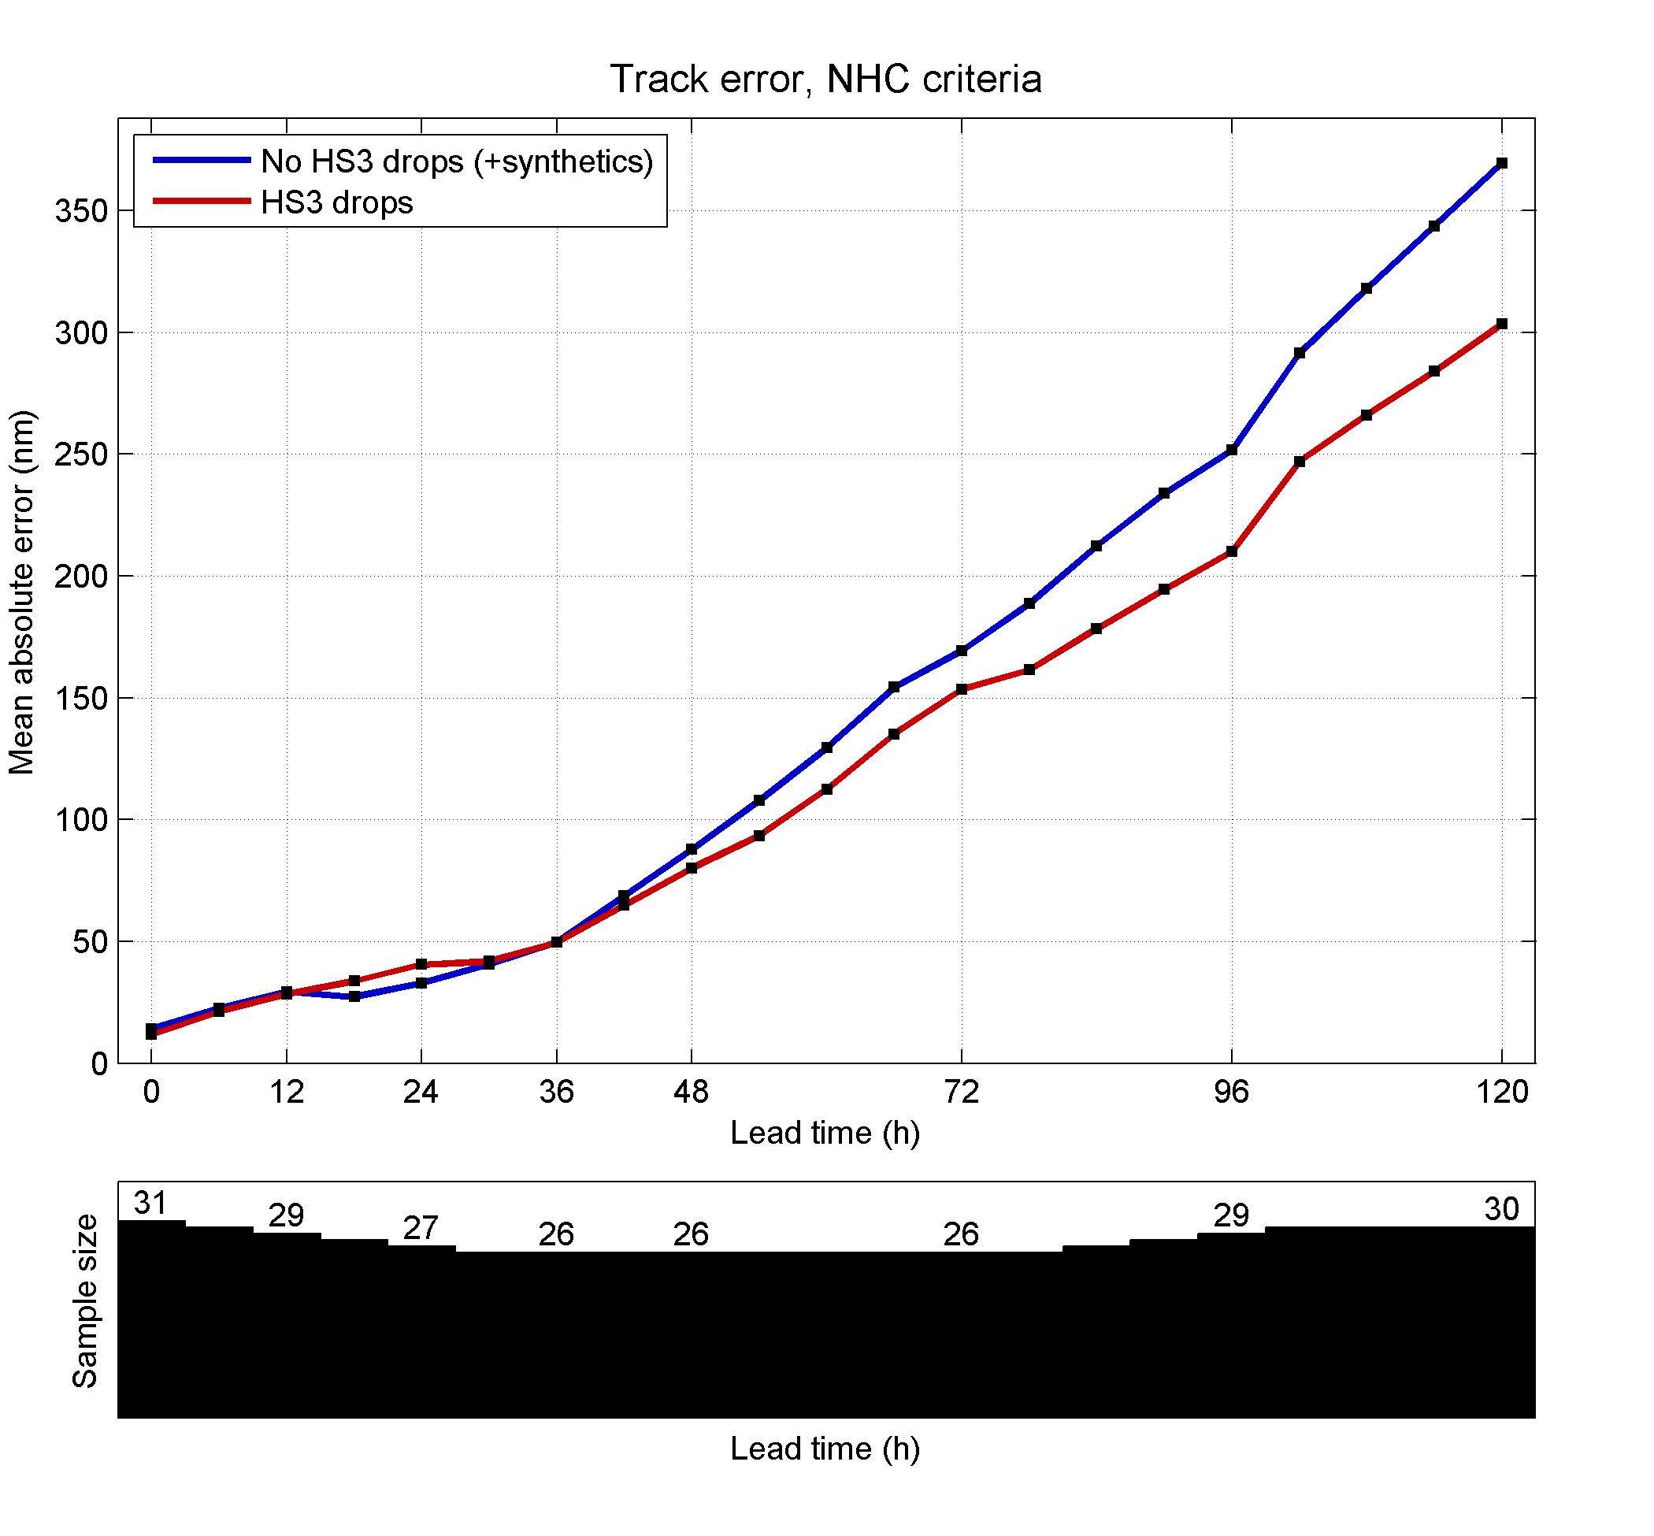
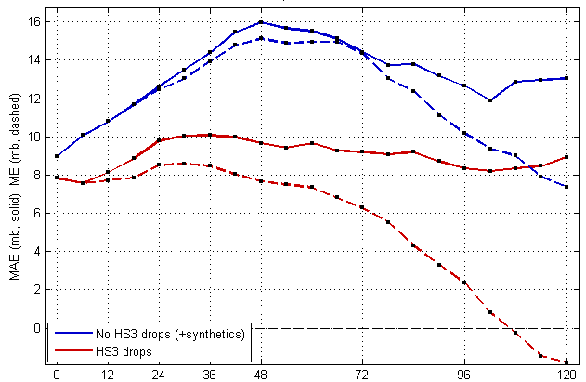
Impact of HS3 Dropsondes for Navy COAMPS-TC Hurricane Nadine Predictions
Track Error (nm)
Intensity: Max. Wind Error (kts)
No drops
No drops
HS3 drops
HS3 drops
Bias (dash)
Intensity: Min. SLP Error (hPa)
No drops
Dropsonde impact experiments performed for 19-28 Sep. (3 flights)
Red: with HS3 drops
Blue: No drops with synthetics
COAMPS-TC Intensity and Track skill are improved greatly through assimilation of HS3 Drops.
HS3 drops
Bias (dash)
Slide courtesy of James Doyle / NRL

Slide 5
General Plan
FY14
FY15
FY16
OSE with previous HS3 data underway
Continued OSE and OSSE studies
10 – 16 NOAA-dedicated Global Hawk missions
NOAA aviation personnel supporting NASA and NOAA Global Hawk missions
OSSE with simulated data starting soon for Atlantic / Gulf of Mexico tropical cyclones and Pacific / Arctic weather systems
5 extra missions added to HS3
NOAA aviation personnel supporting NASA and NOAA Global Hawk missions
NOAA-dedicated Global Hawk missions and possible partnership with NASA Earth Venture experiment
Finalize data impact studies and analysis of cost and operational benefits
NOAA aviation personnel supporting NASA and NOAA Global Hawk missions

Slide 6
HS3 2014
5th week in place on NASA schedule
August 26 to September 29, NASA Wallops
NOAA adding:
Up to 5 flights
240 dropsondes
Mission science guidance
Targeting input
Real-time data transmission/assimilation planned

Slide 7
NOAA SHOUT Dedicated Missions
September – November, NASA Armstrong
Tropical cyclones and high impact weather targets
Single deployment location adds targeting flexibility
Early period: Tropical cyclones
Forecast improvements for track and intensity
Option for both Atlantic and Pacific Basins
Atlantic tradeoff of deployment costs vs station time
Later period: High-impact storms affecting the continental US and Alaska
Coastal flooding
Atmospheric rivers
Forecast improvement for threats such as extreme precipitation and damaging winds
Targeted lead times of 3-7 days

Slide 8
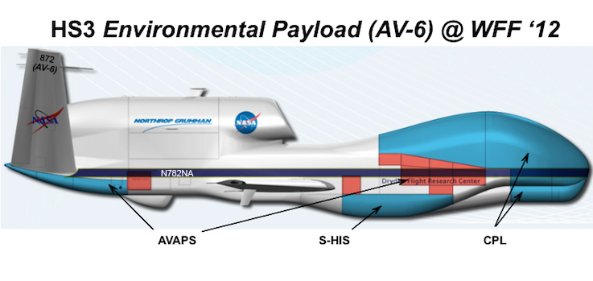
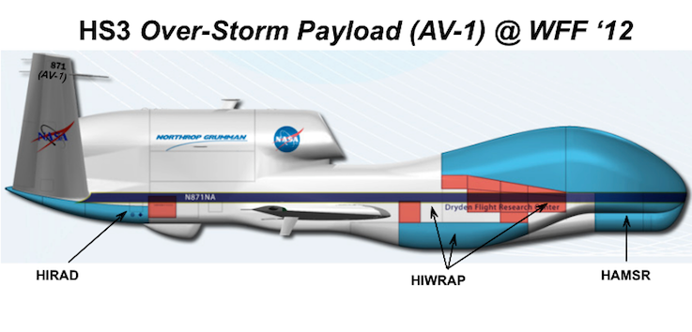
Potential Payloads from HS3
Environment Observations
Profiles of temperature, humidity, wind, and pressure (AVAPS)
Cloud top height (CPL)
Cloud top temperature and profiles of temperature and humidity (S-HIS)
Over-storm Observations
Doppler velocity, horizontal winds, and ocean surface winds (HIWRAP)
Profiles of temperature and humidity and total precipitable water (HAMSR)
Ocean surface winds and rain (HIRAD)

Slide 9
SHOUT Targeting Strategies
Flight plans to optimize forecast impact
Tropical cyclones
SUNY group proposed to explore
Interactions with AOML/ESRL
High-impact weather events
Toth (ESRL) proposed to explore methodologies
Identification of threat cases
Fully automated Ensemble Transform sensitivity algorithm to identify sensitive areas
Produce “optimized” flight track to sample sensitive region for selected threat

Slide 10
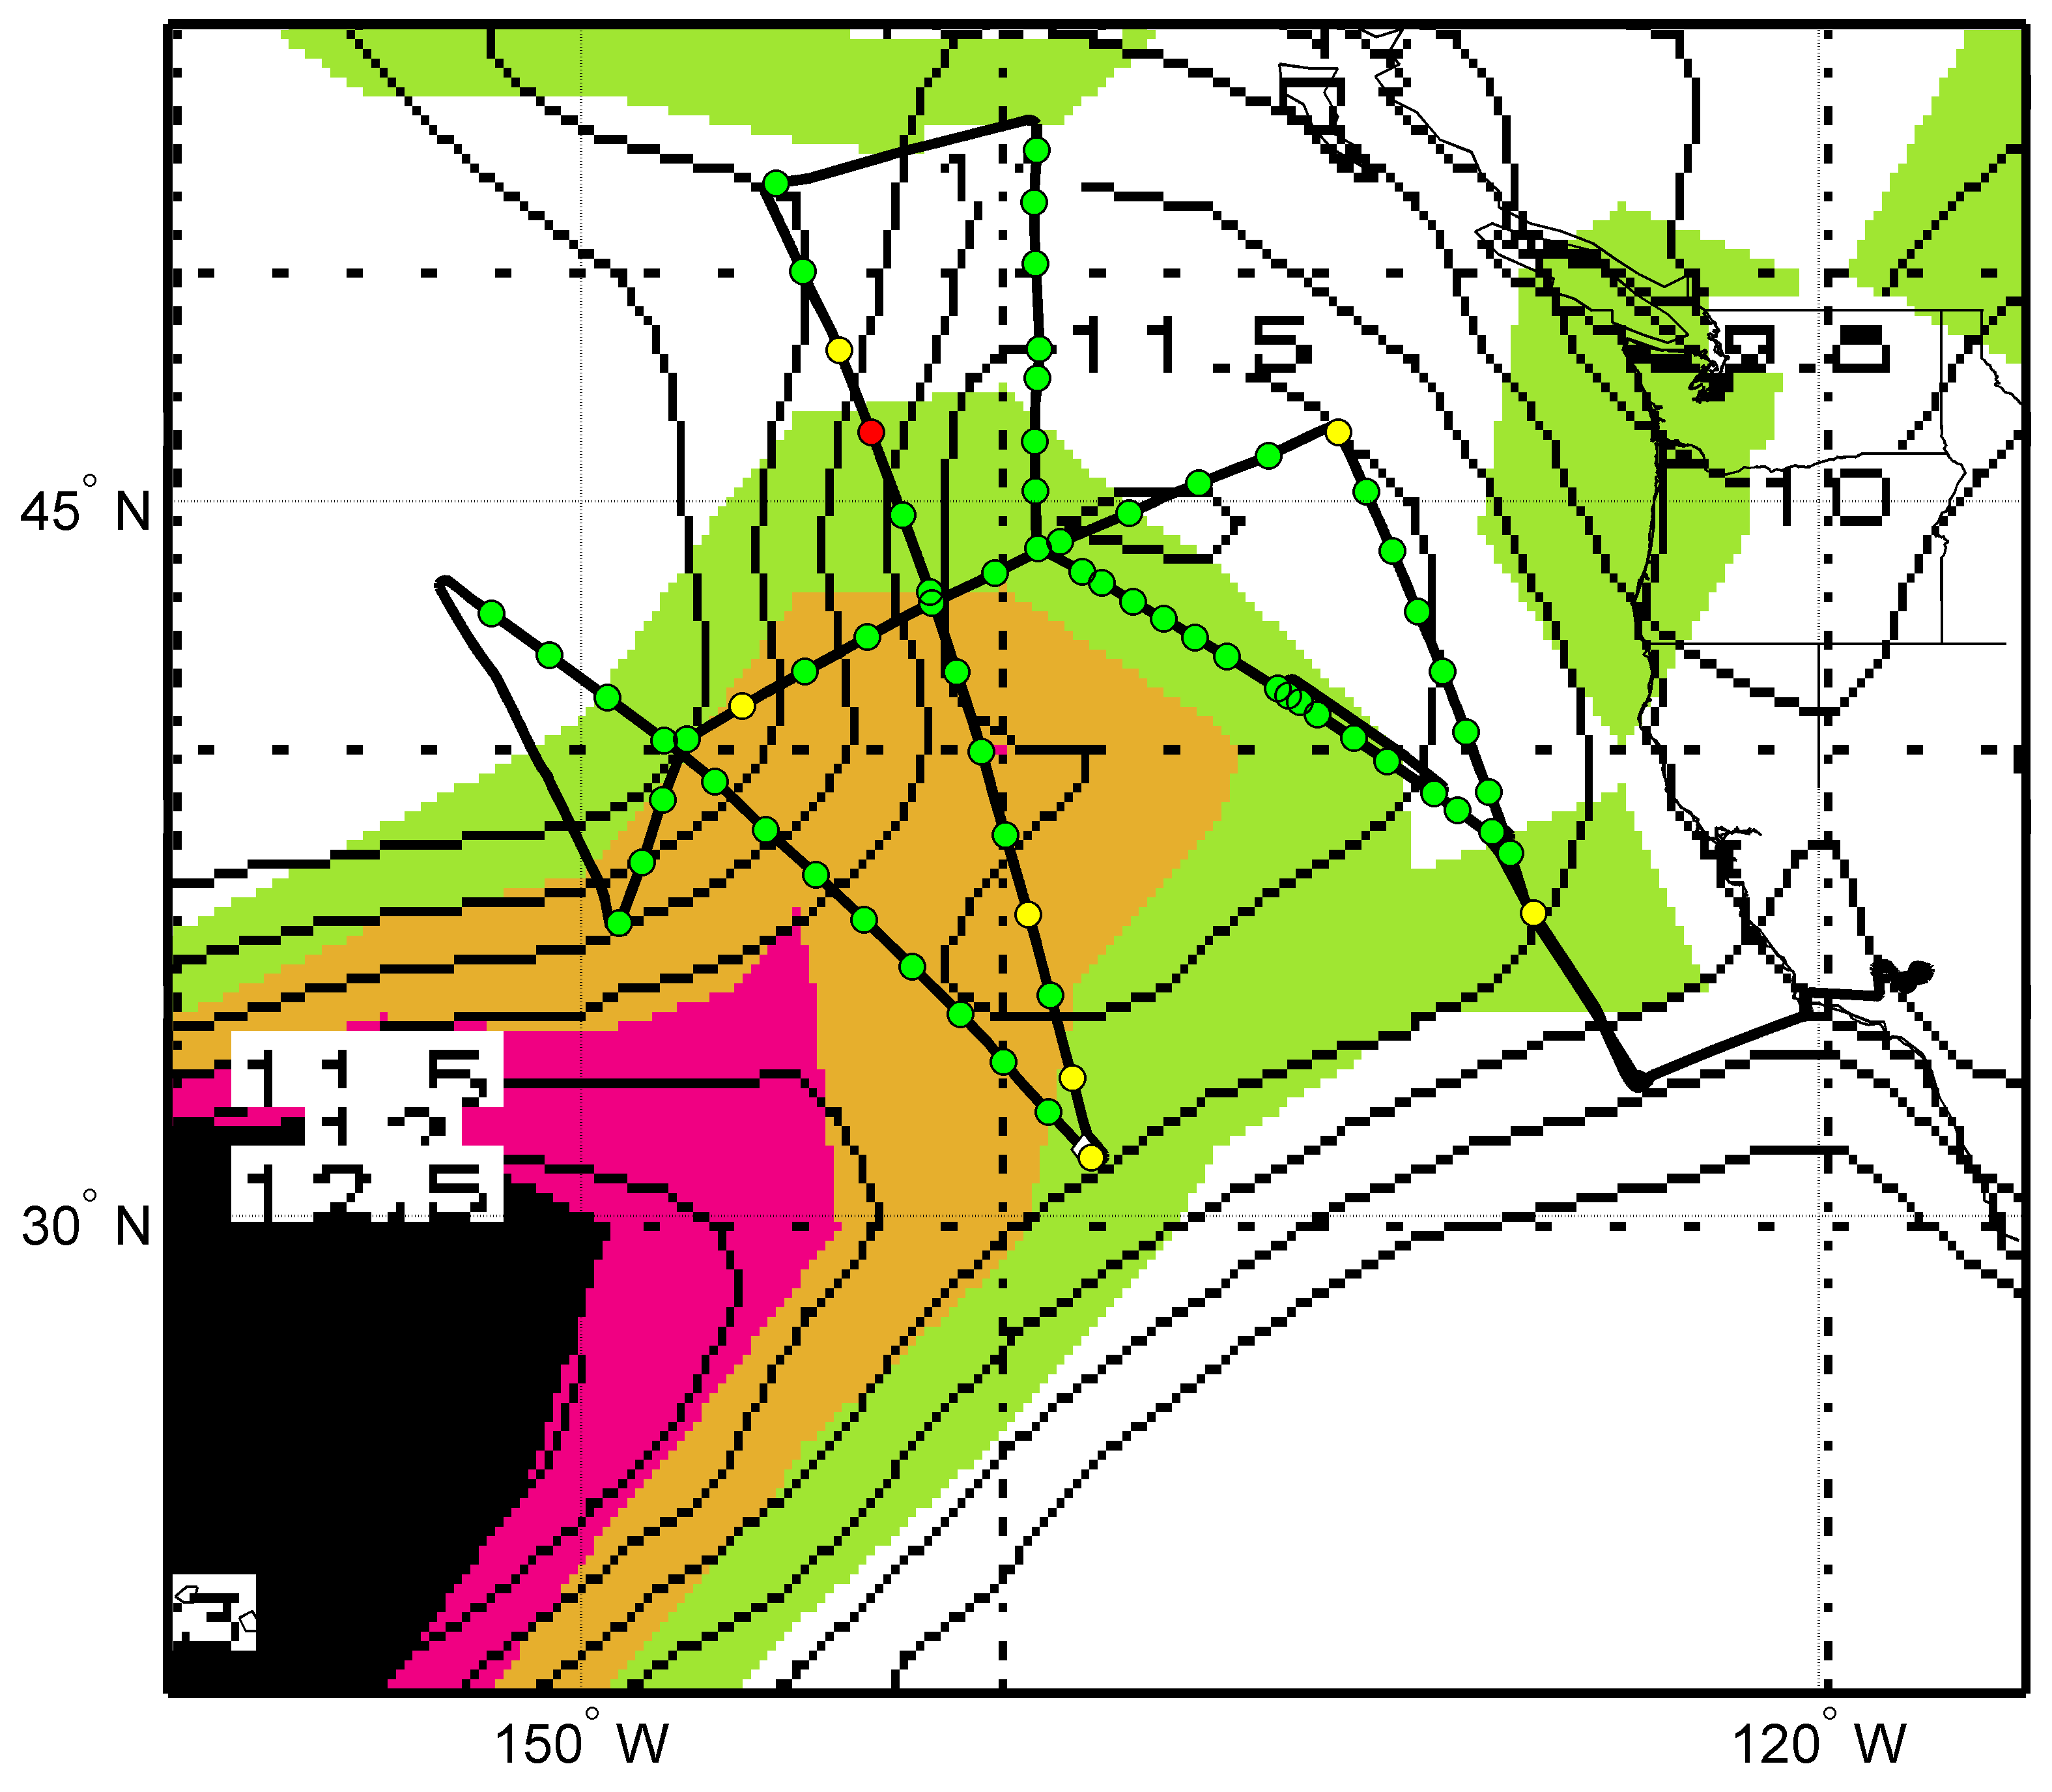
WISPAR Winter Storms Flight
Sensitivity Forecast
Valid 00Z Mar 4 (colors)
Valid 12Z Mar 4 (contours)

Slide 11
Next Steps
SHOUT Working Group to meet May 7-8
Representation from OAR, NWS, NESDIS, and OMAO
Need to resolve:
Timing and duration of field campaigns
Use of one or two aircraft for deployment
Optimal use and choice of instrumentation
Metrics to quantify impact of SHOUT missions
Priority of real-time transmission from various instruments

Slide 12
Desired Input
Guidance on obtaining forecast impact
Target regions
Timing of observations
Recommendations on instrumentation
Flight planning considerations

Slide 13
SHOUT Contact Information
Robbie Hood / robbie.hood@noaa.gov
Michael Black / michael.black@noaa.gov
Gary Wick / gary.a.wick@noaa.gov
Philip Kenul / philip.m.kenul@noaa.gov
JC Coffey / john.j.coffey@noaa.gov
Philip Hall / philip.g.hall@noaa.gov

Slide 14
Assimilation of GH dropsondes in HWRF
EXP | Description
HWRF | Operational HWRF 2013
DSA1 | HWRF based on operational HWRF 2013 Raised model top (from 50 hPa to 2 hPa) Increased vertical levels ( from 43 to 61) GSI based on EMC trunk (October 2013) 3-hourly FGAT Variational quality control (VQC) for conventional data Include more conventional data types and longer data window Assimilate conventional data only in both parent and inner domains
DSA2 | Based on DSA1 Assimilate GH dropsondes in inner domain
DSB2 | Based on DSA1 Assimilate GH dropsondes with reduced obs error in inner domain
HWRF Domains
Observation errors:
Temperature, moisture, and wind errors are assigned as a function of vertical pressure
Potential issues with GH dropsondes assimilation:
When available, data has good temporal and spatial coverage in the inner domain; however data is not available for every cycle
Dropsondes drift problem; the GPS measured geo-locations at each pressure level are not included in PREPBUFR
Slide courtesy of Vijay Tallapragada / NCEP

Slide 15
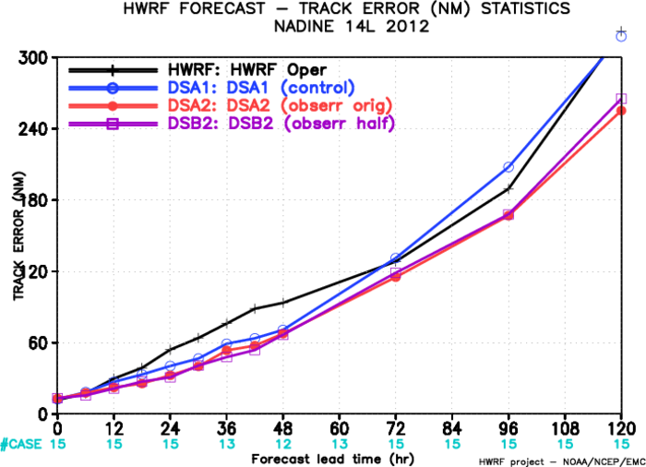
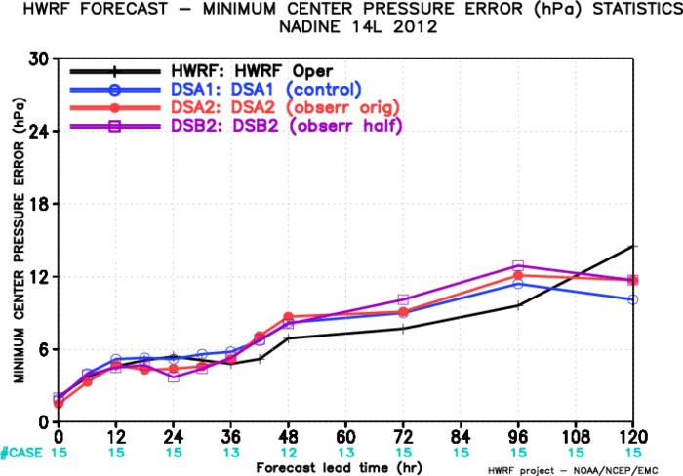
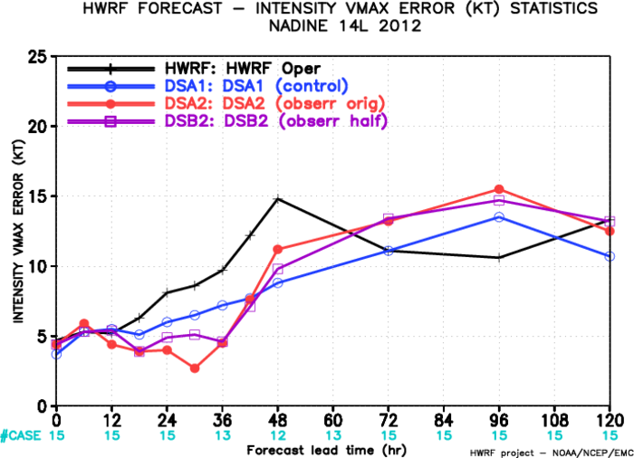
Hurricane Nadine 14L 2012
Verification for HWRF forecast from cycles with Global Hawk Dropsondes for H. Nadine (2012):
Significant improvement in track forecasts compared to control
Intensity (Vmax) errors improved in the first 36 hrs, degraded afterwards.
No impact on MSLP forecasts
Slide courtesy of Vijay Tallapragada / NCEP

Slide 16
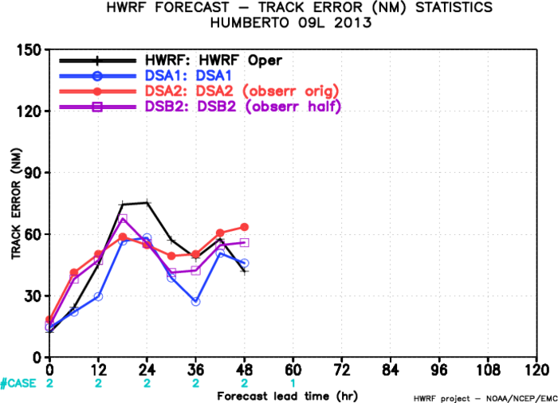
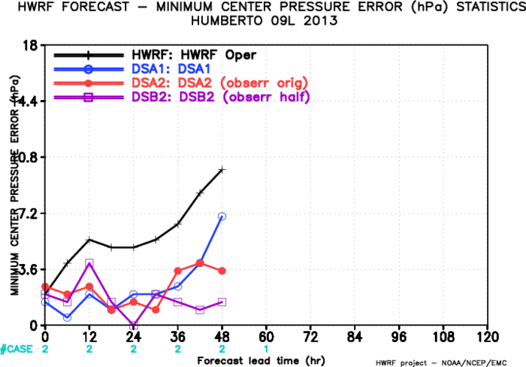
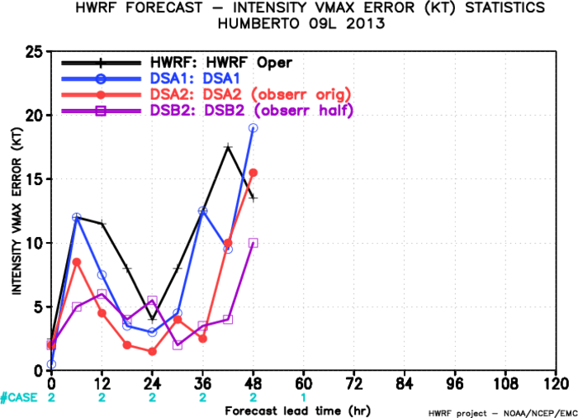
Humberto 09L 2013
Verification for HWRF forecast for two cycles of TS Humberto (2013) with direct assimilation of Global Hawk Dropsondes:
Neutral impact on track forecasts
Significant impact on intensity (Vmax) forecasts
Significant positive impact on MSLP forecasts
Slide courtesy of Vijay Tallapragada / NCEP

