Slide 1
Satellite Cloud Properties for CalWater 2
P. Minnis
NASA LaRC

Slide 2
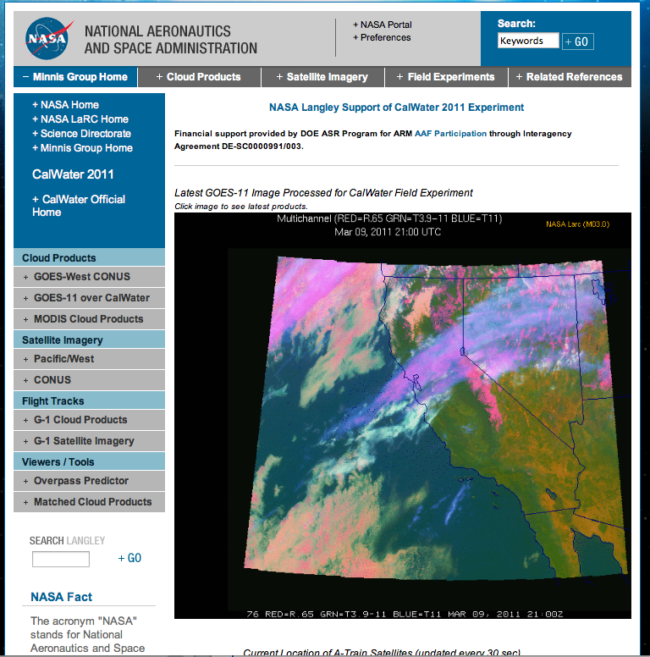
LaRC plans to provide a web page similar to the CALWATER 2011 page shown here
• near-real time GOES imagery & retrieved products (15 – 30 min)
• lagged imagery & products from Aqua & Terra MODIS, SNPP VIIRS, & AVHRR
• flight track overlays & matching for all planes
• other?
http://cloudsgate2.larc.nasa.gov/cgi-bin/site/showdoc?docid=4&cmd=field-experiment-homepage&exp=calwater

Slide 3
Standard Cloud Parameters
Cloud Mask, Phase
Optical Depth, IR emissivity
Effective Radius/Diameter
Liquid/Ice Water Path
Cloud Effective Temperature
Cloud Top/ Bottom Pressure
Cloud Effective Pressure
Cloud Effective Height
Cloud Top/Base Height
Clear-sky, Surface Skin Temperature
Overshooting Tops
Aircraft Icing Potential

Slide 4
Additional Cloud Parameters
New Size Retrievals*
Water droplet eff radius (1.24 μm)
Ice effective radius (1.24 μm)
Water droplet eff radius (2.1 μm)
Ice effective radius (2.1 μm)
CO2 Slicing
Cloud Top Pressure
Cloud Top Temperature
Cloud Top Height
IR Emissivity
Multilayer Cloud Retrieval | ( Ice Over Water )
Upper Layer (Ice Clouds) | Lower Layer (Water Clouds)
Cloud Top Pressure | Cloud Top Pressure
Cloud Top Temperature | Cloud Top Temperature
Cloud Top Height | Cloud Top Height
Cloud Visible Optical Depth | Cloud Visible Optical Depth
Ice Effective Radius (3.7 μm) | Water Droplet Radius (3.7 μm)
*Ice Effective Radius (2.1 μm) | *Water Droplet Radius (2.1 μm)
Multilayer Identification
Lower layer
cloud top
*Only for MODIS and SNPP VIRS

